Slide 1
Good Programming Practice
Dr Robin Wilson

Slide 2
“Any fool can write code that a computer can understand. Good programmers write code that humans can understand.”
Martin Fowler, "Refactoring: Improving the Design of Existing Code"
“Programs should be written for people to read, and only incidentally for machines to execute.”
Abelson & Sussman, “Structure and Interpretation of Computer Programs"
“Always code as if the person who ends up maintaining your code is a violent psychopath who knows where you live.”
Anon

Slide 3
BEWARE:
There are no right answers…
…rules are there to be broken!
(sometimes, when necessary, with careful thought)

Slide 4
Comments
# Add one to items
items = items + 1
# Keep track of number of items
# ready for calculating average later
items = items + 1

Slide 5
Comments
# If lat is positive
if lat > 0:
A = 150.0
B = 1.28
C = 40.0
else:
A = 100.0
B = 1.5
C = 30.0

Slide 6
Comments
# Set parameters which are based on hemisphere
if lat > 0:
# Northern hemisphere
A = 150.0
B = 1.28
C = 40.0
else:
# Southern hemisphere
A = 100.0
B = 1.5
C = 30.0

Slide 7
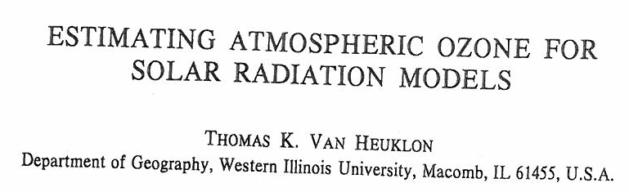

Variable naming

Slide 8
Variable naming
a,b,c,d,e,f,g,h,i,j,k…
averagevalue
maximum_duration_of_the_dropout
cnt_uniq_locs
number
value
result
temp
ROPE

Slide 9
Documentation
def get_ozone_conc(lat, lon, timestamp):
"""Returns the ozone contents in matm-cm for the given latitude/longitude
and timestamp (provided as either a datetime object or a string in any
sensible format - I strongly recommend using an ISO 8601 format of
yyyy-mm-dd) according to van Heuklon's Ozone model.
The model is described in Van Heuklon, T. K. (1979).
Estimating atmospheric ozone for solar radiation models. Solar Energy,
22(1), 63-68.
Variable names in the function are the same as those in equation 4 of the
paper above.
"""
Use docstrings – Python is one of the few languages to provide them!
Available when programming:
help(function)
function.__doc__
function? (in IPython)
Demo

Slide 10
Functions
What’s the point?

Slide 11
Functions
Make your code DRY not WET!
DRY Don’t Repeat Yourself
WET We Enjoy Typing
def pythag_distance(x1, y1, x2, y2):
return sqrt((x2 - x1)**2 + (y2 - y1)**2)

Slide 12
Functions
Hide complexity (‘encapsulation’)
Split code sensibly
Make code re-usable across projects
Easier to test

Slide 13
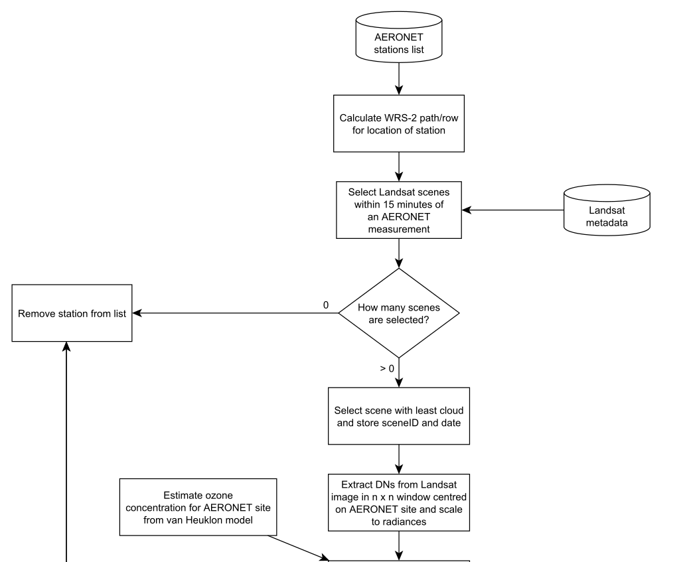

Slide 15
Levels of decomposition

Slide 16
Functions
Create functions that are:
Self-contained (pass/return)
Documented
Generic/Re-usable
No side effects
(Or not…)

Slide 17
Functions – how long?
1 line?
def pythag_distance(x1, y1, x2, y2):
return sqrt((x2 - x1)**2 + (y2 - y1)**2)
1 screen maximum?
1 page maximum?
No fixed rules: be sensible

Slide 18
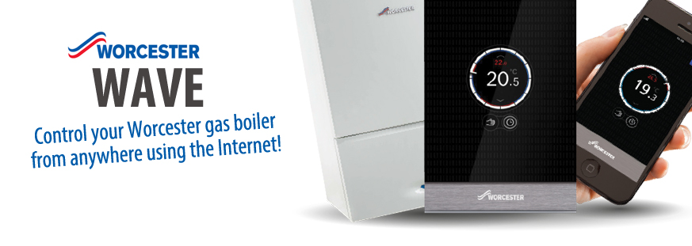
Central Heating control
New software specification:
Runs as a thermostat, keeping the house at a specific temperature
Allow manual control of the heating (on/off)
Allow delayed control (‘turn off in one hour’)

Slide 19
General style
Keep lines short
Split up complex formulae, tests, statements etc

Slide 20
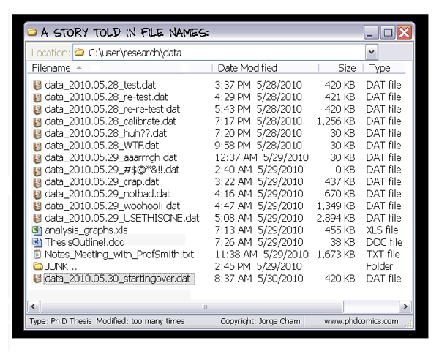
Source control
Demo

Slide 21
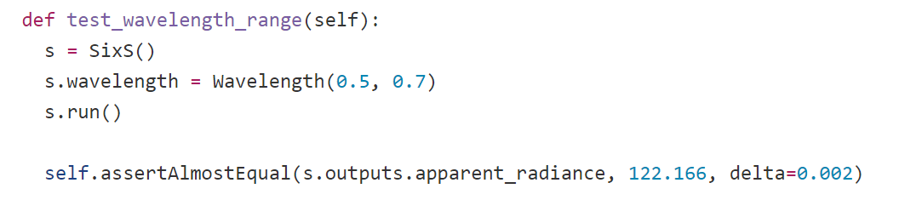
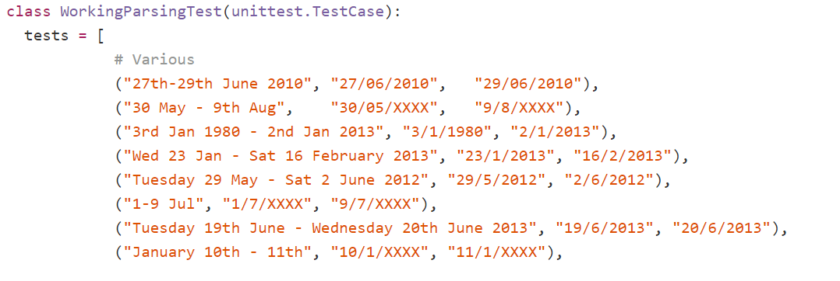
Automated testing

Slide 22
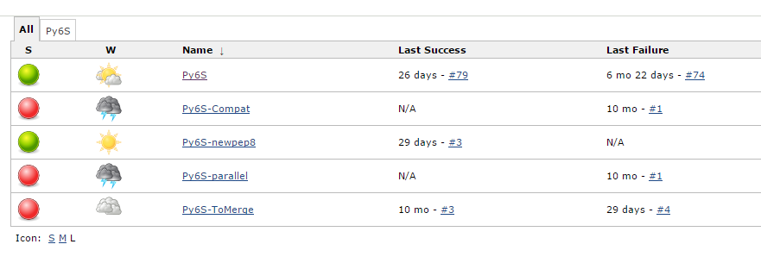
Automated testing
Demo

Slide 23
Summary
No fixed rules!
Comments: why not what
Names: Meaningful, not too long, not too short
Documentation: Use built-in systems & automation to help – any is better than none
Functions:
  DRY!
  Pass and return values – make them self-contained
  Make them generic, when appropriate
  Think about your level of decomposition – use flowcharts!
  Keep to a sensible length – something you can comprehend
General style: Make it easy to read and work with
Advanced techniques: Source control & automated testing can make life a lot easier…

