Slide 1
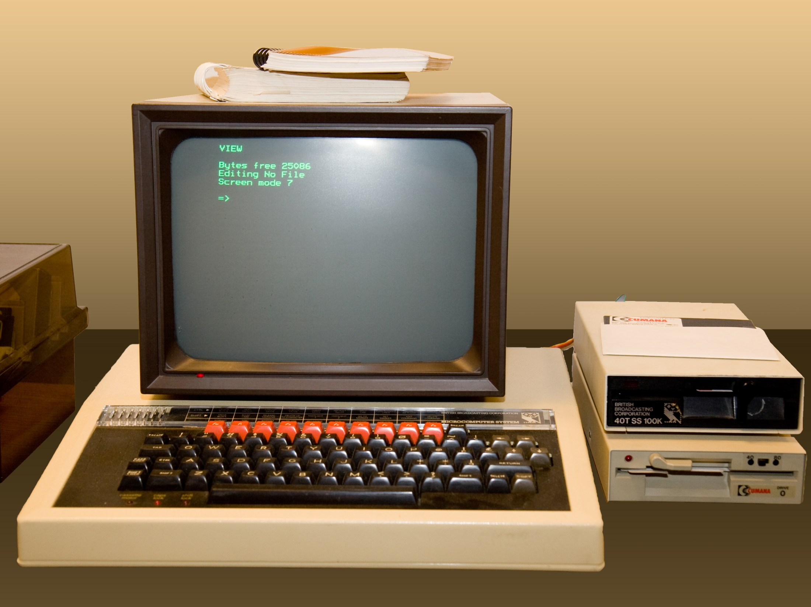

Slide 2
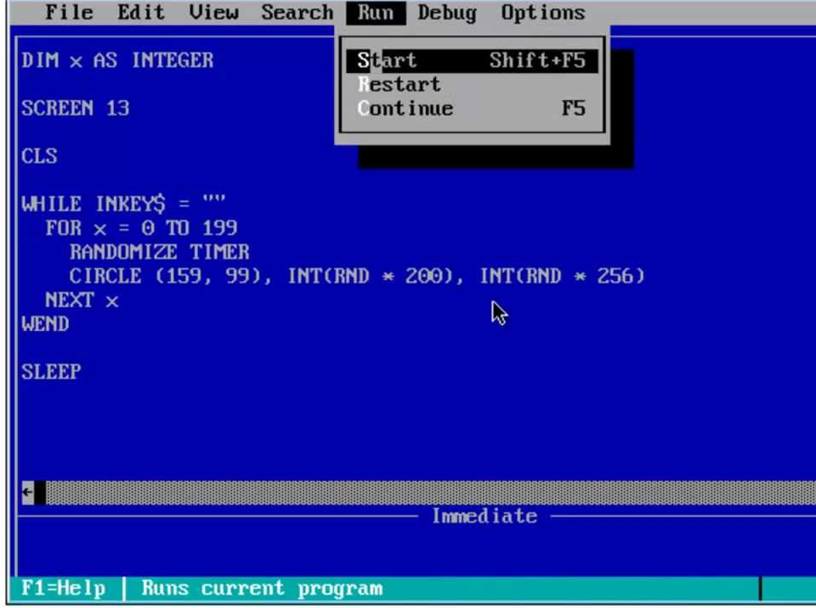

Slide 3
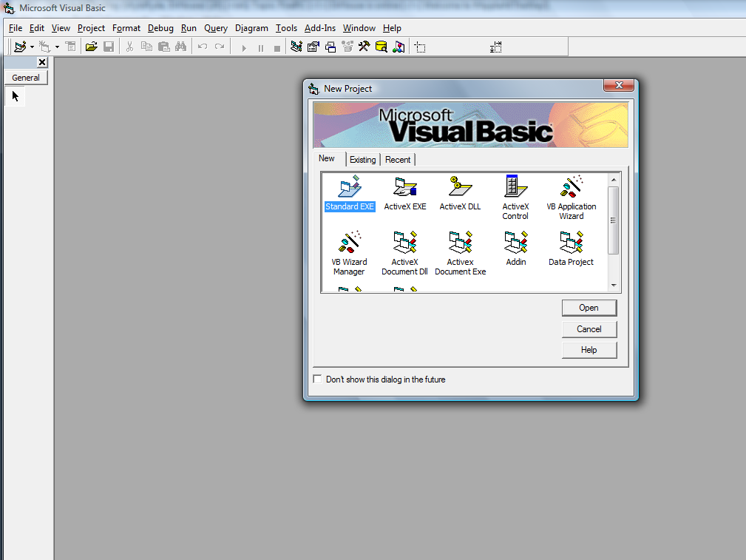

Slide 4
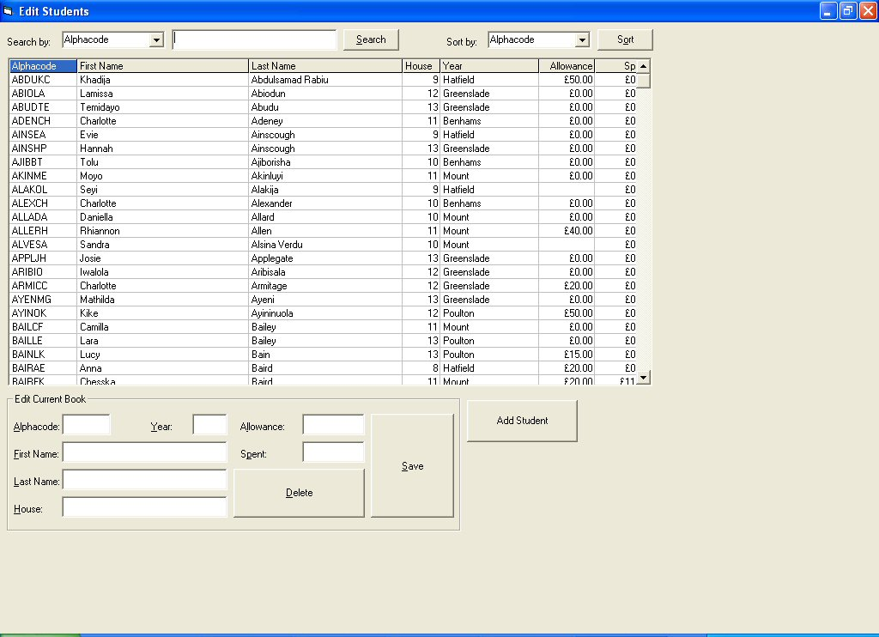

Slide 5
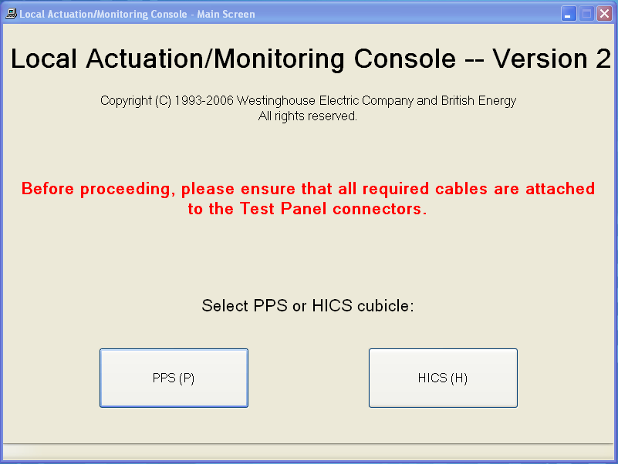
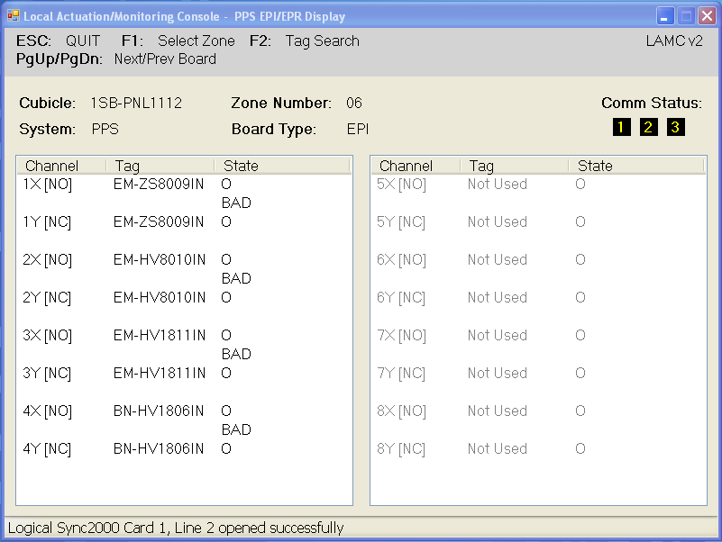

Slide 6

Detector Drive System
Thimble tubes

Slide 7
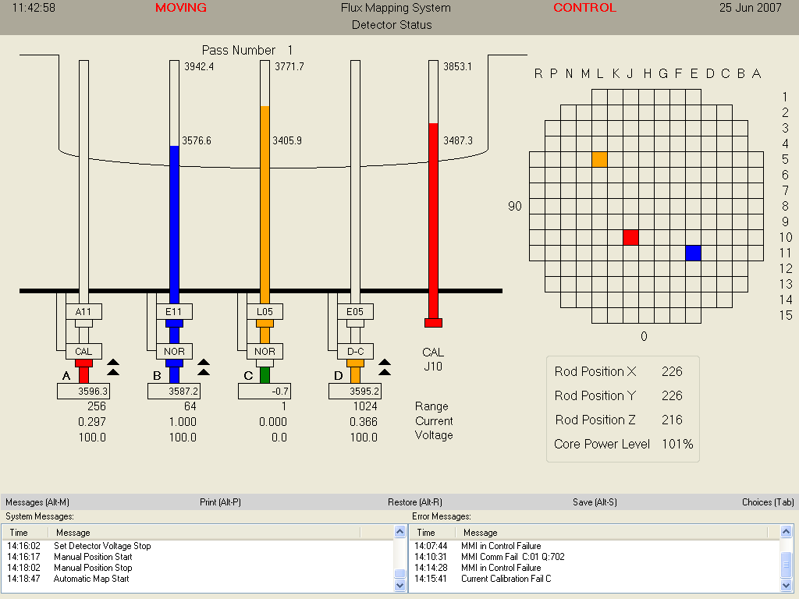

Slide 8


Slide 9
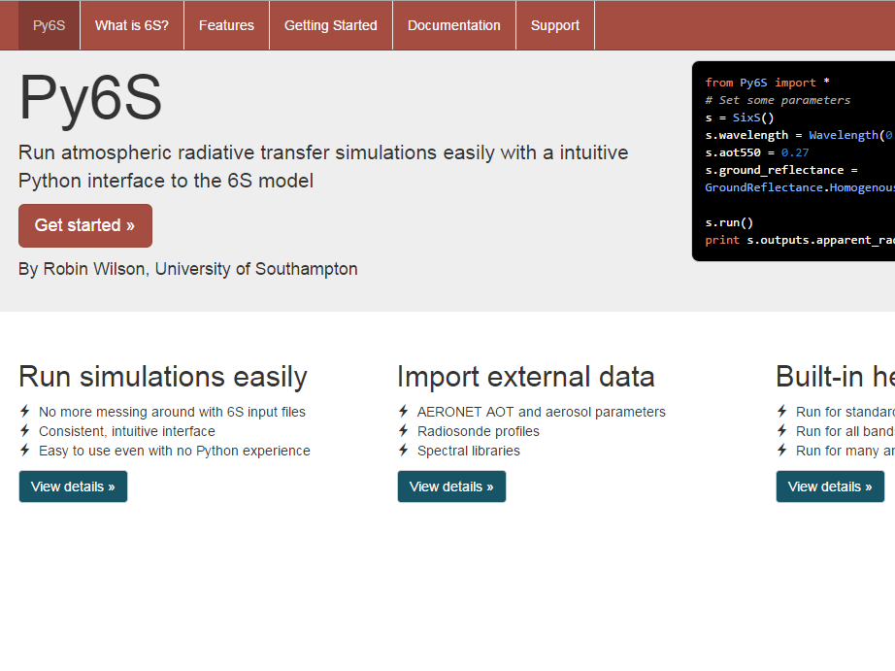

Slide 10
using System.Windows.Forms;
class Program
{
public static void Main(string[] args)
{
MessageBox.Show("Hello, world!");
}
}

Slide 11
print("Hello, world!")

Slide 12
public double[][] mwcont = new double[12]
mwcont = [0] * 12

