Slide 1
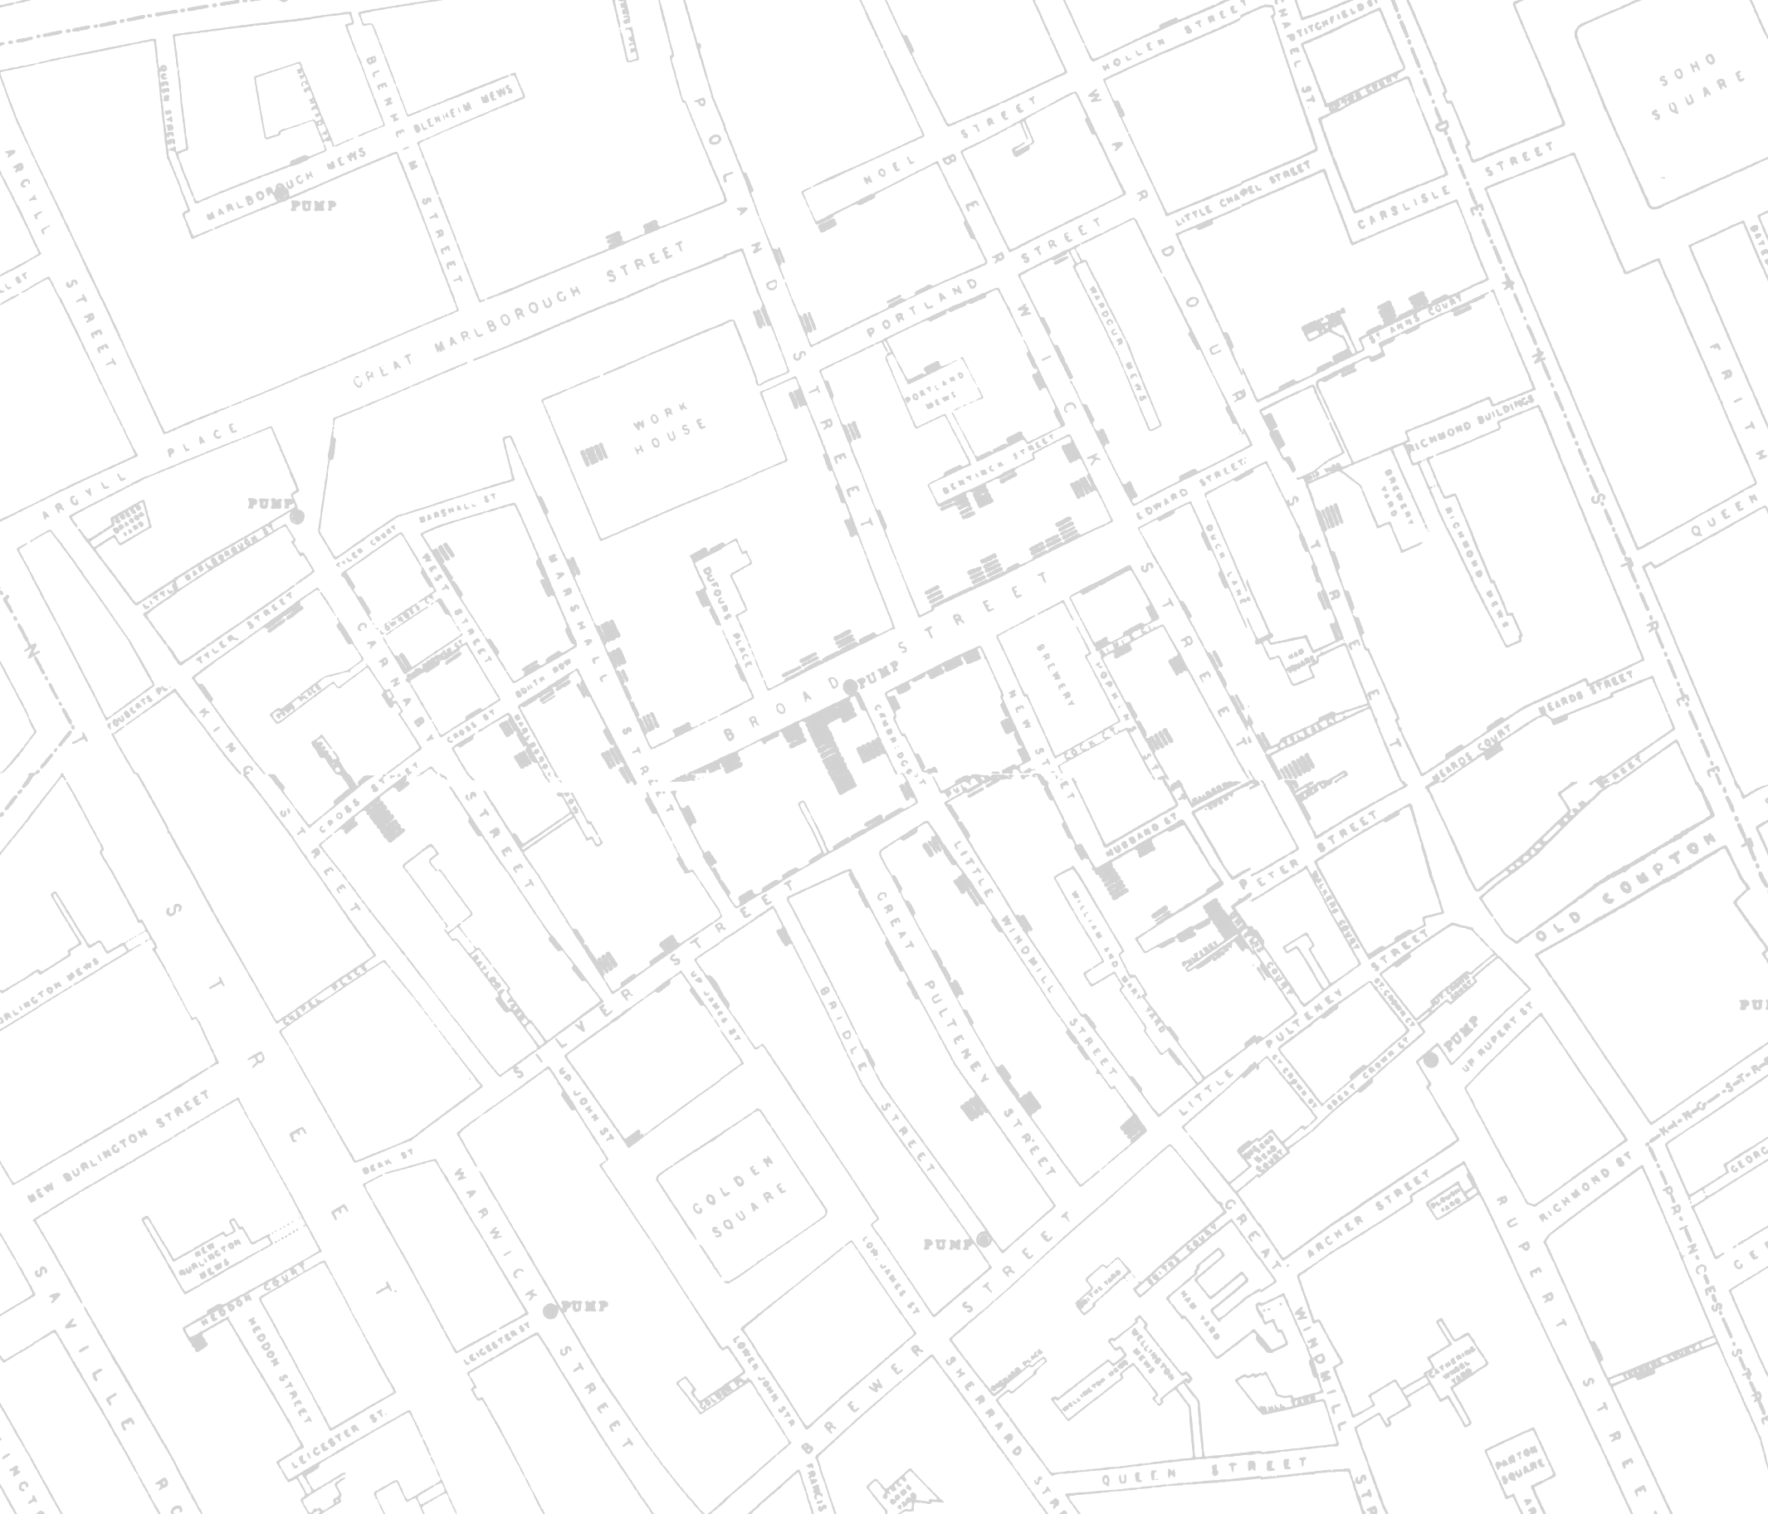
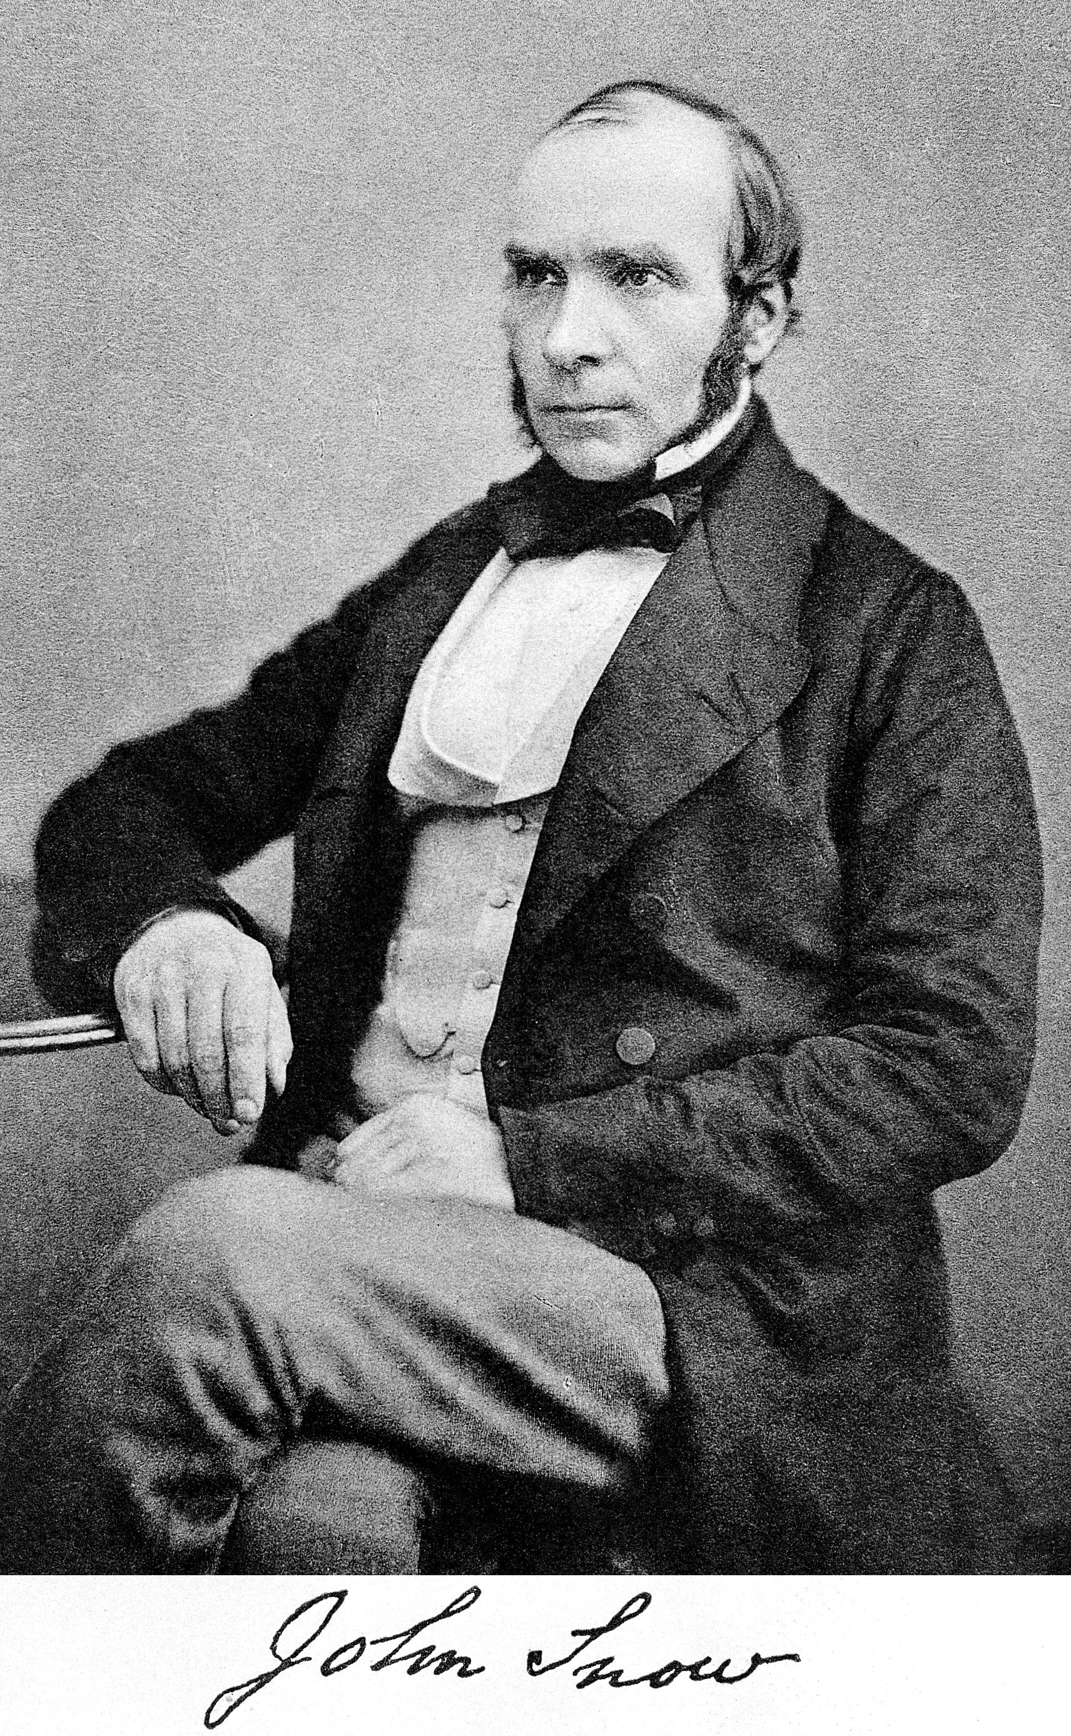
John Snow in the
21st century
Robin Wilson
@sciremotesense
www.rtwilson.com/academic

Slide 2
John Snow in the
21st century
Dr?
Robin Wilson
@sciremotesense
www.rtwilson.com/academic

Slide 3
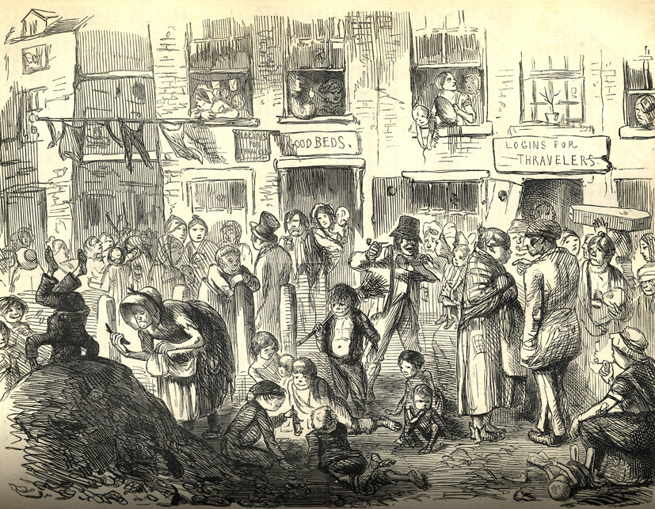
Story

Slide 4
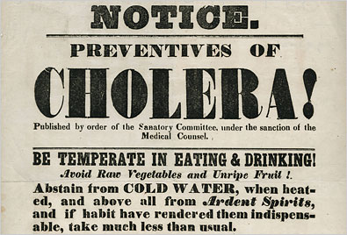

Slide 5
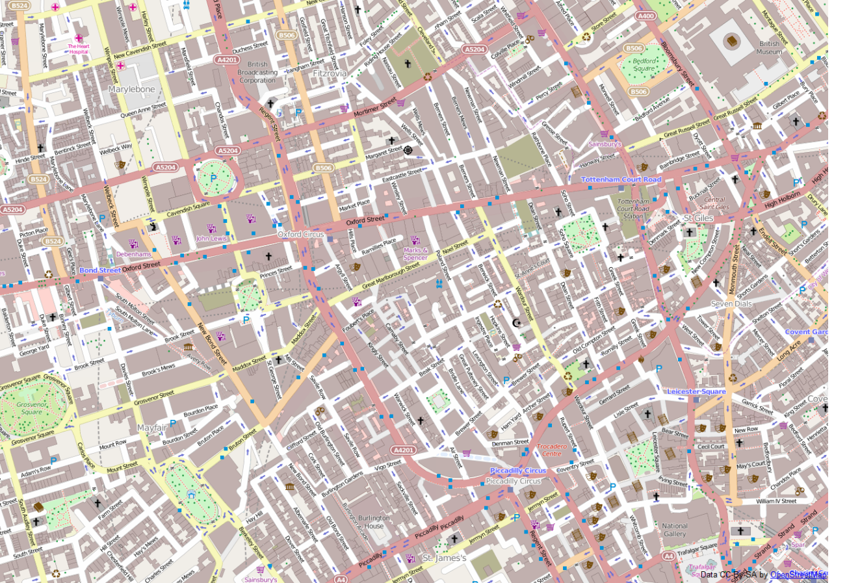
UCL
1854

Slide 8
500 deaths

Slide 10
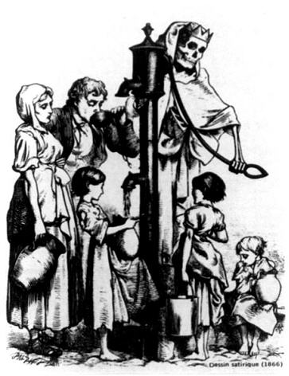

Slide 11
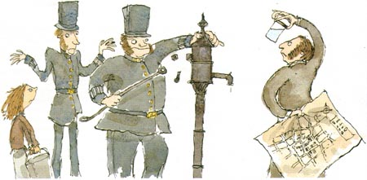

Slide 14
John Snow was the first

Slide 15
John Snow was the first
epidemiologist

Slide 16
John Snow was the first
epidemiologist
GIS technician?

Slide 17
John Snow was the first
epidemiologist
GIS technician?
geospatial developer?

Slide 18
John Snow was the first
epidemiologist
GIS technician?
geospatial developer?
All from the geography

Slide 19
Similar techniques are still used today

Slide 20
Similar techniques are still used today
Can we use his data in modern tools?

Slide 21
Similar techniques are still used today
Can we use his data in modern tools?
What would modern analyses give?

Slide 22
Similar techniques are still used today
Can we use his data in modern tools?
What would modern analyses give?
Do privacy concerns have an impact?

Slide 23
Similar techniques are still used today
Can we use his data in modern tools?
What would modern analyses give?
Do privacy concerns have an impact?
What similar work is done now?

Slide 24
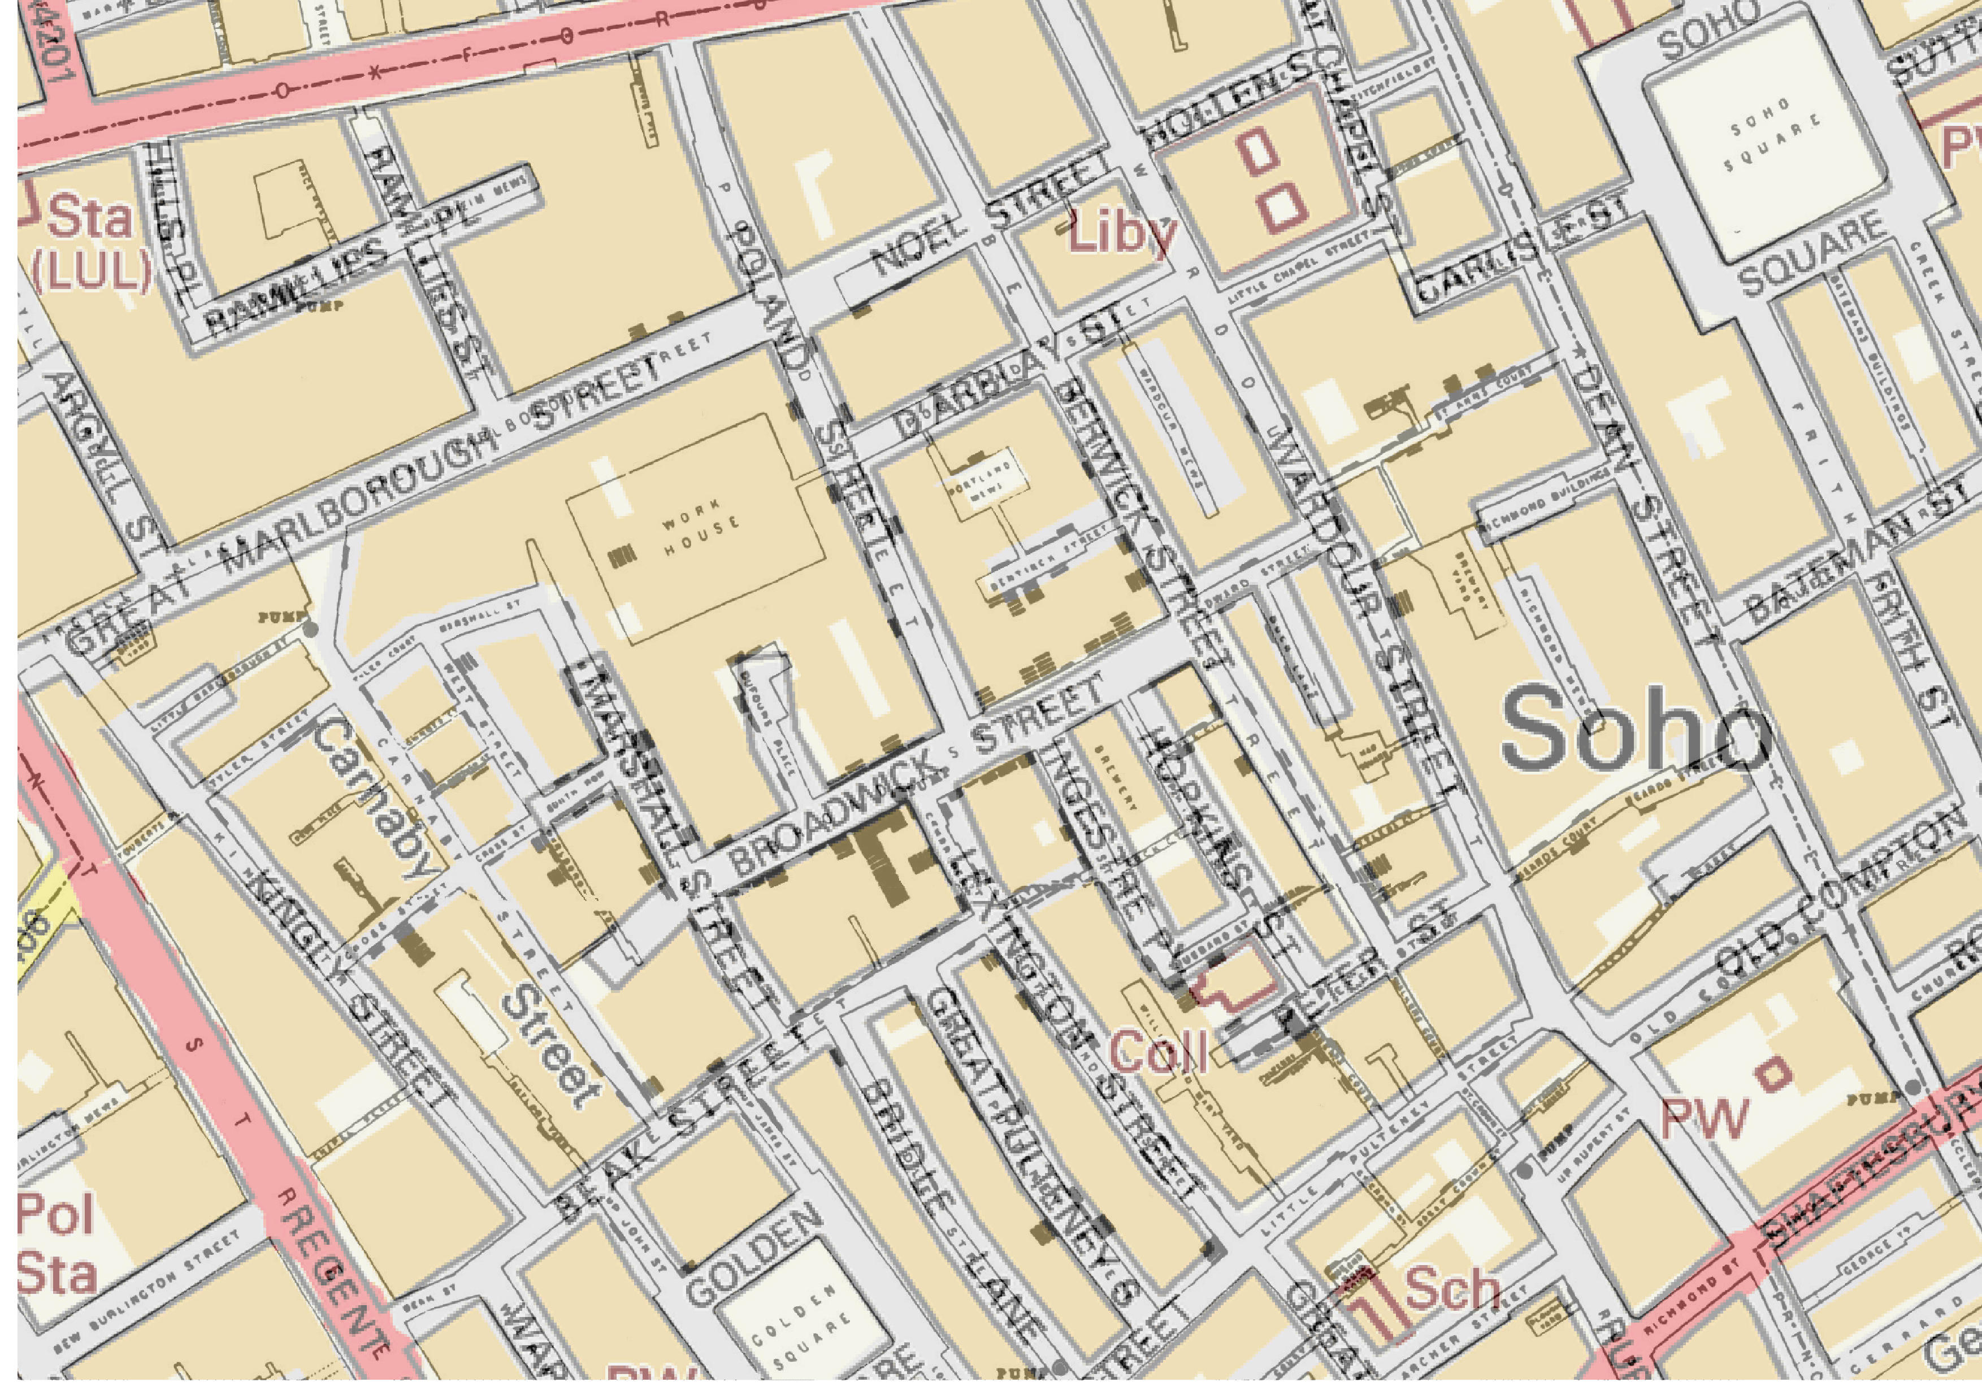
Georeferencing
OS OpenData StreetView – Crown copyright and database right 2014

Slide 25
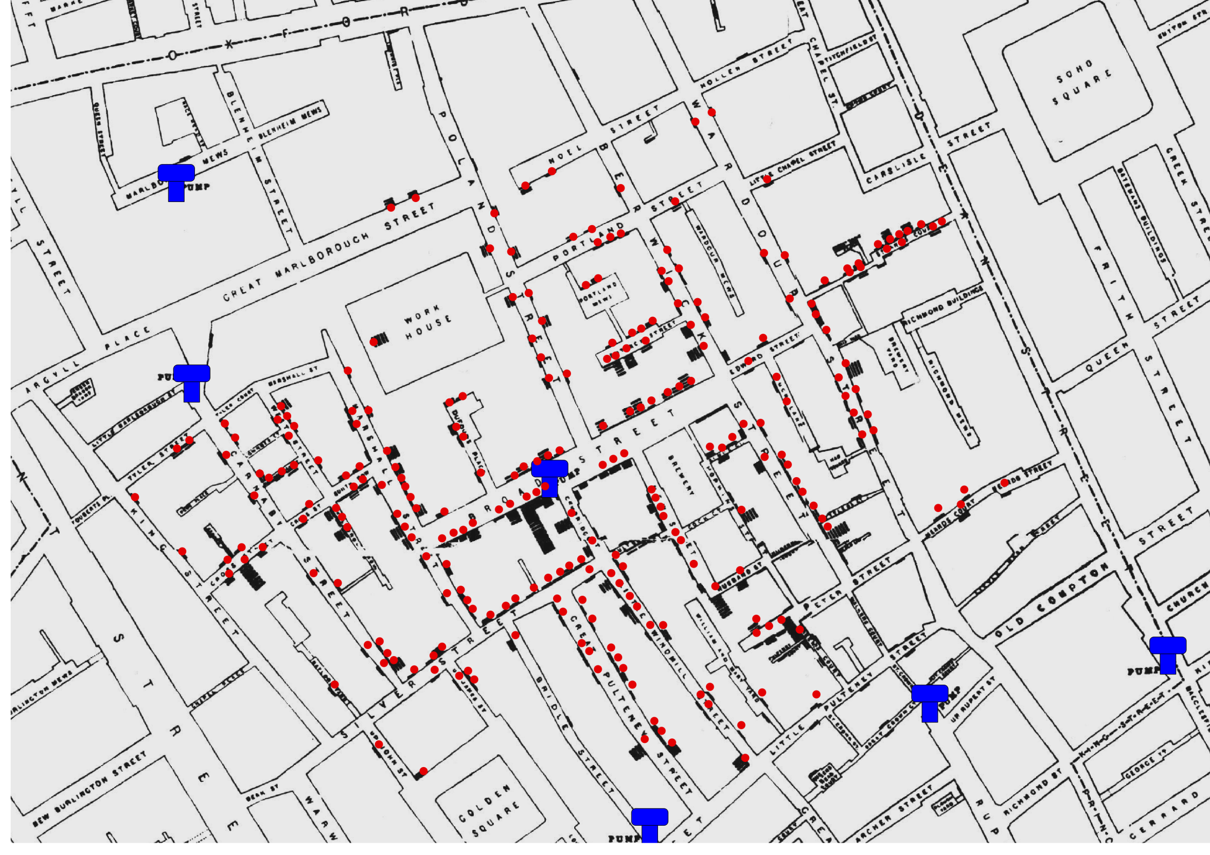

Slide 26
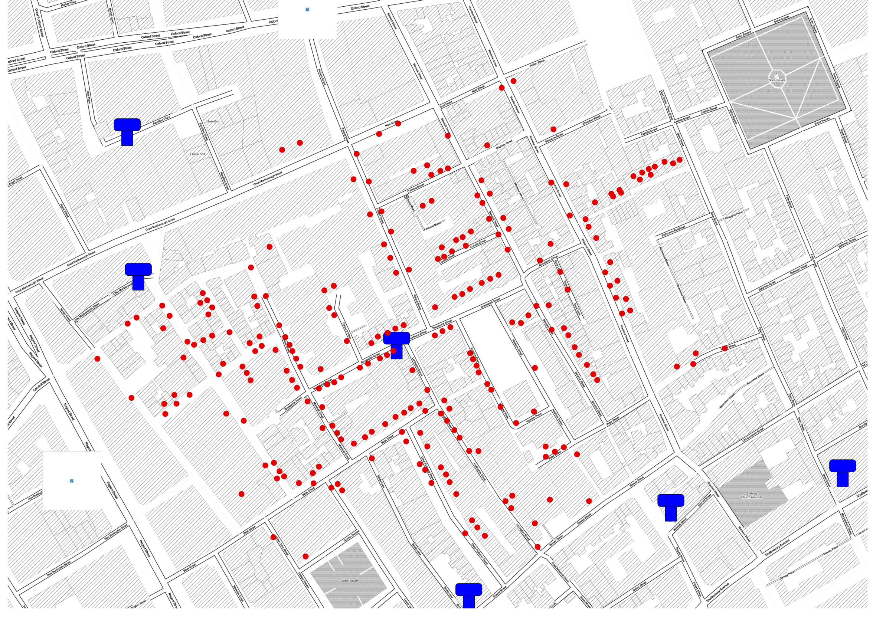

Slide 27
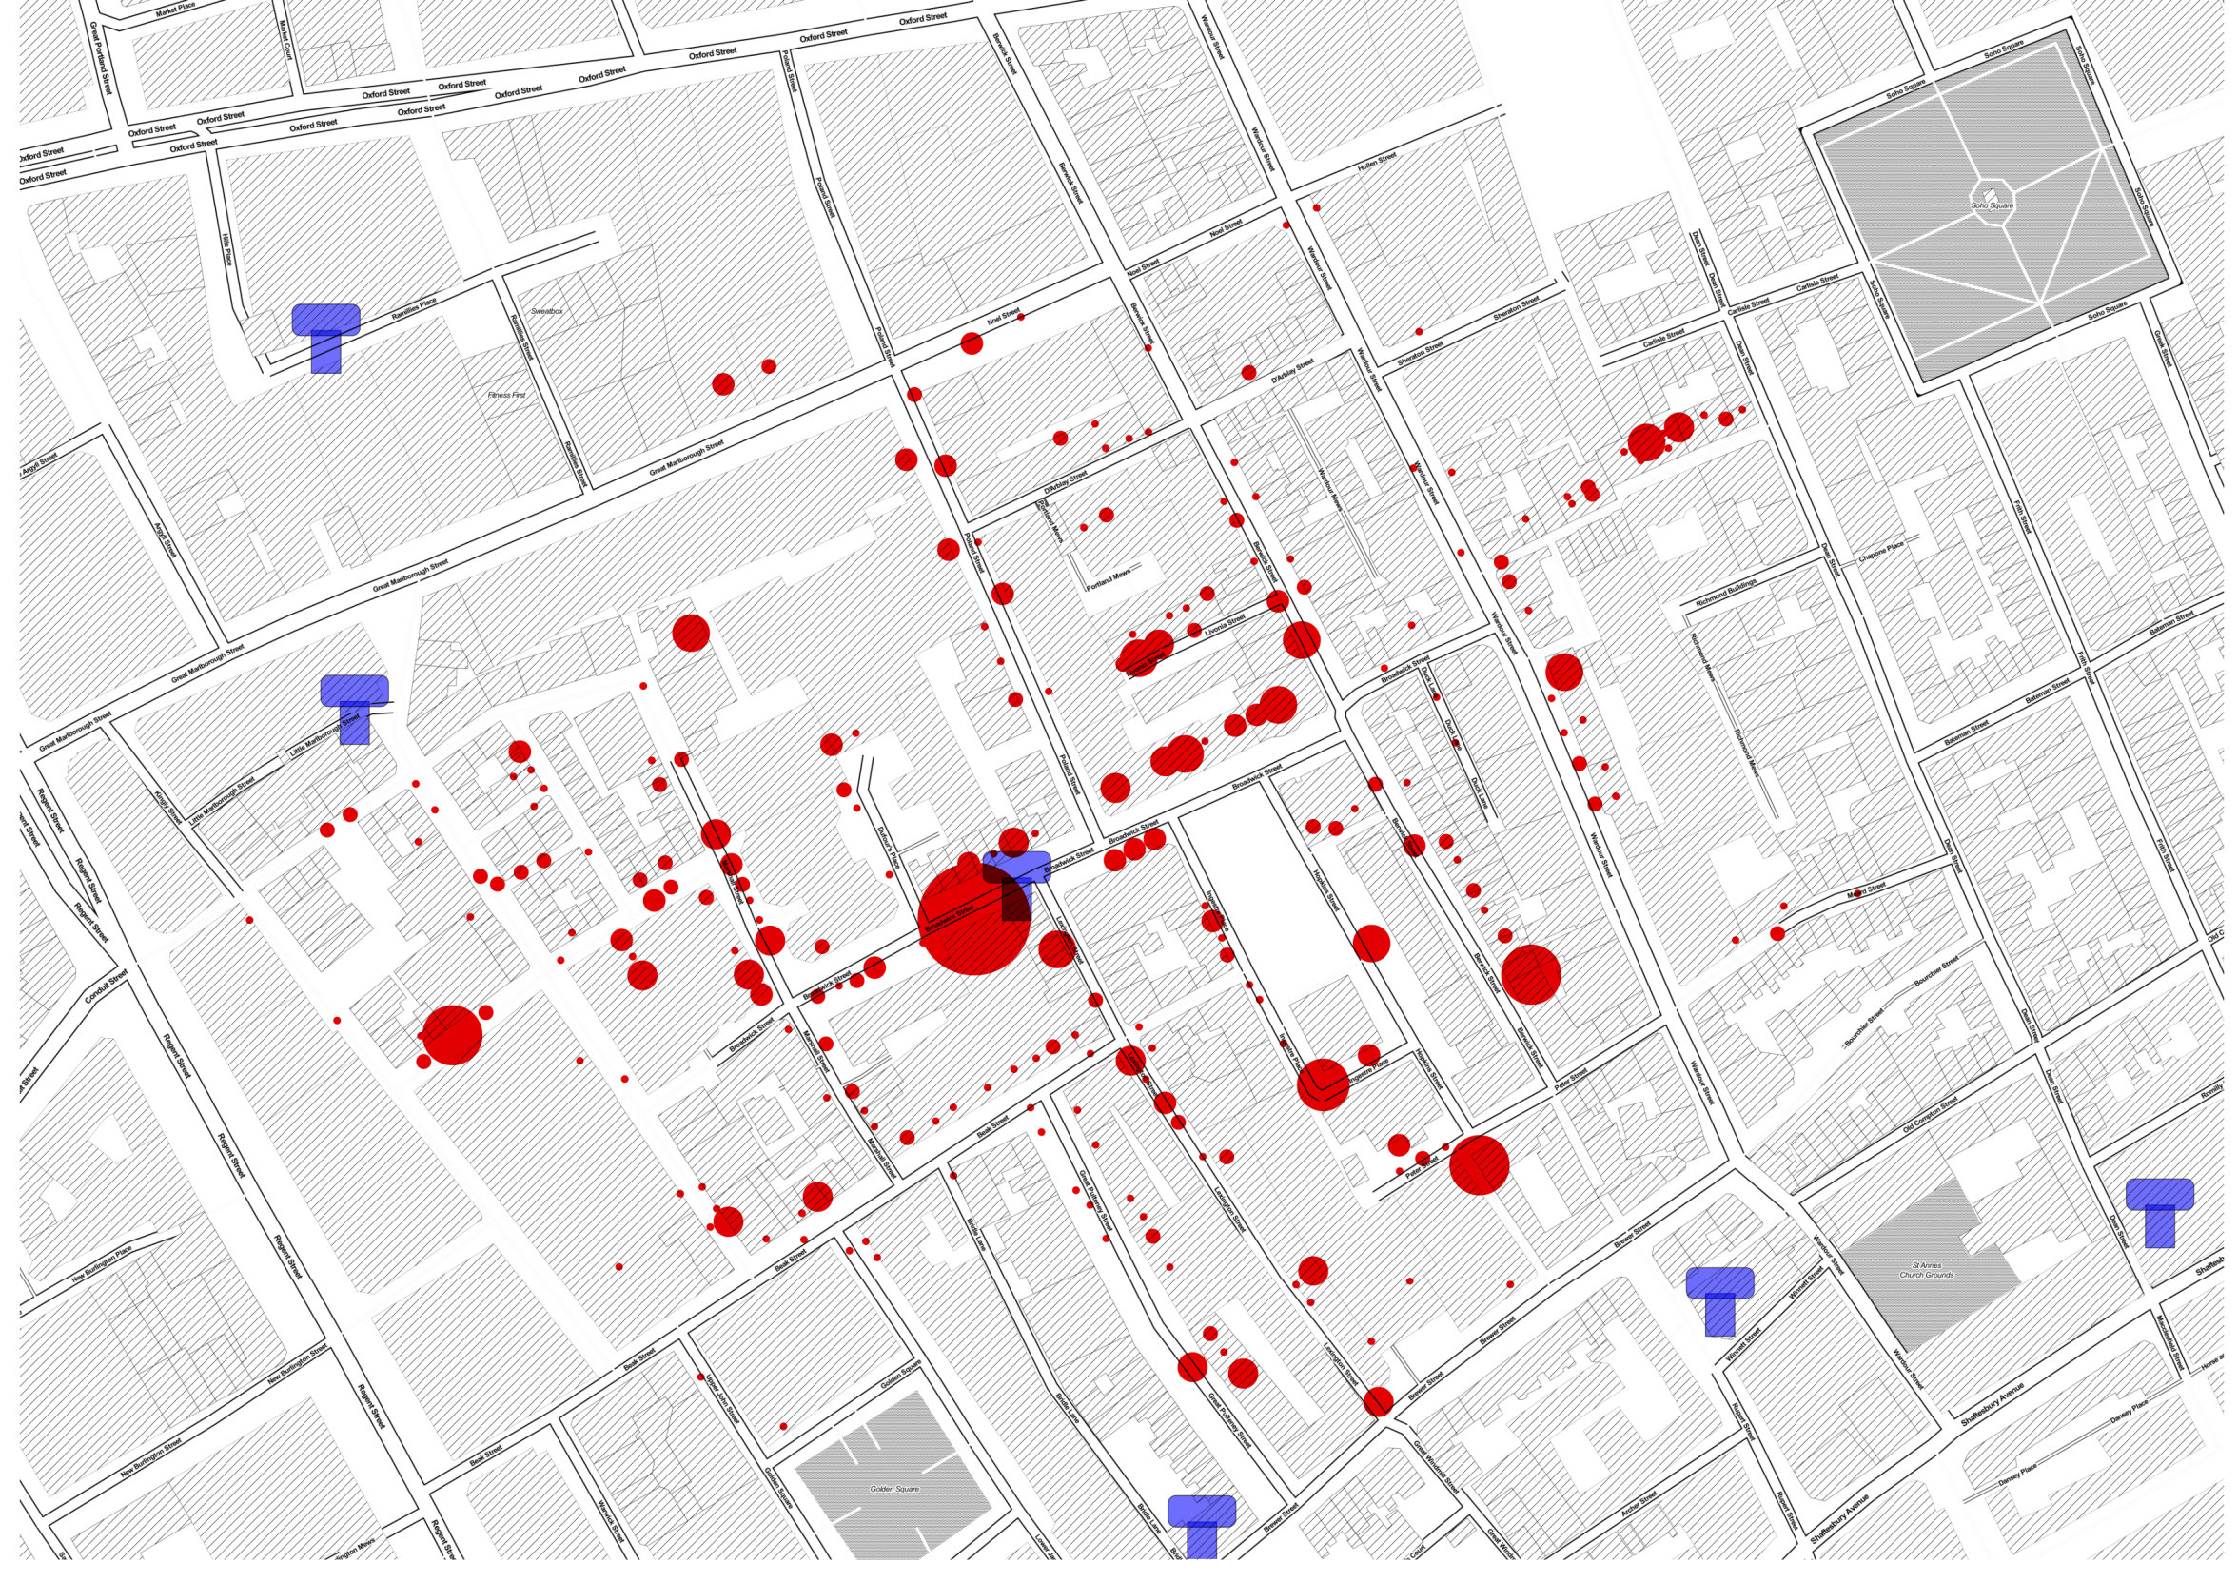
Available at www.rtwilson.com/johnsnow

Slide 28
Snow just looked at the map
Lets try some modern analysis methods

Slide 29
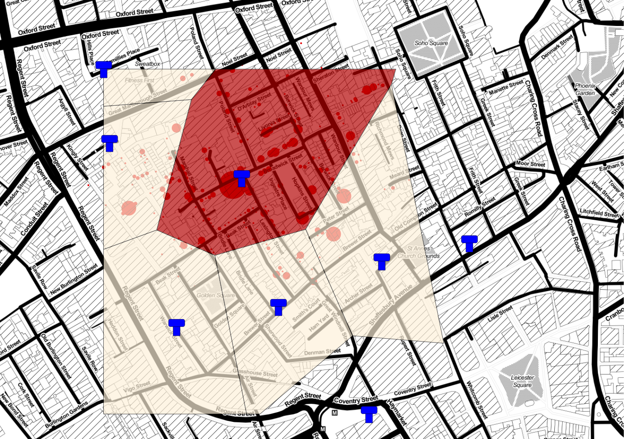
Voroni polygons

Slide 30
Voroni polygons

Slide 31
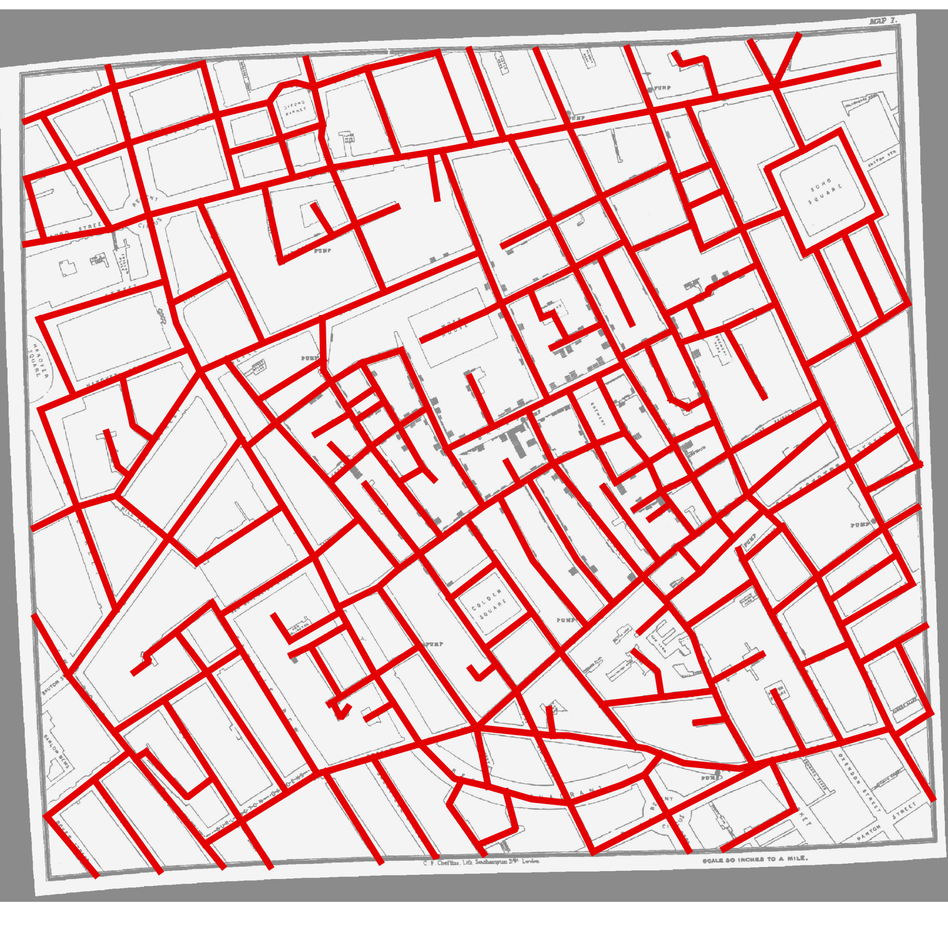
But you can’t walk through walls…

Slide 32
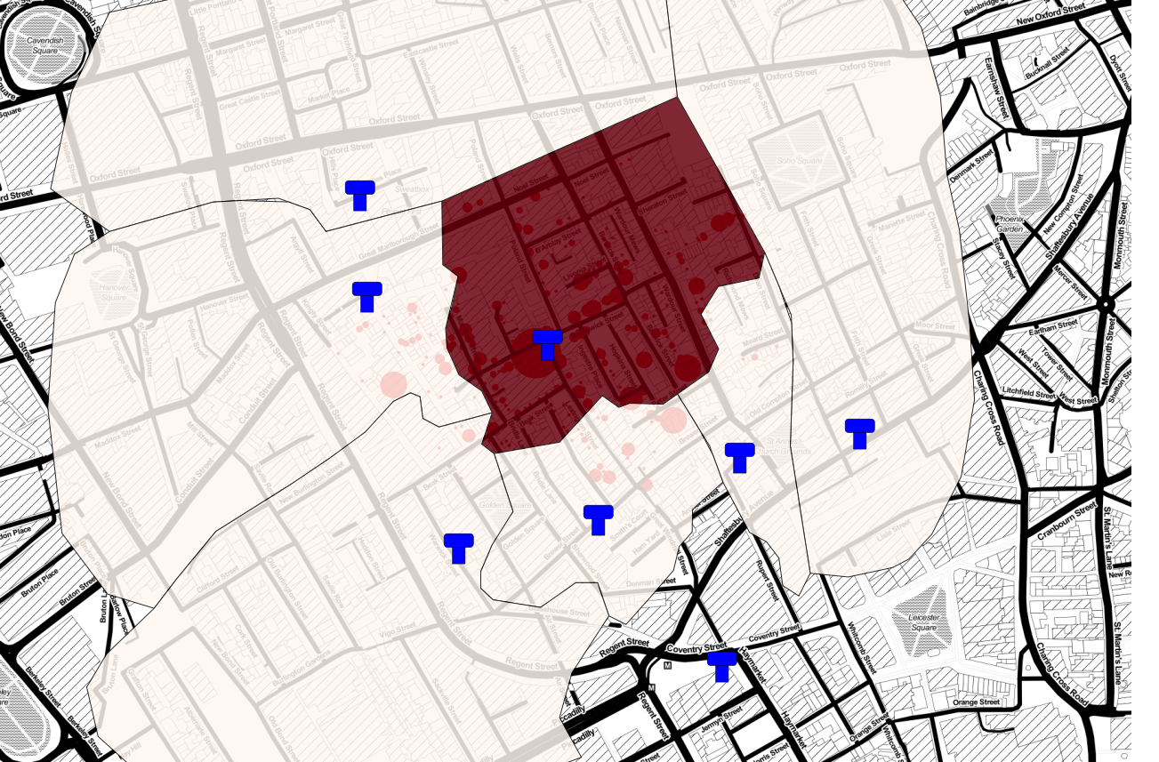
Network analysis

Slide 33
Network analysis

Slide 34
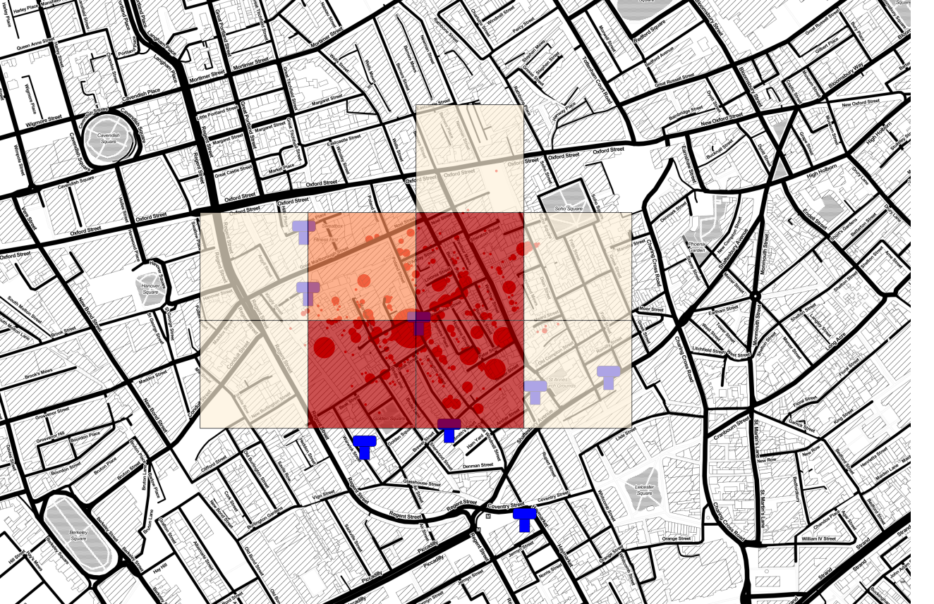
Modern data can be a problem…

Slide 35
Modern data can be a problem…

Slide 36
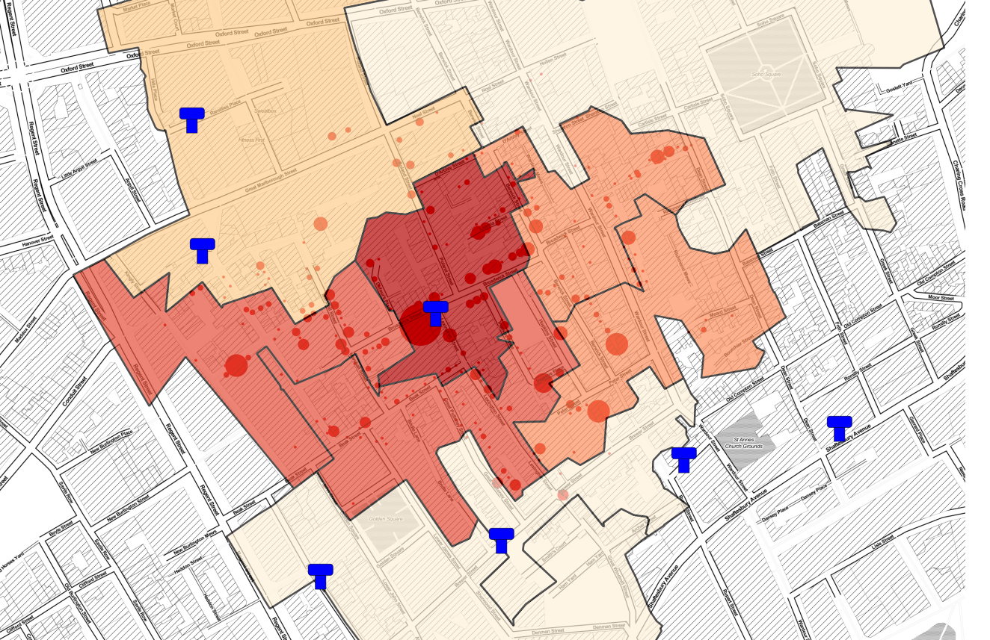
Modern data can be a problem…

Slide 37
Modern data can be a problem…

Slide 38
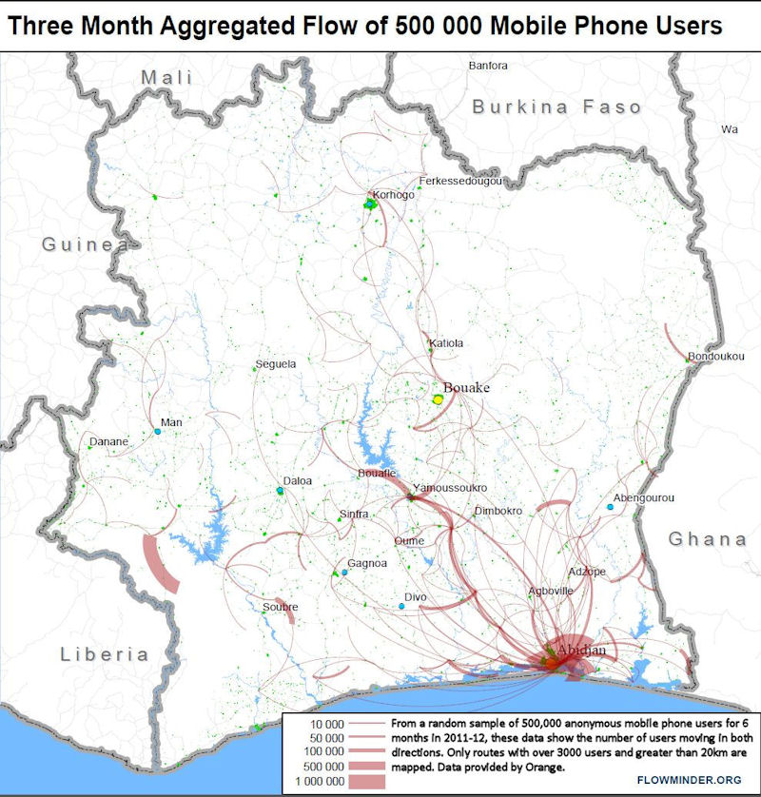
What do we do these days?
Images courtesy of Flowminder (www.flowminder.org)

Slide 39
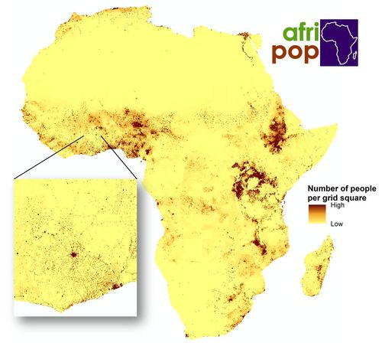
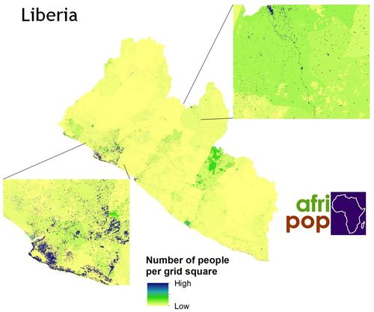
What do we do these days?
Images courtesy of Flowminder (www.flowminder.org)

Slide 40
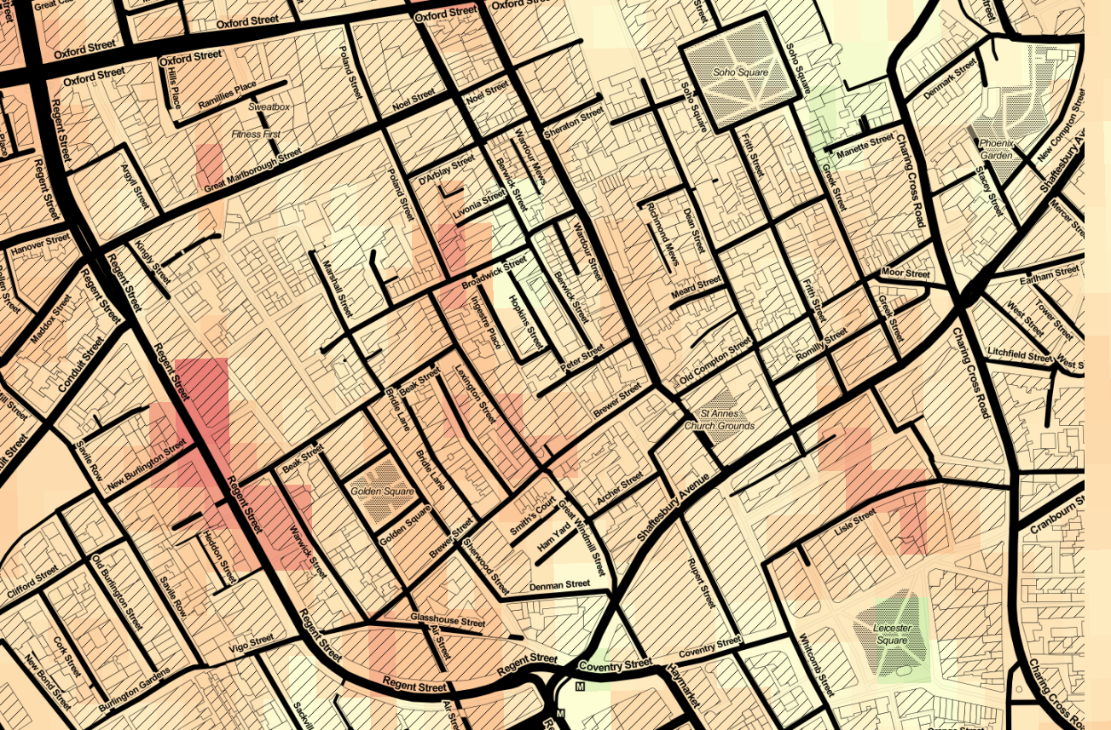
Air pollution & health

Slide 41
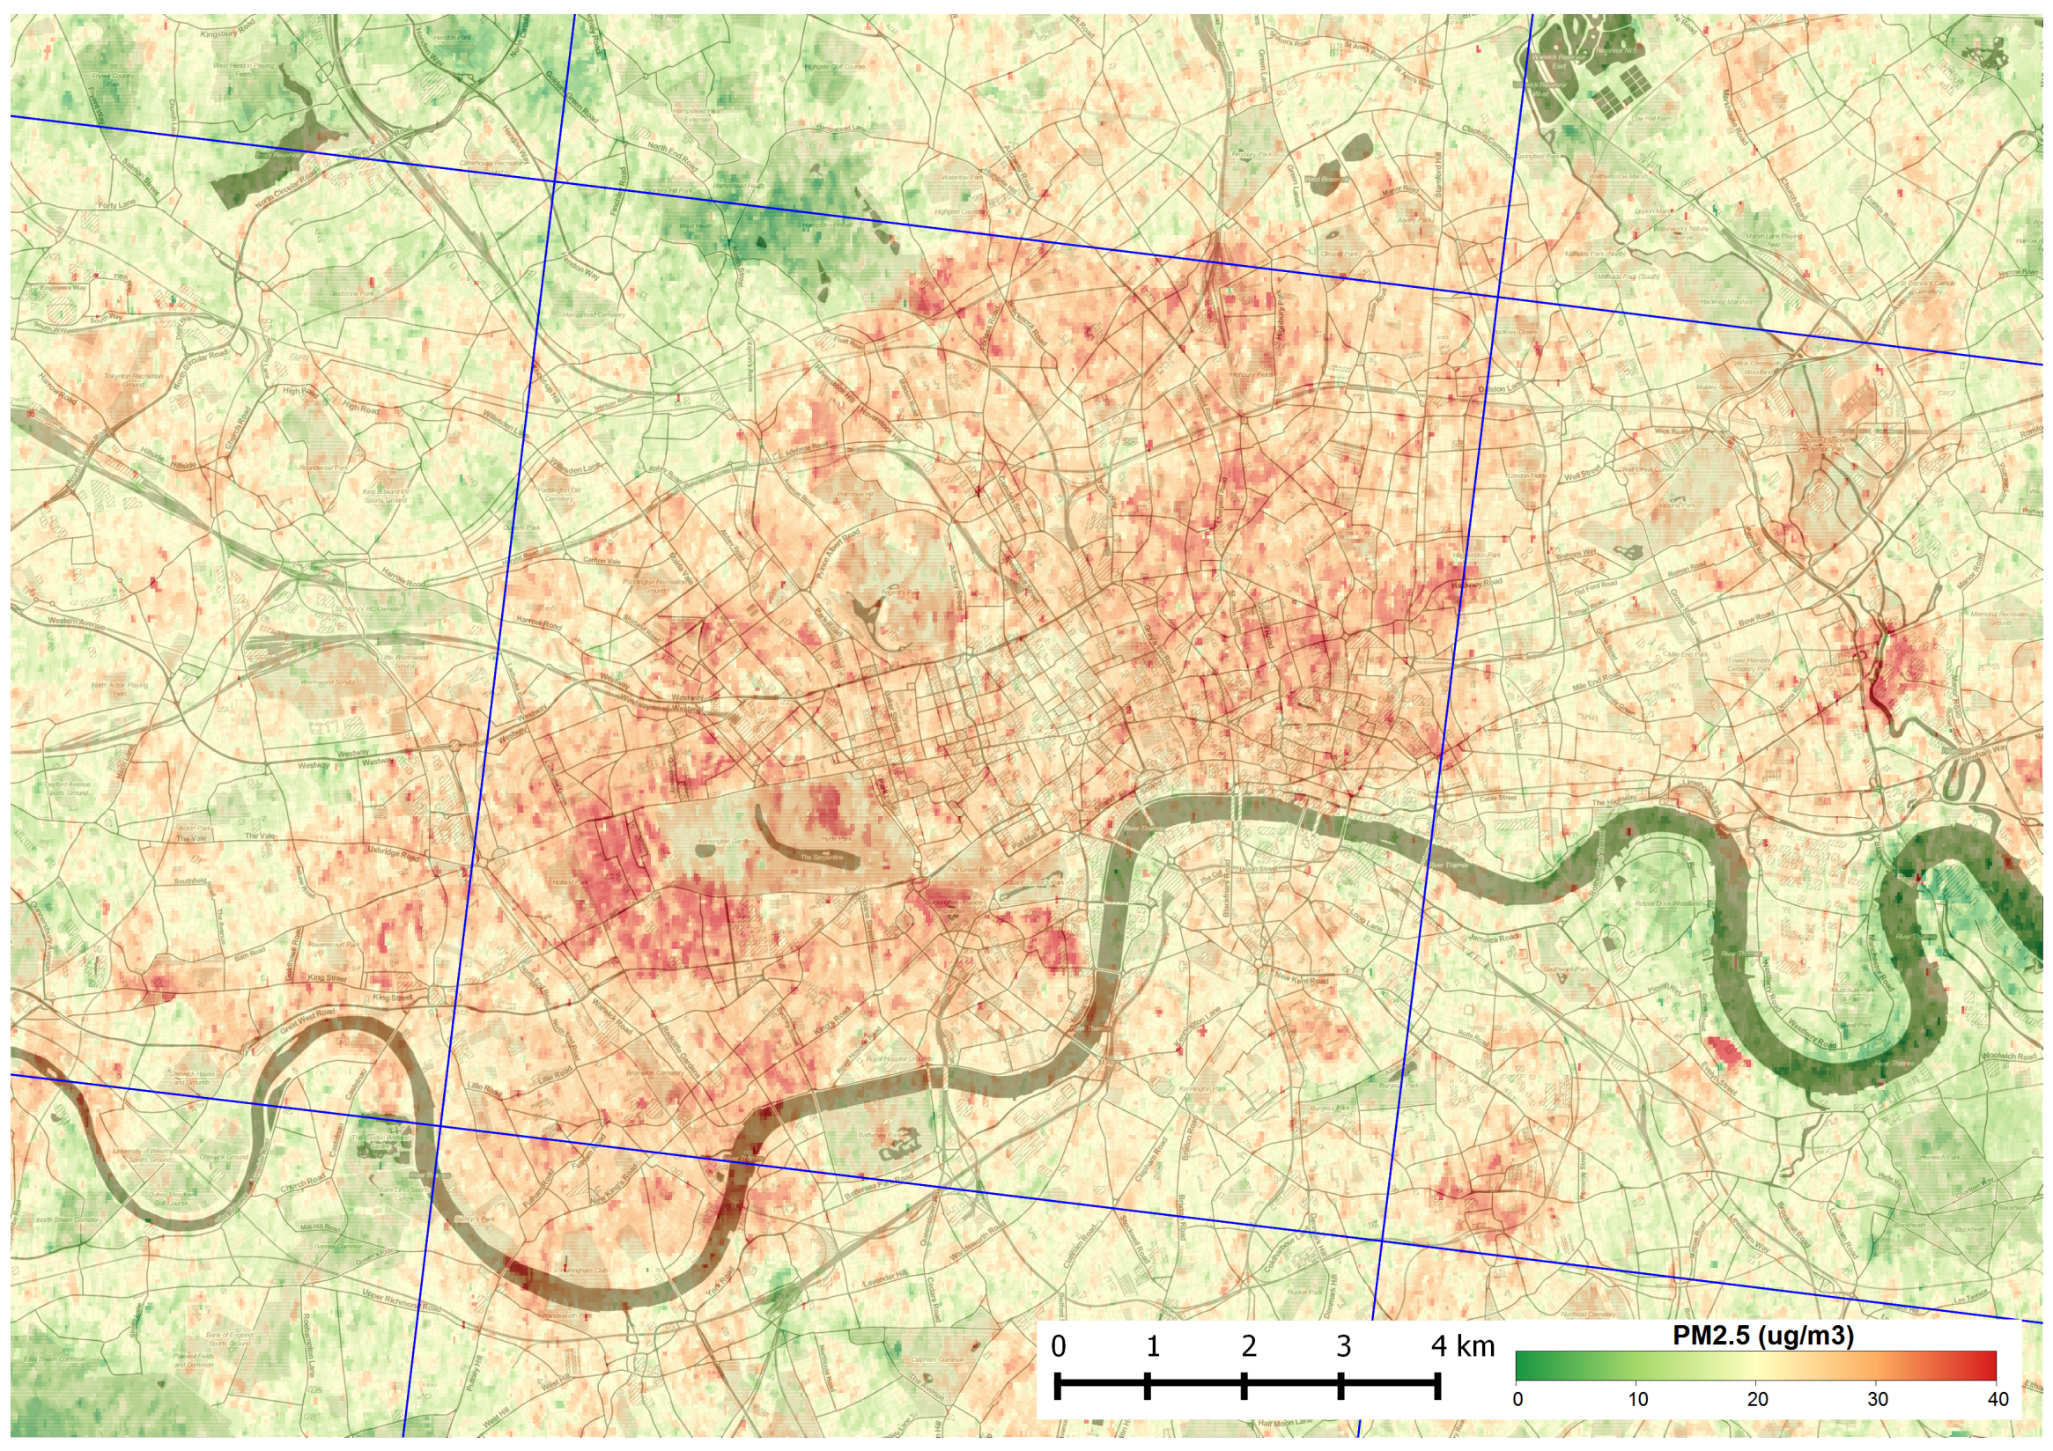
Air pollution & health

Slide 42
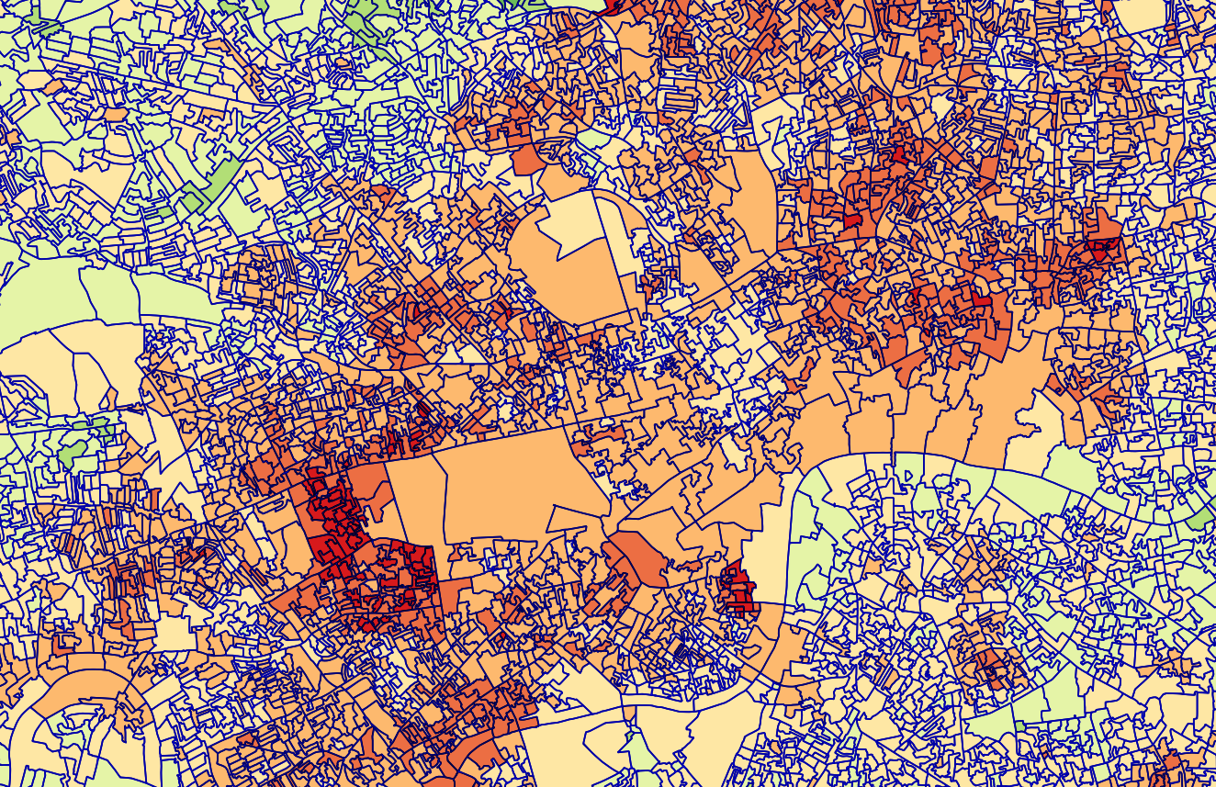
Air pollution & health

Slide 43
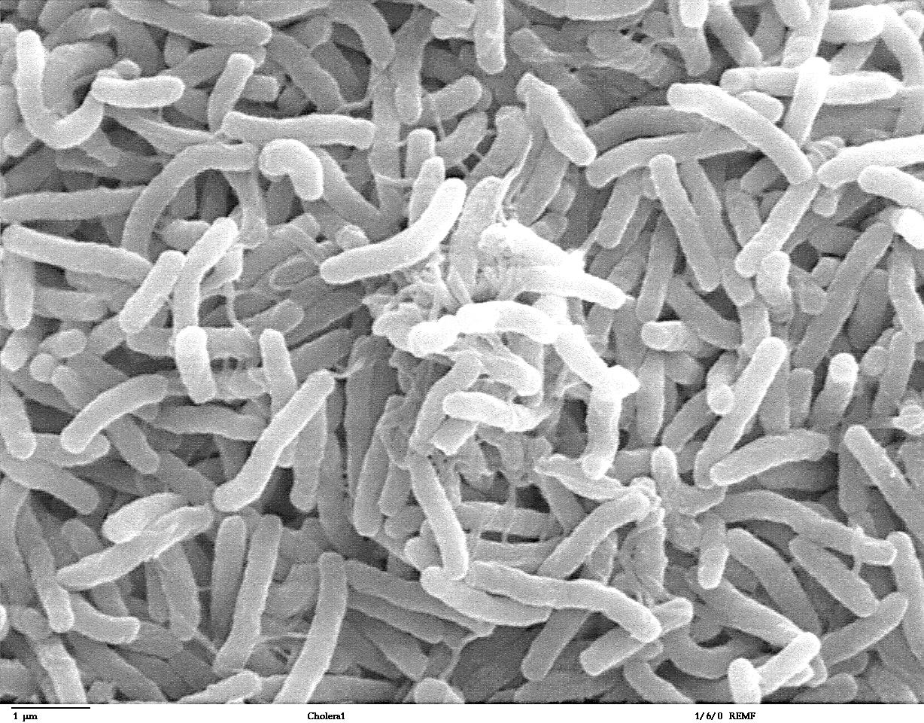
So what?

Slide 44
So what?

Slide 45
So what?

Slide 46
So what?

Slide 47
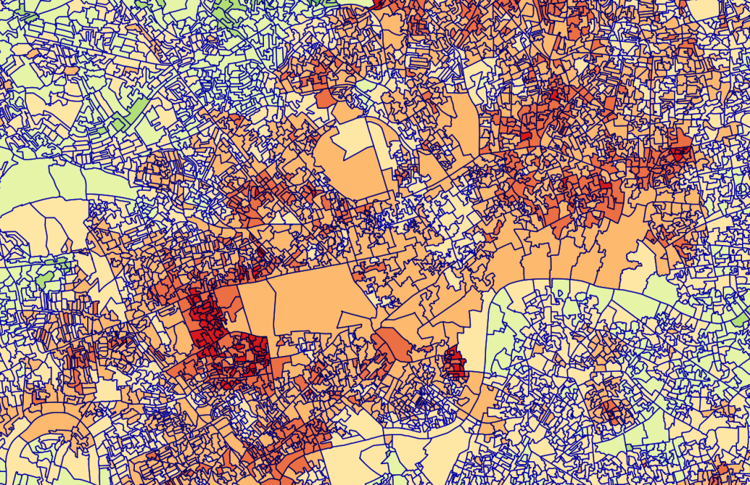
So what?

Slide 48
So what?
Please have a play with the data at
www.rtwilson.com/johnsnow
and show me what you make!

