Slide 1
A lightning talk on lightning talks… or 5 lightning talks in 5 minutes
Robin Wilson
www.rtwilson.com
robin@rtwilson.com

Slide 2
A cool Python module
pip install tqdm
from tqdm import tqdm
for item in tqdm(stuff):
# Do stuff

Slide 3
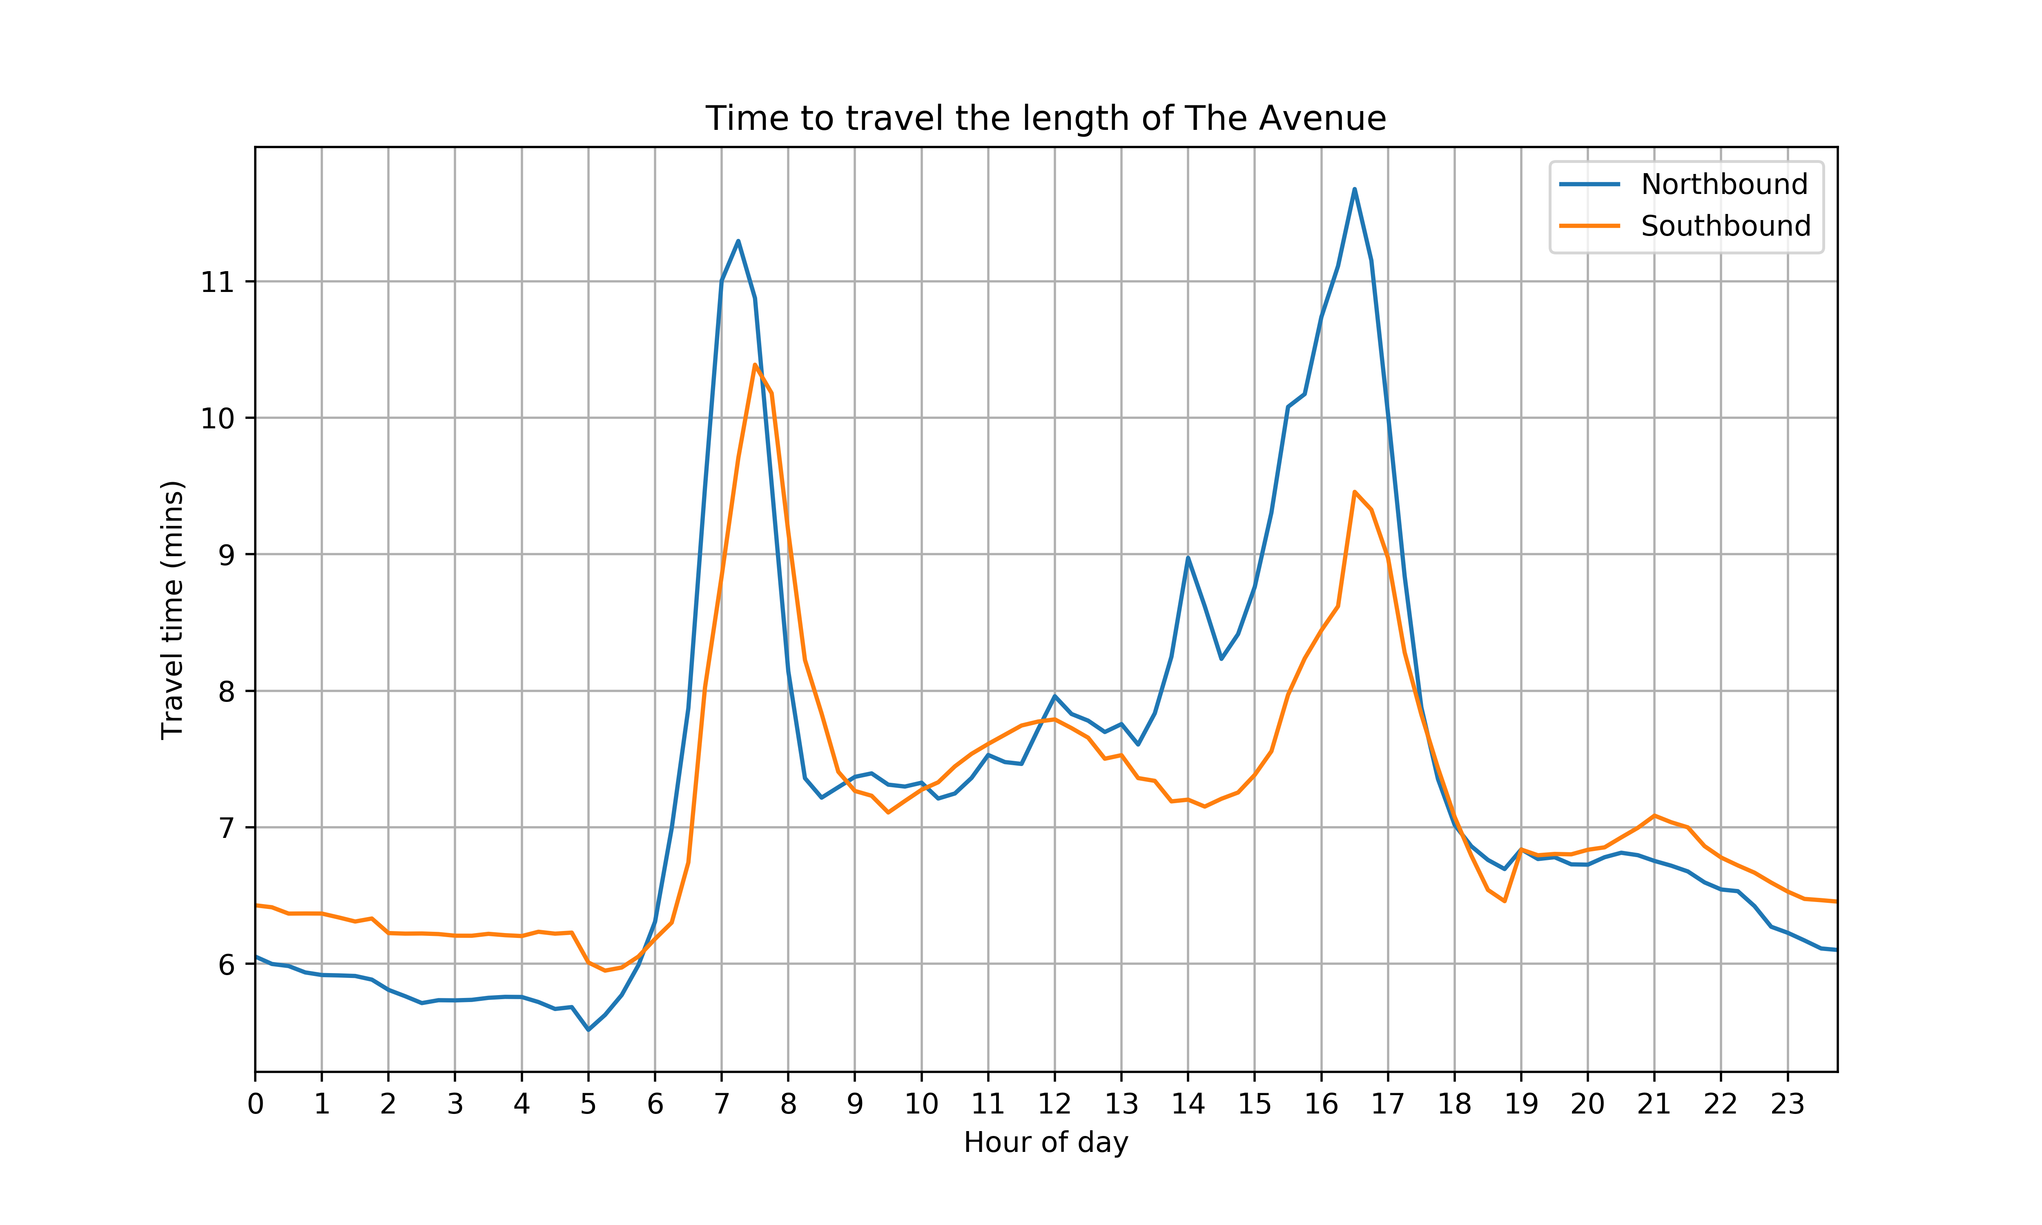
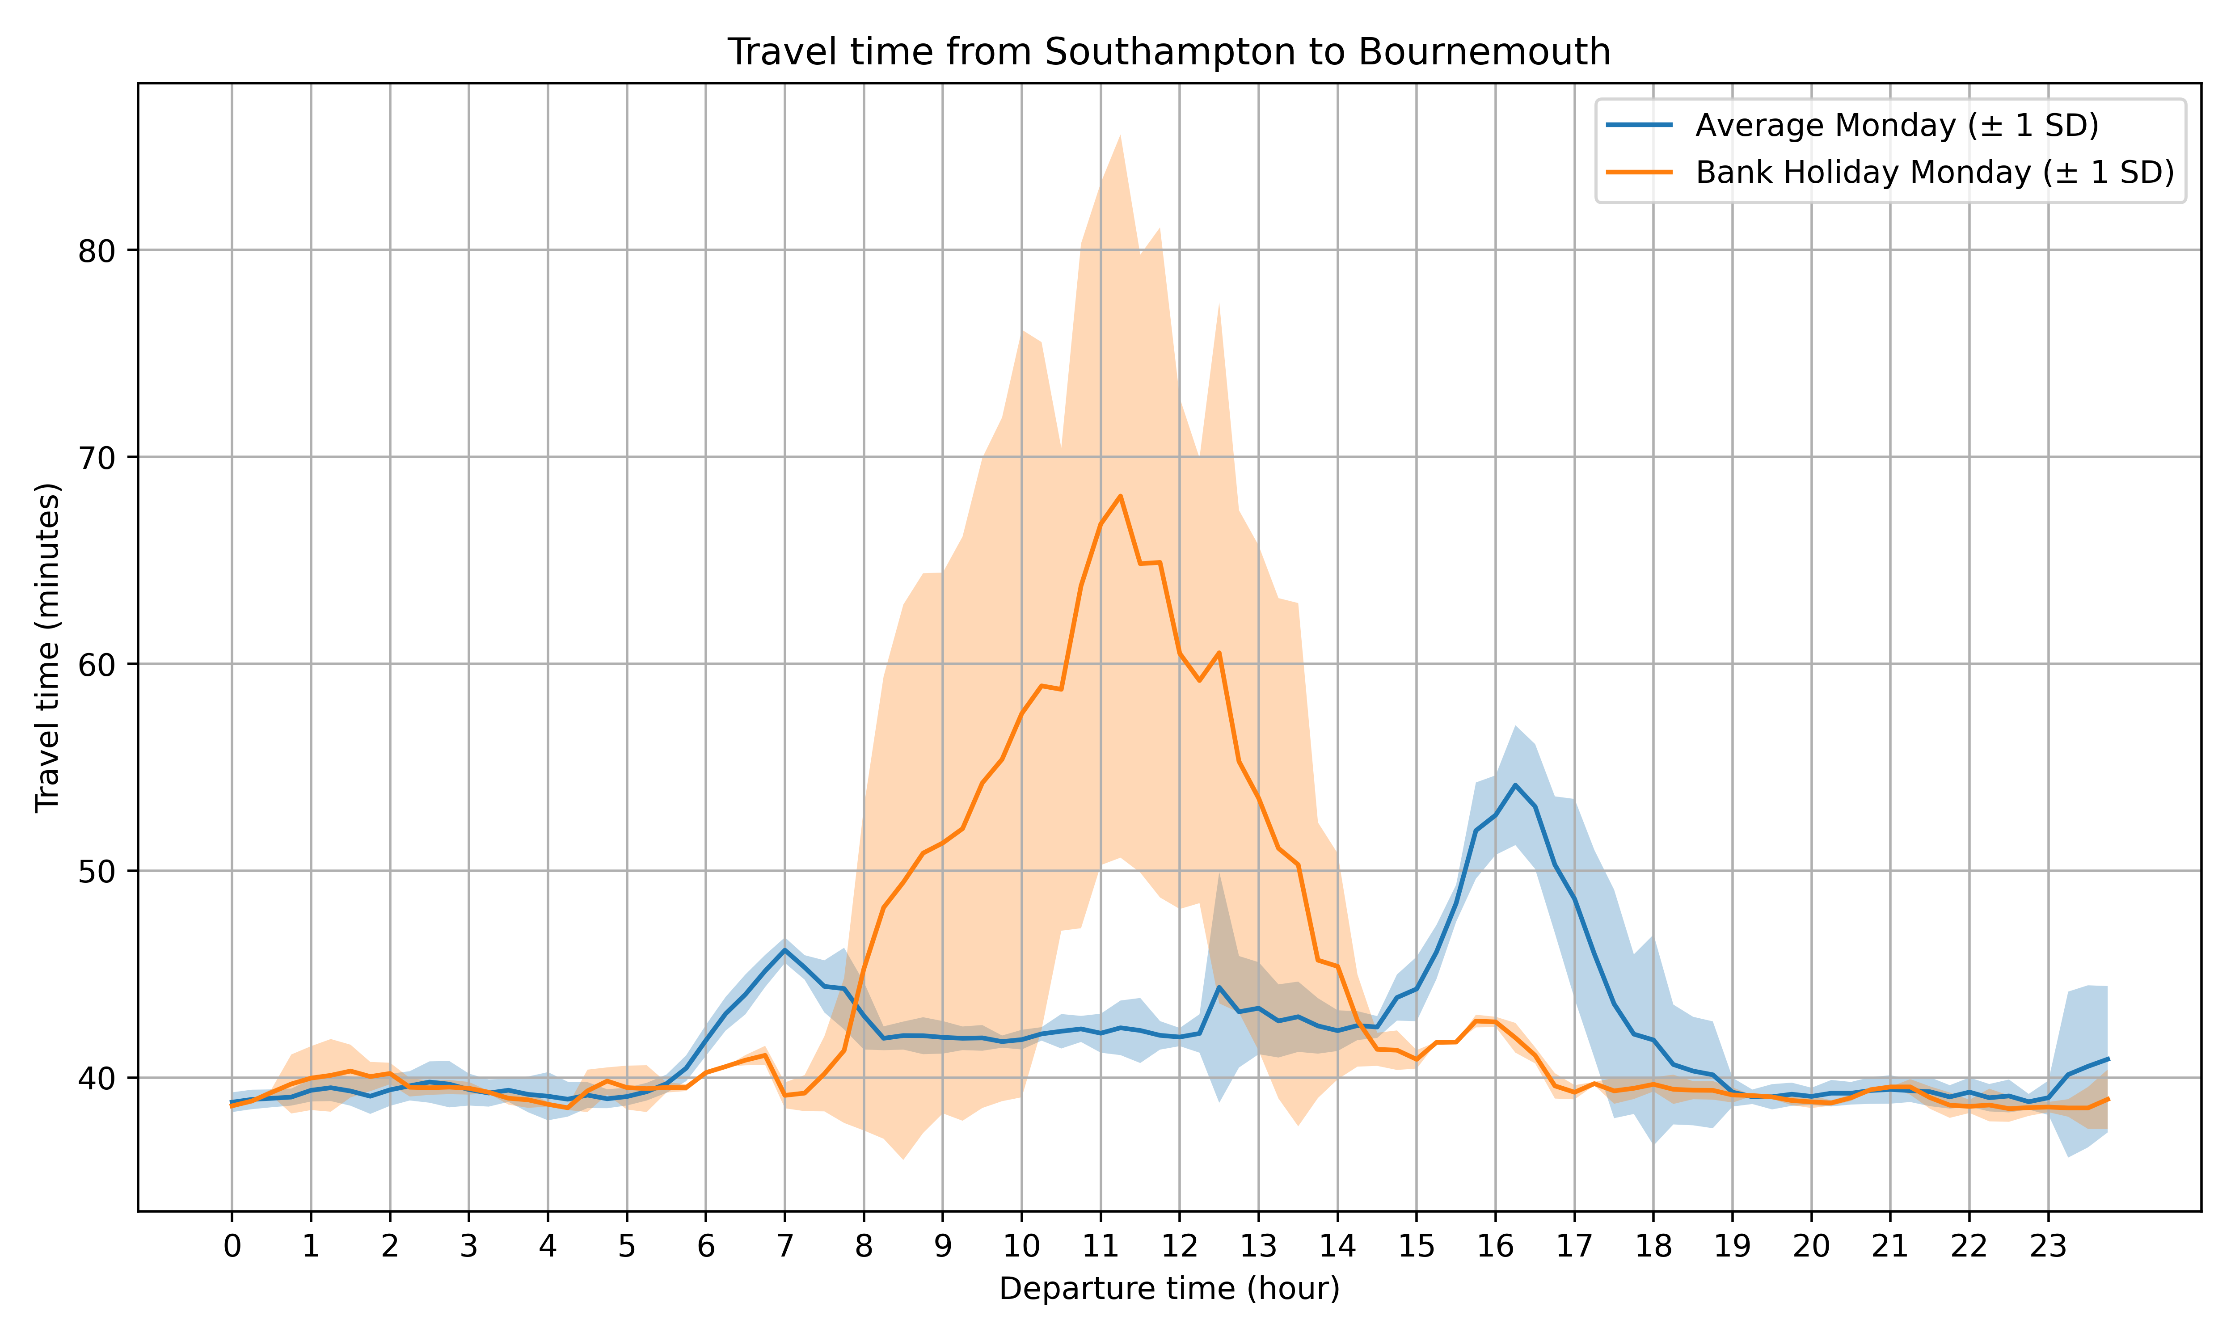
An interesting analysis
directions_result = gmaps.directions(from_loc, to_loc, mode="driving", departure_time=now)
time_taken = directions_result[0]['legs'][0]['duration_in_traffic']['value'] / 60
Cron
Python
Google Maps API
Database

Slide 4
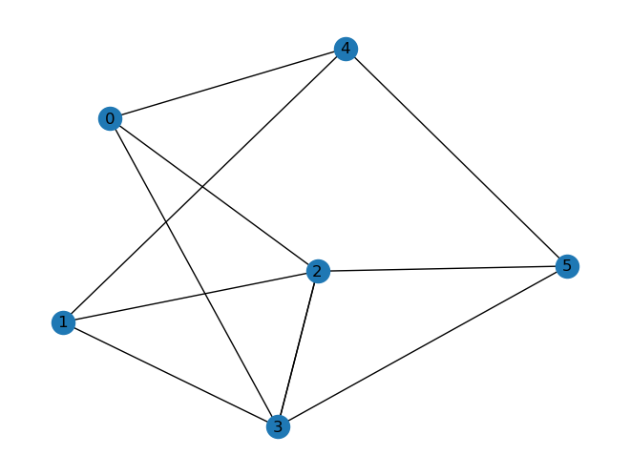
A brief introduction to a topic
Shortest Path
Connected components
Centrality
Distance Matrices
Depth-First Search
Breadth-First Search
People?
Computers?
Roads?
Web pages?
Nodes & Edges
Directed or Non-Directed
networkx, rustworkx

Slide 5
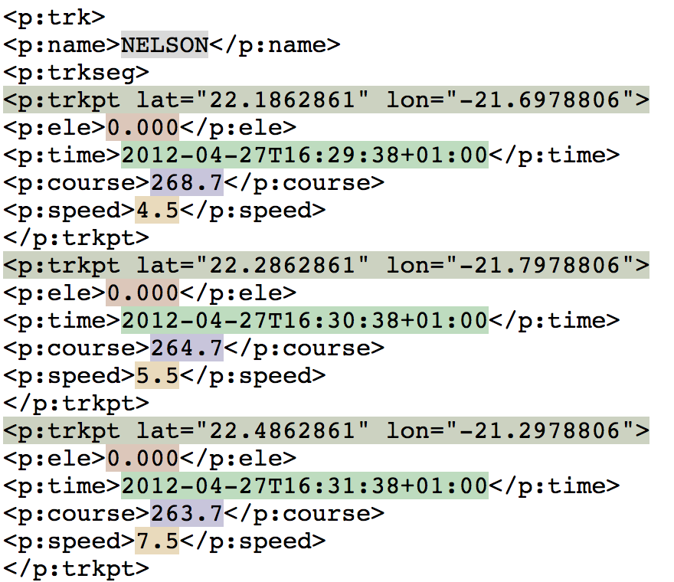
A problem and how I solved it
class MyTreeBuilder:
"""
Class used to build the tree structure of an XML file in memory,
while keeping track of byte offsets to get XML element locations.
Note: the majority of this is copied from the Python Standard Library
TreeBuilder, but this has been extended to:
- Store a parser instance from the constructor
- Call self._parser.parser.CurrentByteIndex to get the byte index in
methods like `start` and `end`
- Pass this byte index to the MyElement constructor
- Set the end and text_start locations in the MyElement constructor too
"""
elem = self._factory(
tag,
attrs,
start_byte=self._parser.parser.CurrentByteIndex,
line_number=self._parser.parser.CurrentLineNumber,
highlighted_file=self._highlighted_file,
)
track_name_element = document.find("name")
track_name = track_name_element.text
track_name_element.record("name", track_name)

Slide 6
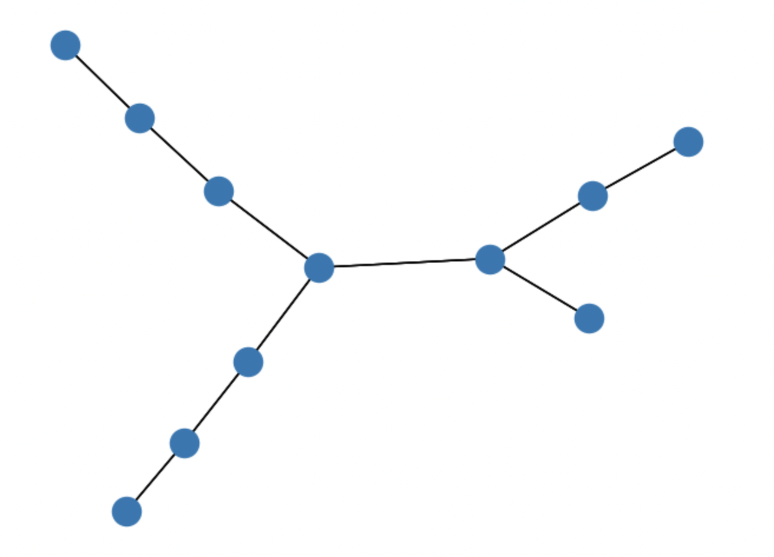
A problem I’m still struggling with
Convert back
and forth
efficiently!
for index, row in chambers.iterrows():
obj = Node(id=row['id’], geometry=row['geometry'])
index = graph.add_node(obj)
graph[index].index = index
rustworkx

Slide 7
They’re not that hard, so
volunteer to give a lightning talk next time!
Ideas:
A cool Python module
An interesting analysis
A brief introduction to a topic
A problem and how I solved it
A problem I’m still struggling with

