Slide 1
“Any fool can write code that a computer can understand. Good programmers write code that humans can understand.”
Martin Fowler, "Refactoring: Improving the Design of Existing Code"
“Programs should be written for people to read, and only incidentally for machines to execute.”
Abelson & Sussman, “Structure and Interpretation of Computer Programs"
“Always code as if the person who ends up maintaining your code is a violent psychopath who knows where you live.”
Anon

Slide 2
Functions
What’s the point?

Slide 3
Functions
Make your code DRY not WET!
DRY Don’t Repeat Yourself
WET We Enjoy Typing
def pythag_distance(x1, y1, x2, y2):
return sqrt((x2 - x1)**2 + (y2 - y1)**2)

Slide 4
Functions
Hide complexity (‘encapsulation’)
Split code sensibly
Make code re-usable across projects
‘Generalisation’
Easier to test

Slide 5
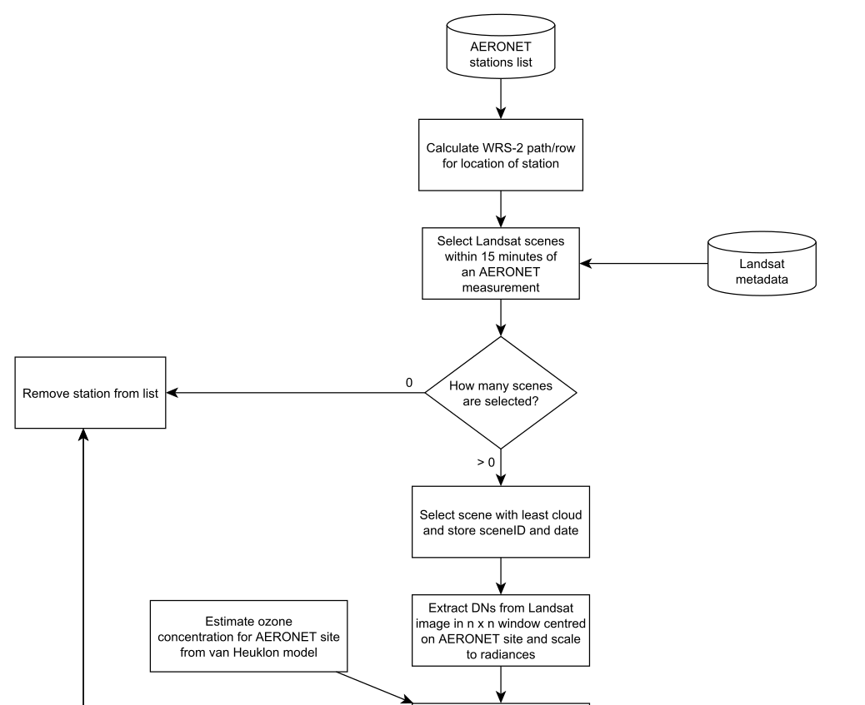

Slide 7
Functions
Create functions that are:
Self-contained (pass/return)
Documented
Generic/Re-usable
No side effects
(Or not…)

Slide 8
Functions – how long?
1 line?
def pythag_distance(x1, y1, x2, y2):
return sqrt((x2 - x1)**2 + (y2 - y1)**2)
1 screen maximum?
1 page maximum?
No fixed rules: be sensible

Slide 9
Variable naming
a,b,c,d,e,f,g,h,i,j,k…
averagevalue
maximum_duration_of_the_dropout
cnt_uniq_locs
number
value
result
temp
ROPE

Slide 10
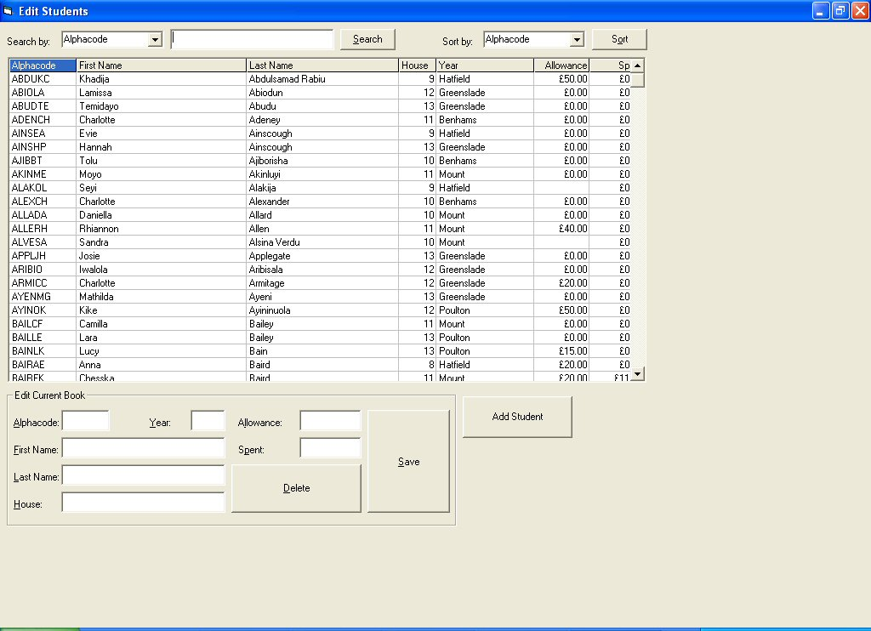

Slide 11
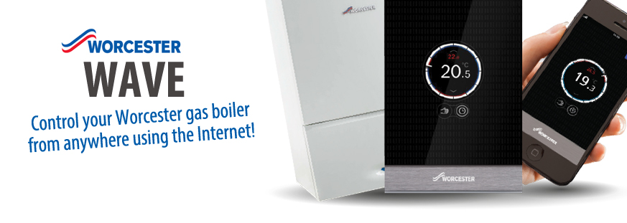
Central Heating control
New software specification:
Runs as a thermostat, keeping the house at a specific temperature
Allow manual control of the heating (on/off)
Allow delayed control (‘turn off in one hour’)

