Slide 1
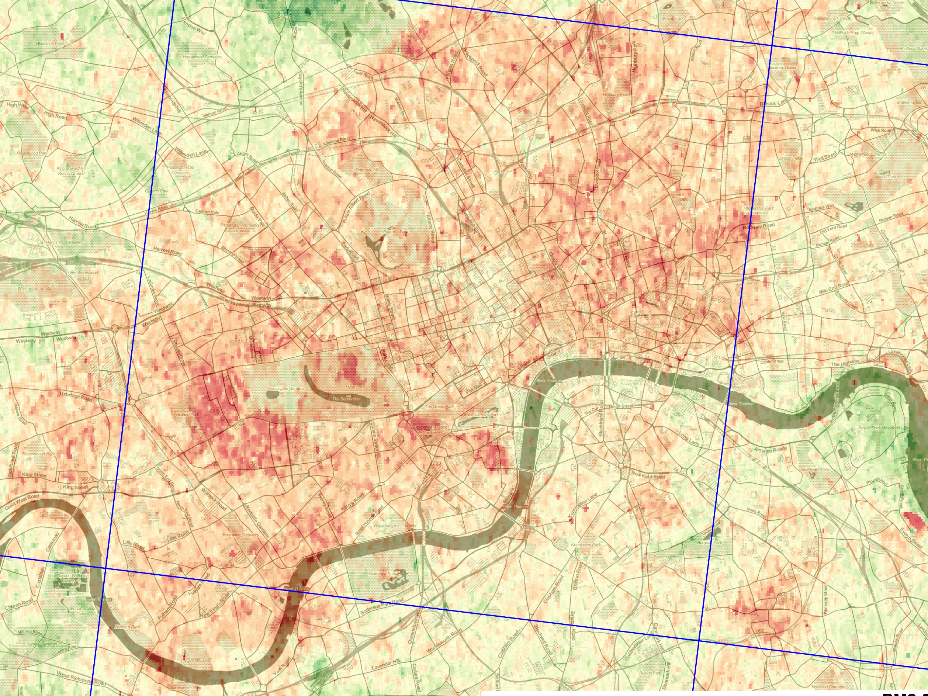
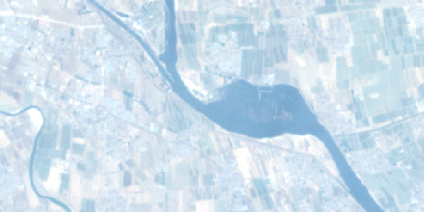
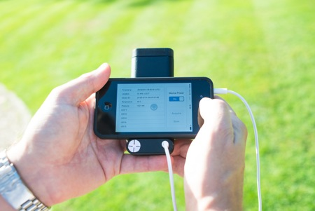
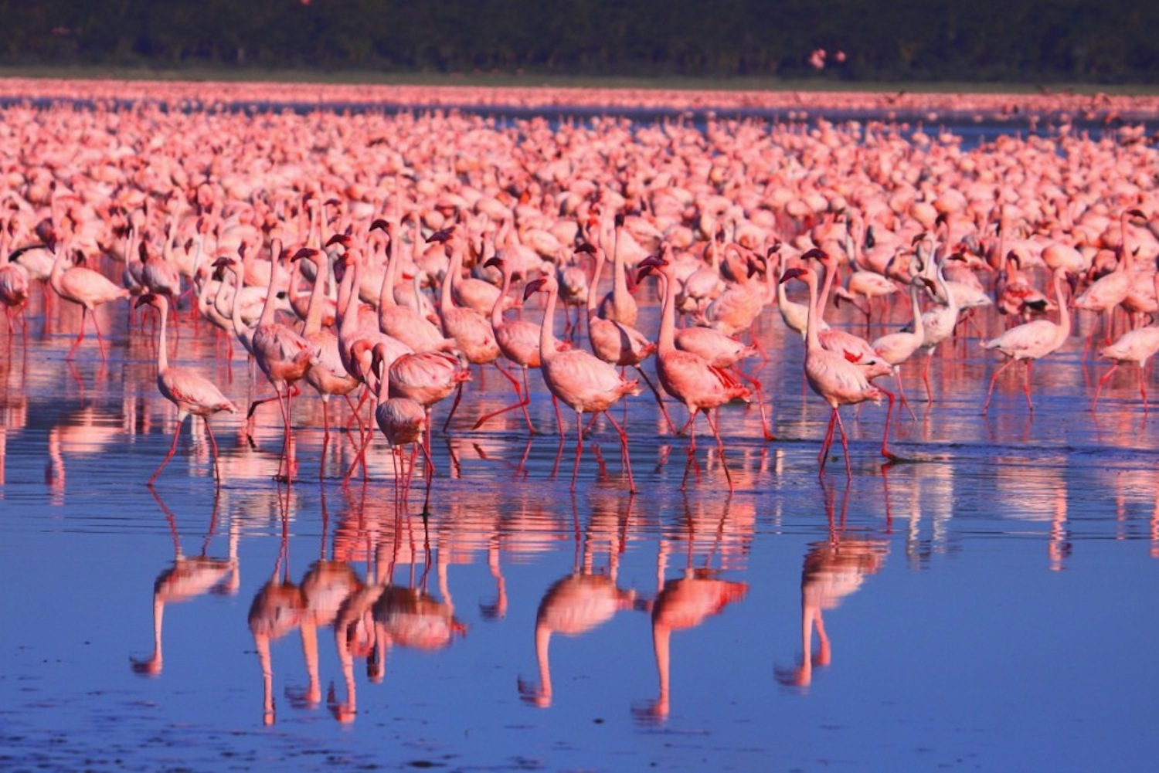
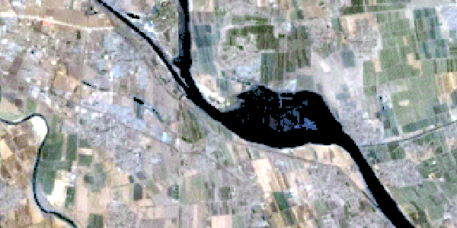
Robin Wilson
Lecturer in Physical Geography
King’s College London

Slide 2

Atmosphere as noise
Atmosphere as signal
Landsat atmospheric correction
Particulate Matter (PM_{2.5}) over London

Slide 3
Atmosphere as noise
Atmosphere as signal
Applied quantitative remote sensing

Slide 4
Answering practical questions about atmospheric correction
Can we use visibility?
Is uniform correction ok?
Build a modelling foundation
A real impact on users

Slide 5
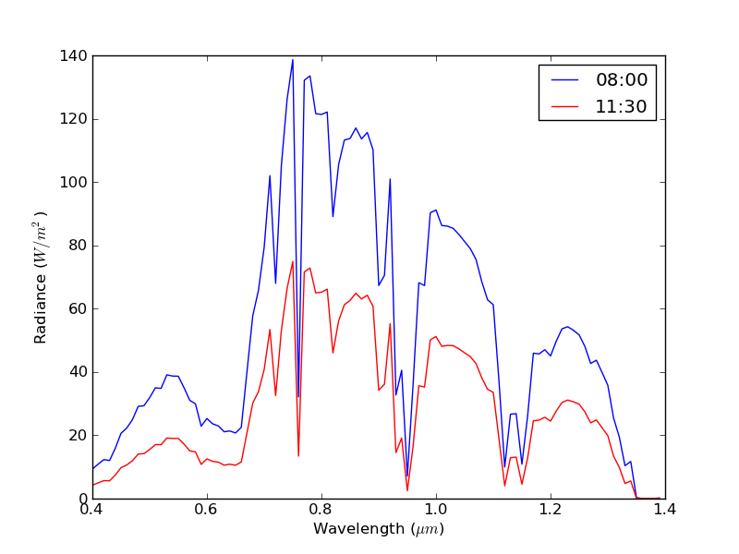
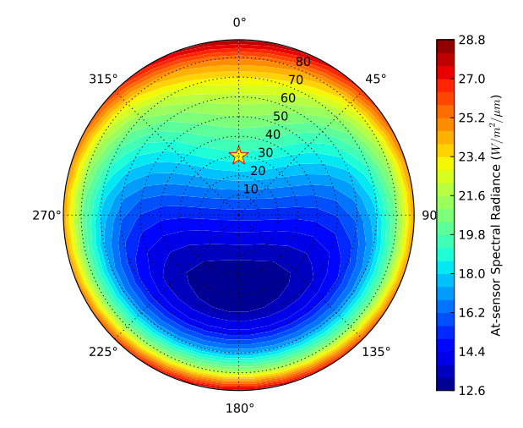
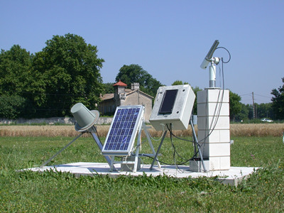
Py6S
Python interface to the 6S Radiative Transfer Model
# Input file
0
40.0 100.0 45.0 50.0 7 23
3.6 0.9
# Py6S code
from Py6S import *
s = SixS()
s.atmosprofile = AtmosProfile.UserWaterAndOzone(3.6, 0.9) s.run()
Wilson (2012), Computers & Geosciences 51

Slide 6

















Py6S users

Slide 7
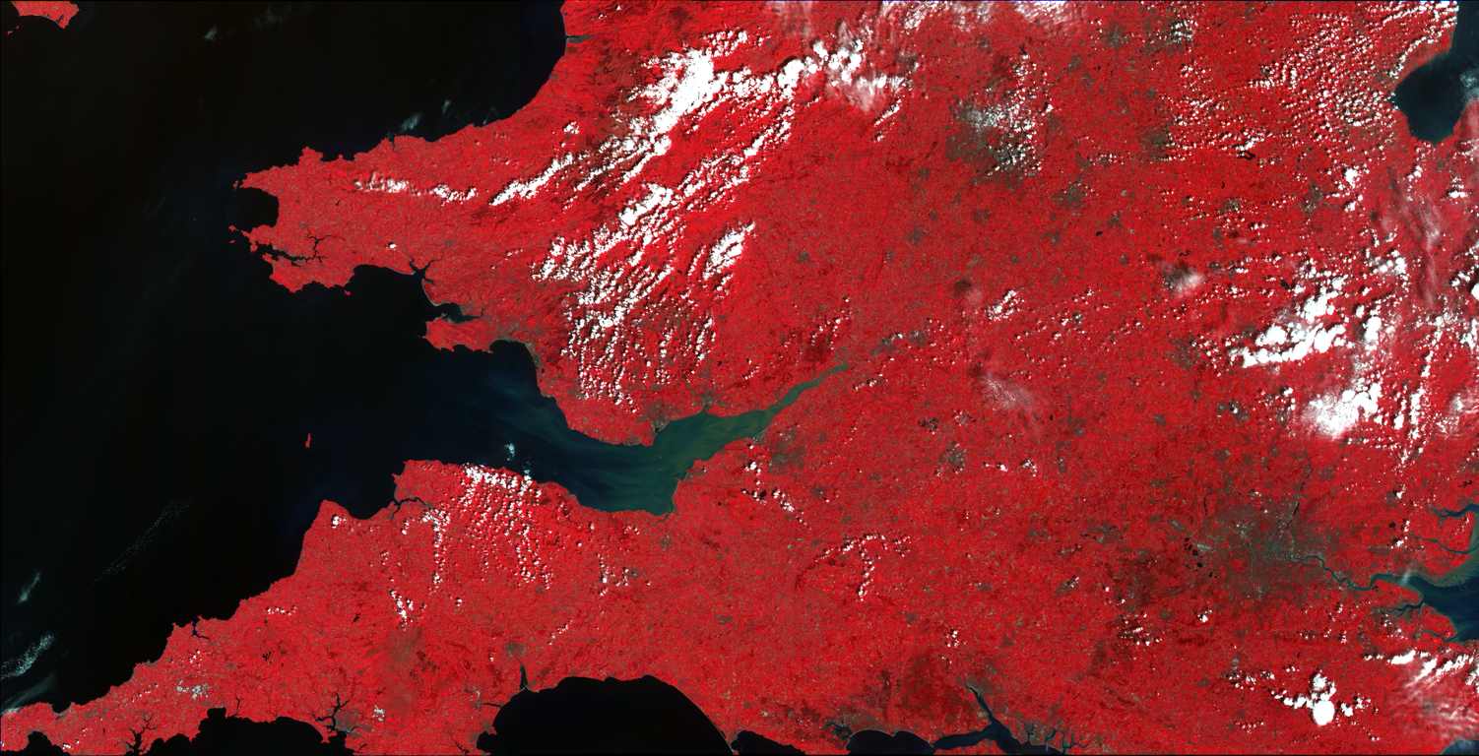
Spatial variability & atmospheric correction
Wilson, Milton & Nield (2014) International Journal of Remote Sensing 35 (13)

Slide 8
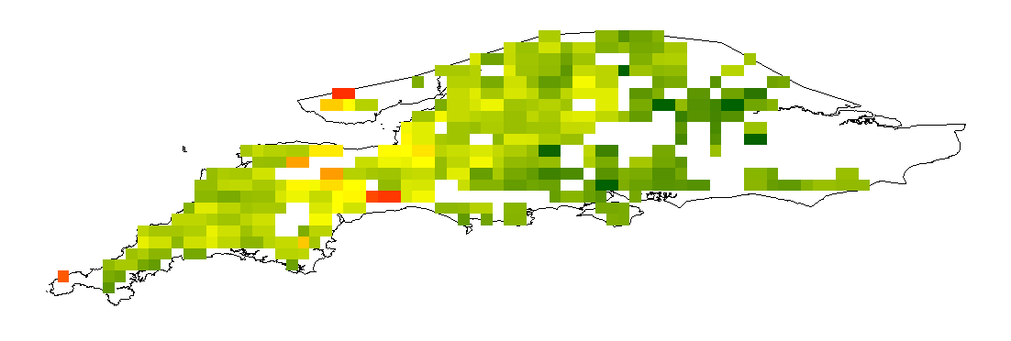
How much do atmospheric properties vary across southern England?
What errors would result from ignoring this variability?
Aerosol Optical Thickness: 0.1–0.5
Precipitable Water Content: 1.5–3.0cm
Wilson, Milton & Nield (2014) International Journal of Remote Sensing 35 (13)

Slide 9
How much do atmospheric properties vary across southern England?
What errors would result from ignoring this variability?
Error
NDVI: Up to 5%
Net Primary Productivity: Up to 12.3Mt C
Significant error
Don’t use uniform correction!
Wilson, Milton & Nield (2014) International Journal of Remote Sensing 35 (13)

Slide 10
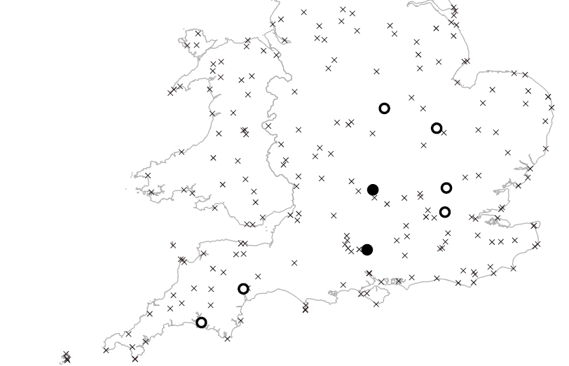
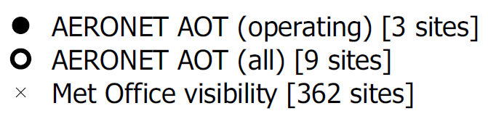
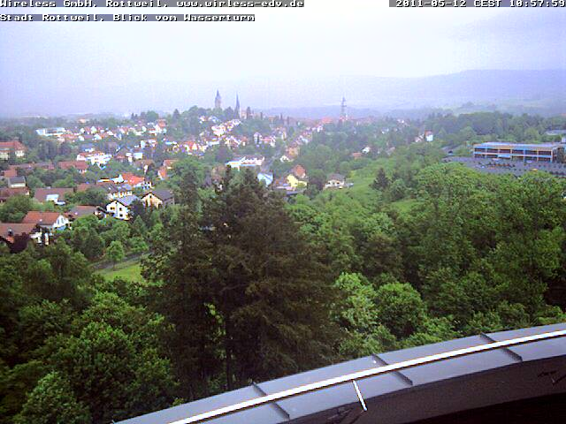
Is visibility-derived AOT ok to use?
Wilson, Milton & Nield (2015) International Journal of Remote Sensing 36 (6)

Slide 11

Is visibility-derived AOT ok to use?
AOT errors of up to 70%
Errors far higher than other AOT estimation methods
Don’t use unless you have no other options!
Wilson, Milton & Nield (2015) International Journal of Remote Sensing 36 (6)

Slide 12
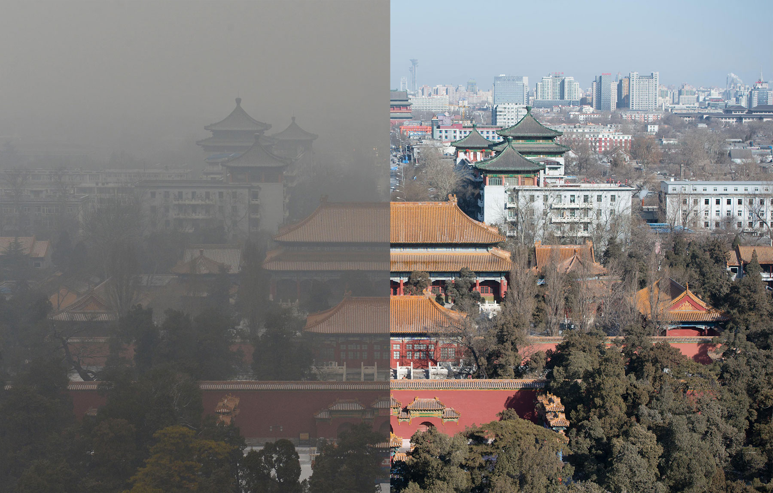
3.2m deaths per year

Slide 13
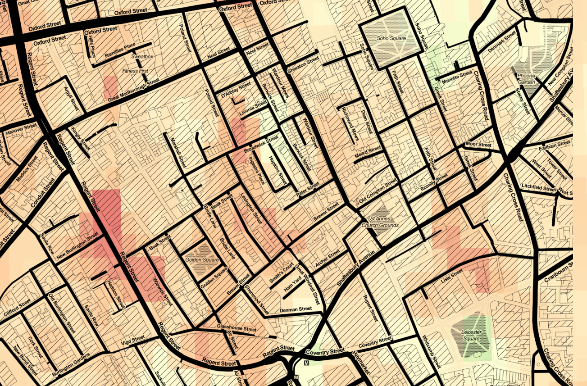
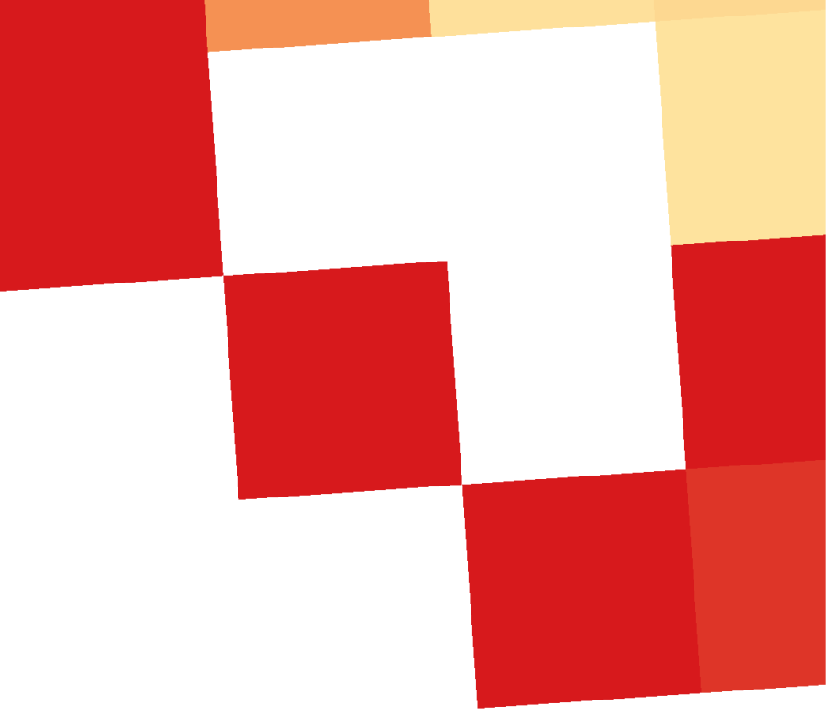

MODIS
HOTBAR
Wilson (2015), PhD thesis
HOTBAR: 30m air quality

Slide 14
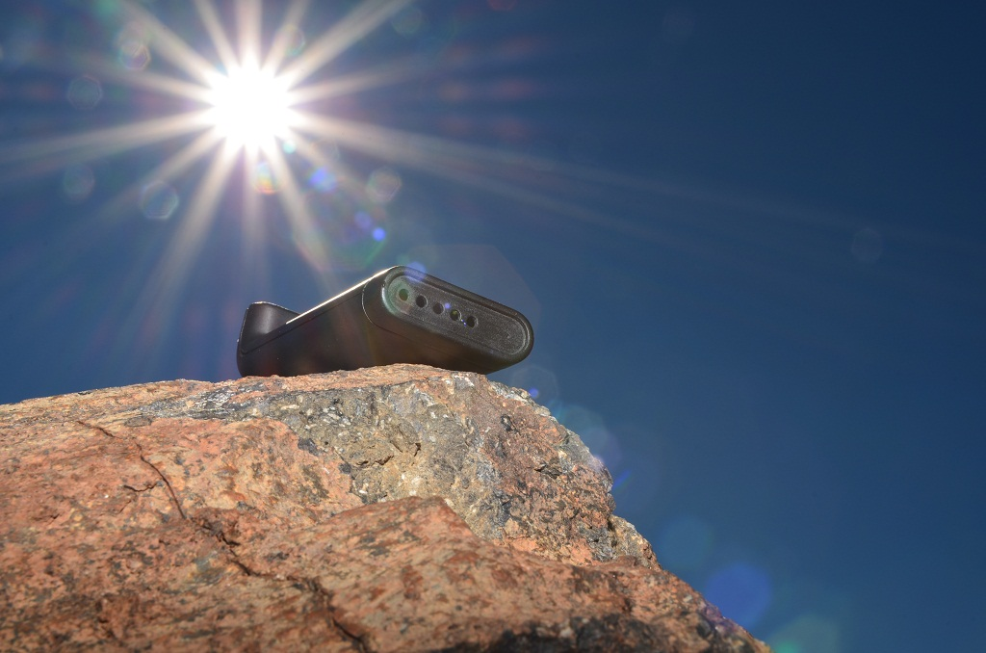

SkySci instrument
Wilson (2015), PhD thesis

Slide 15
Teaching
“Robin is already a confident and effective lecturer… an excellent session in every respect”
Teaching observation, 2014
“Excellent one-to-one support in the practical class”
Teaching observation, 2013

Slide 16
I already have experience of:
Lecturing
Small group & seminar work
Practical classes (lab & computer)
Supervising students (undergraduate, MSc, Post-Doc)
Fieldwork
Individual tutoring
1st year through to PhD and beyond

Slide 17
In three years’ time I will be:
a Fellow of the Higher Education Academy (PGCAP-certified)
supervising undergraduate, MSc and PhD students
convening a new 3rd year/MSc module: Atmospheric Remote Sensing or Programming for GIS/RS

Slide 18
In three years’ time I will have:
expanded remote-sensing in fieldtrip work
expanded basic programming & modelling in remote sensing courses
excited and engaged students in Remote Sensing at all levels

Slide 19
Research
“I believe Robin is on the threshold of a career of national and international significance”
Neil Chu Hong, Director, Software Sustainability Institute
“Py6S, and Robin’s support, enabled key research which would otherwise have been impossible”
Py6S user, via mailing list

Slide 20
In three years’ time I will have:
produced world-leading research in:
  Atmospheric correction
  Satellite estimation of air quality
  Practical, applied remote sensing
published highly-cited papers → REF
received funding from national/ international bodies

Slide 21
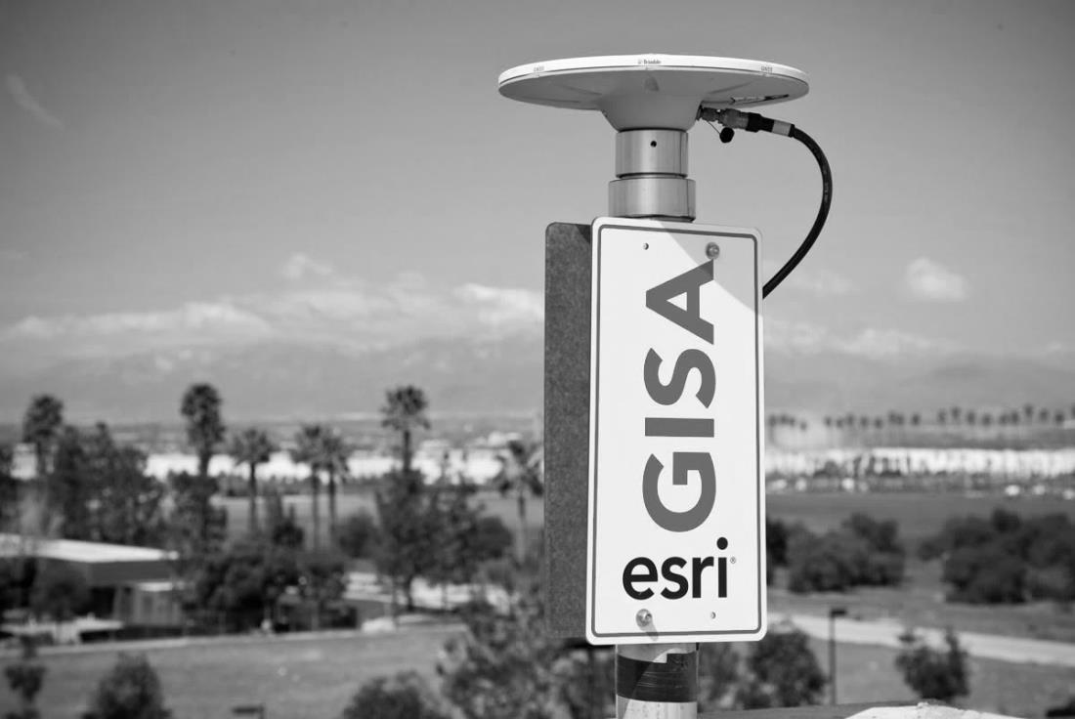
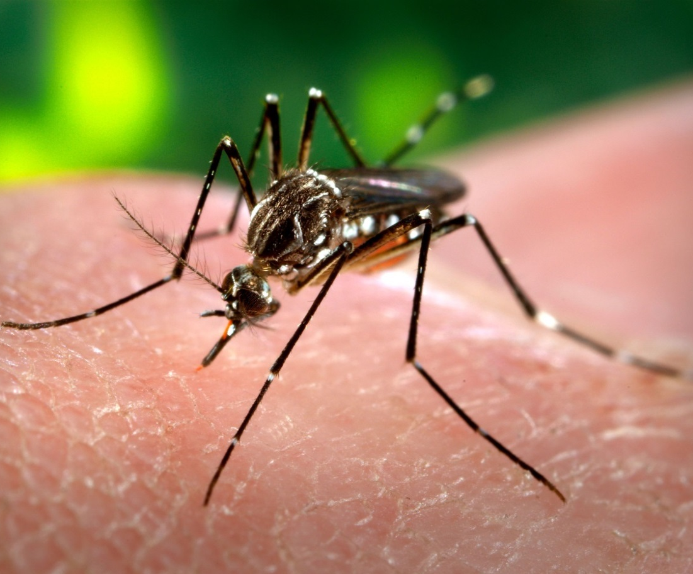
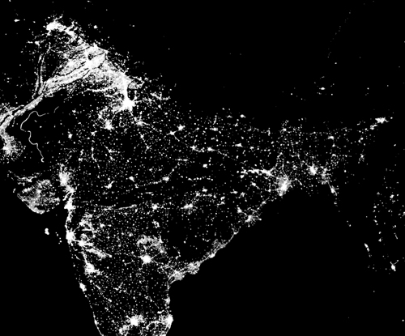
SkySci
GPS
Water
Vapour
Atmos Meas Tech 2015
Atmos Meas Tech 2015
Nighttime lights
& ‘urbanicity’
GPS for Dengue
Fever
PLoS ONE 2015
Int J of Health Geographics 2015

Slide 22
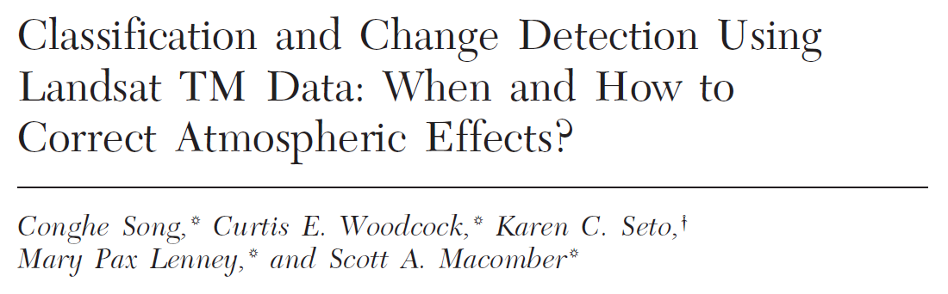
Vision: Atmospheric correction for the modern era
What is the spatial scale of AOT?
Can we link HOTBAR in to automated atmospheric correction?
How accurately do we need to parameterise RTMs?
Is this right in the modern world?

Slide 23



Slide 24

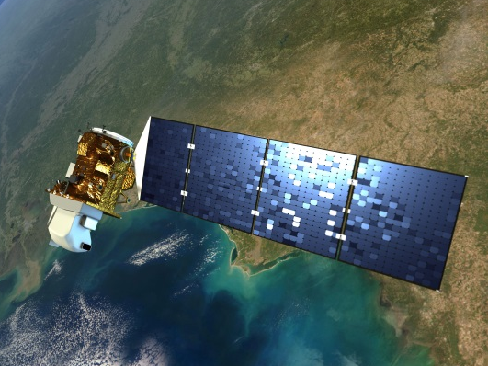
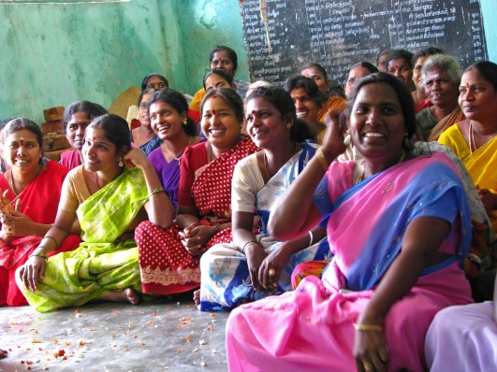
Vision: Accurate high spatial & temporal resolution air quality measurements
Combining satellites & models
Novel validation with SkySci,
citizen science and models
Application in LMICs, and with TfL & King’s ERG

Slide 25





+
ERG
EuNetAir

Slide 26
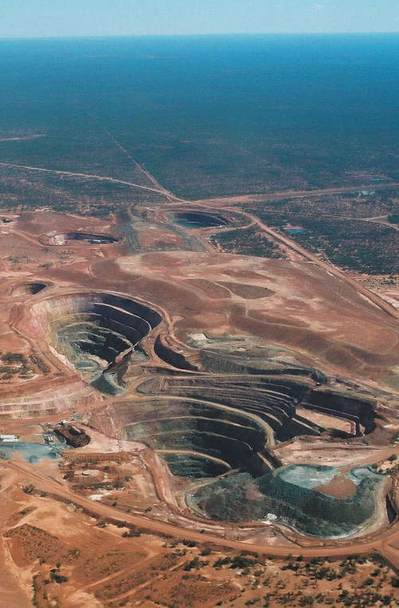



Slide 27
?

Slide 28


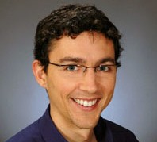

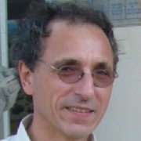
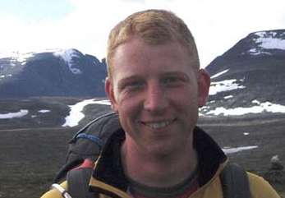

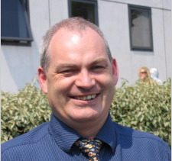
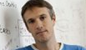
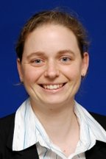
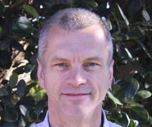
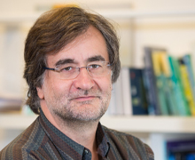

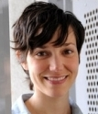
Thank you to my
collaborators

