Slide 1
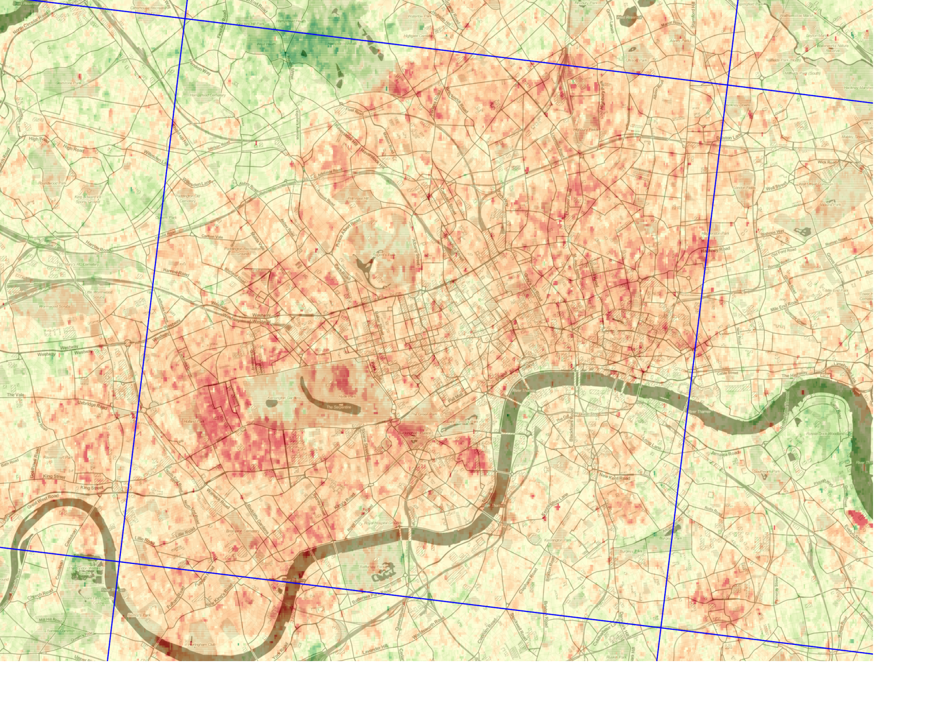
Satellite-based monitoring of particulate matter pollution at very high resolution: the HOTBAR method Robin Wilson, Edward Milton & Joanna Nield
r.t.wilson@soton.ac.uk @sciremotesense

Slide 2
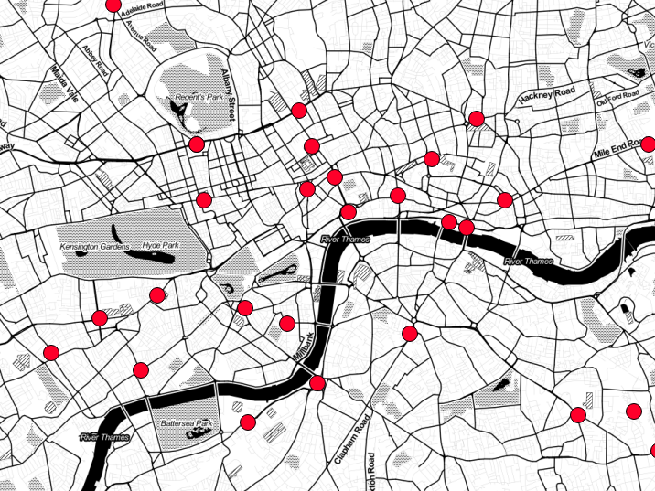
Ground monitoring is not detailed enough

Slide 3
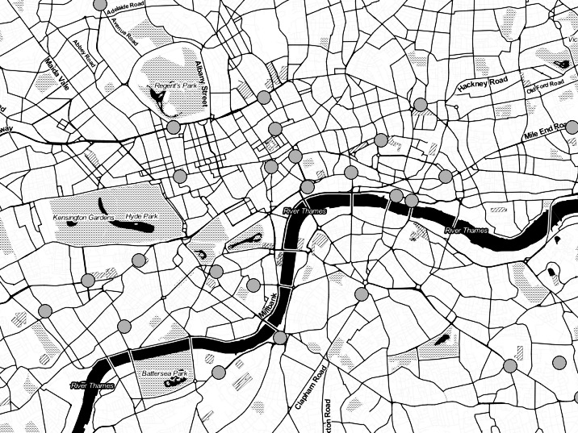
“Health exposure needs tend to focus on spatial scales ranging from 1 to 100m ...neither surface monitoring or satellite measurements can deal with that spatial scale”
Hoff & Christopher (2009)

Slide 4
“Health exposure needs tend to focus on spatial scales ranging from 1 to 100m ...neither surface monitoring or satellite measurements can deal with that spatial scale”
Hoff & Christopher (2009)
And… Martin (2008), Gupta et al. (2006), Loughner et al. (2007)…
We need high-res data!

Slide 5
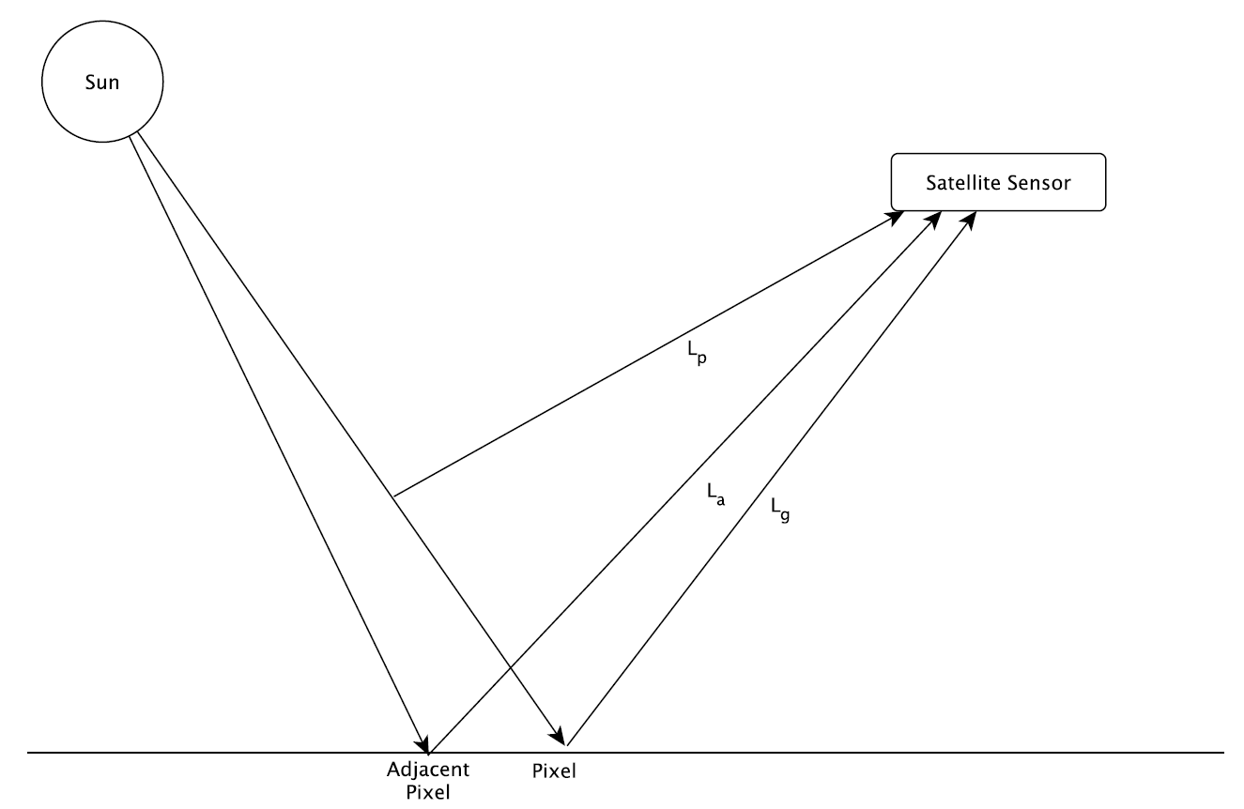
Radiative Transfer
But, we measure the sum!
Path Radiance
Aerosols cause scattering
Ground Radiance
Adjacent Radiance

Slide 6
Radiative Transfer
But, we measure the sum!
Path Radiance
Aerosols cause scattering
Ground Radiance
How do we separate these?
Polarisation, Multi-temporal, Multi-angle…
Adjacent Radiance

Slide 7
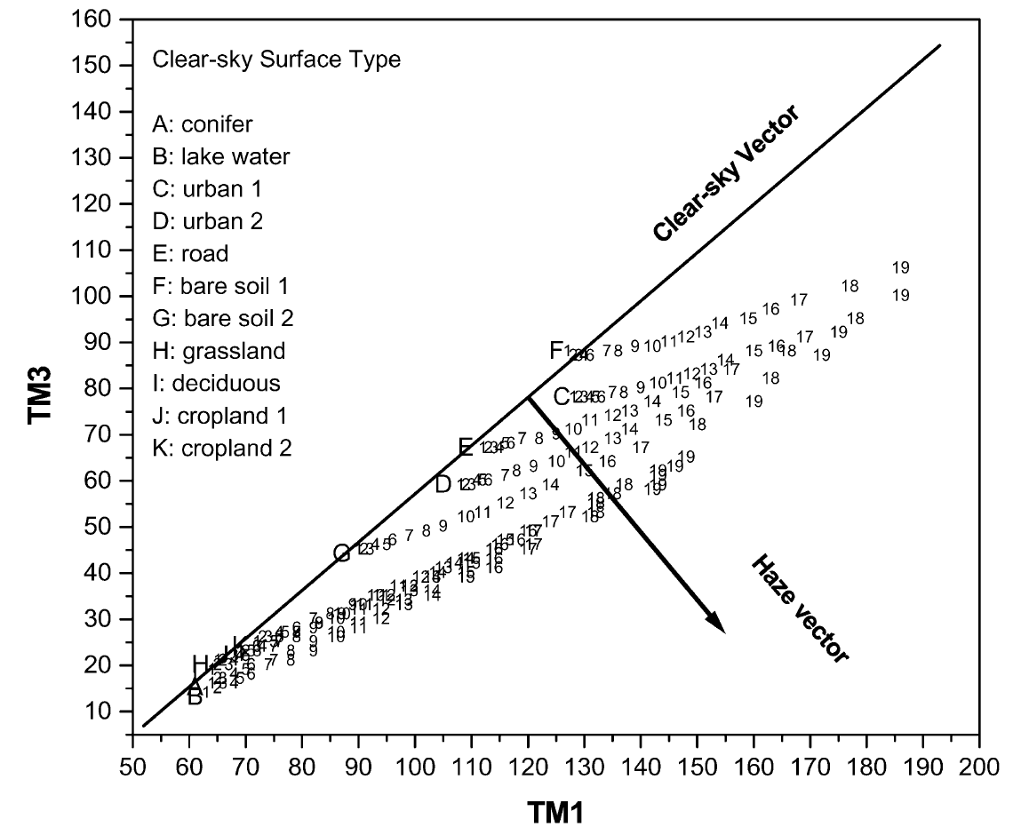
Haze Optimized Transform (HOT)
Distance ∝
Haze
Red
Haze =
Aerosols
Blue
Zhang et al. (2002)

Slide 8
HOTBAR
Haze Optimised Transform based Aerosol Retrieval
Input: Landsat image
Estimate the Clear Line
Correct for land-cover effects
Link HOT values to AOT
Estimate PM_{2.5} concentrations
Output: PM_{2.5} image

Slide 9
HOT to PM_{2.5}
Start with a Landsat image
Estimate the Clear Line
Correct for land-cover effects
Link HOT values to AOT
Estimate PM_{2.5} concentrations
HOTBAR
Haze Optimised Transform based Aerosol Retrieval

Slide 10
Estimating the Clear Line
The HOT set the Clear Line from a regression of a clear part of the image
BUT aerosols are everywhere!
We need Clear Pixels
Created the LandsatAERONET dataset:
Thousands of very accurately atmospherically-corrected pixels
Range of land covers
Easy to model any sort of atmospheric conditions

Slide 11
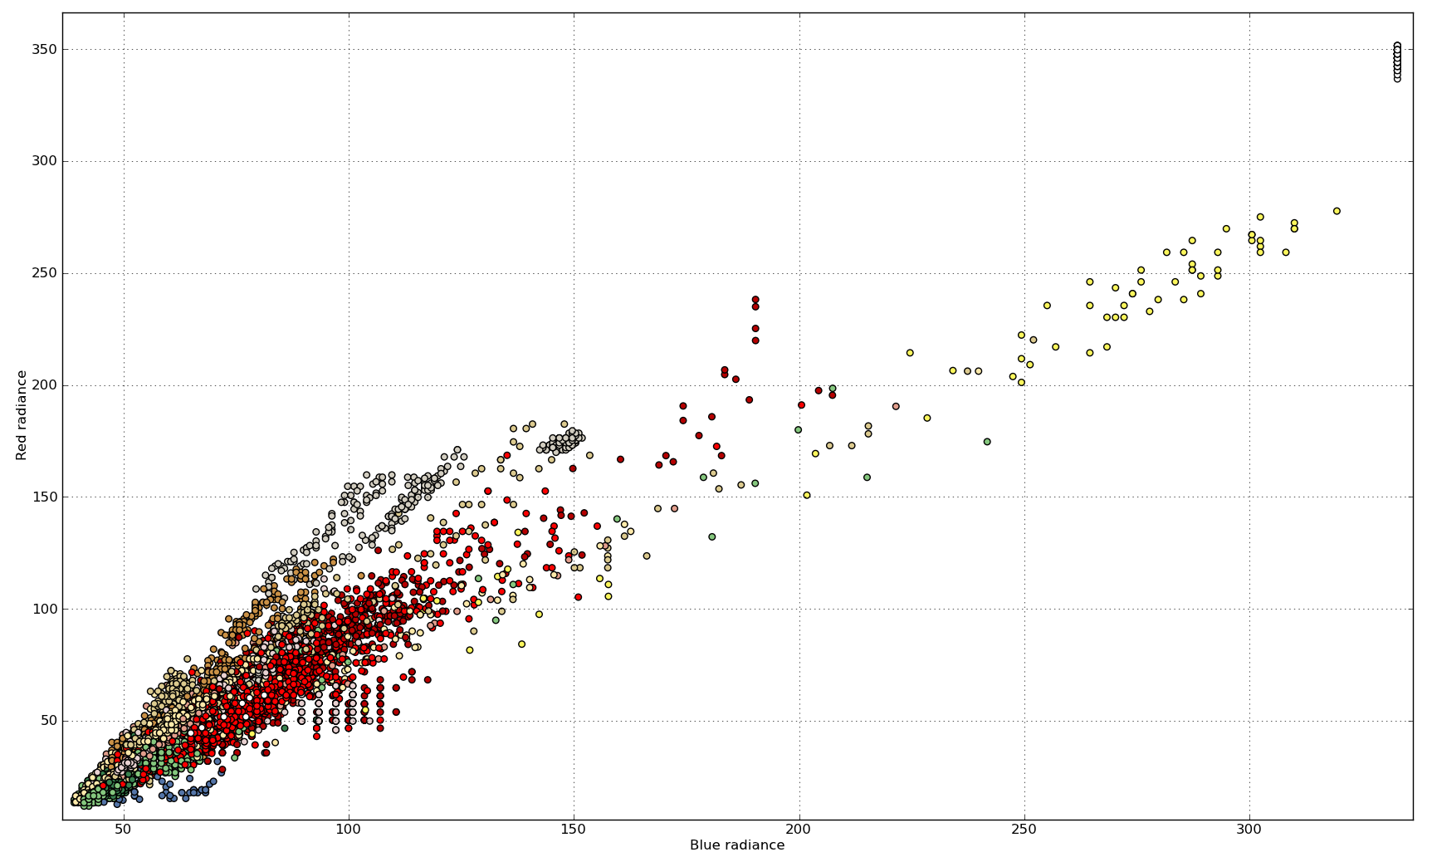

Slide 12
Monte Carlo Regression
Clear Line depends on land cover
So, get land cover proportions (from a global land cover map like GlobCover)
Estimate Clear Line with a Monte Carlo Regression process

Slide 13
Correcting for Land Cover effects

Slide 14
Correcting for Land Cover effects
The HOT is not Land Cover invariant
We need to correct for this – how?
Aerosols mix in the atmosphere
→ no sharp boundaries
Land covers often have sharp boundaries
Look for sharp boundaries, correct the pixel values inside these ‘objects’
→ Object-based Image Analysis

Slide 15
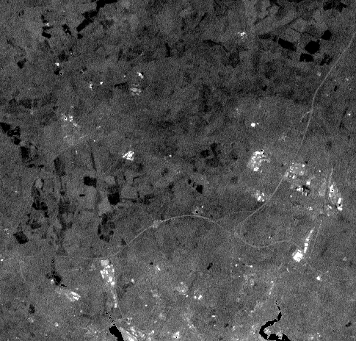
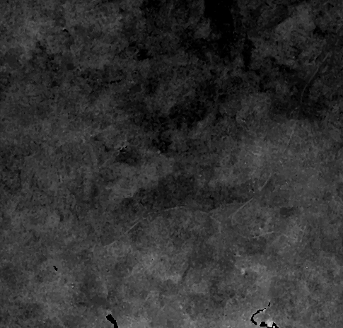
TODO: Update these images!
Original
Corrected

Slide 16
Link HOT to Aerosol Optical Thickness
LandsatAERONET sample
Simulate with AOT
Monte Carlo simulations using Py6S

Slide 17
Link HOT to Aerosol Optical Thickness
Calculate HOT and link with AOT

Slide 18
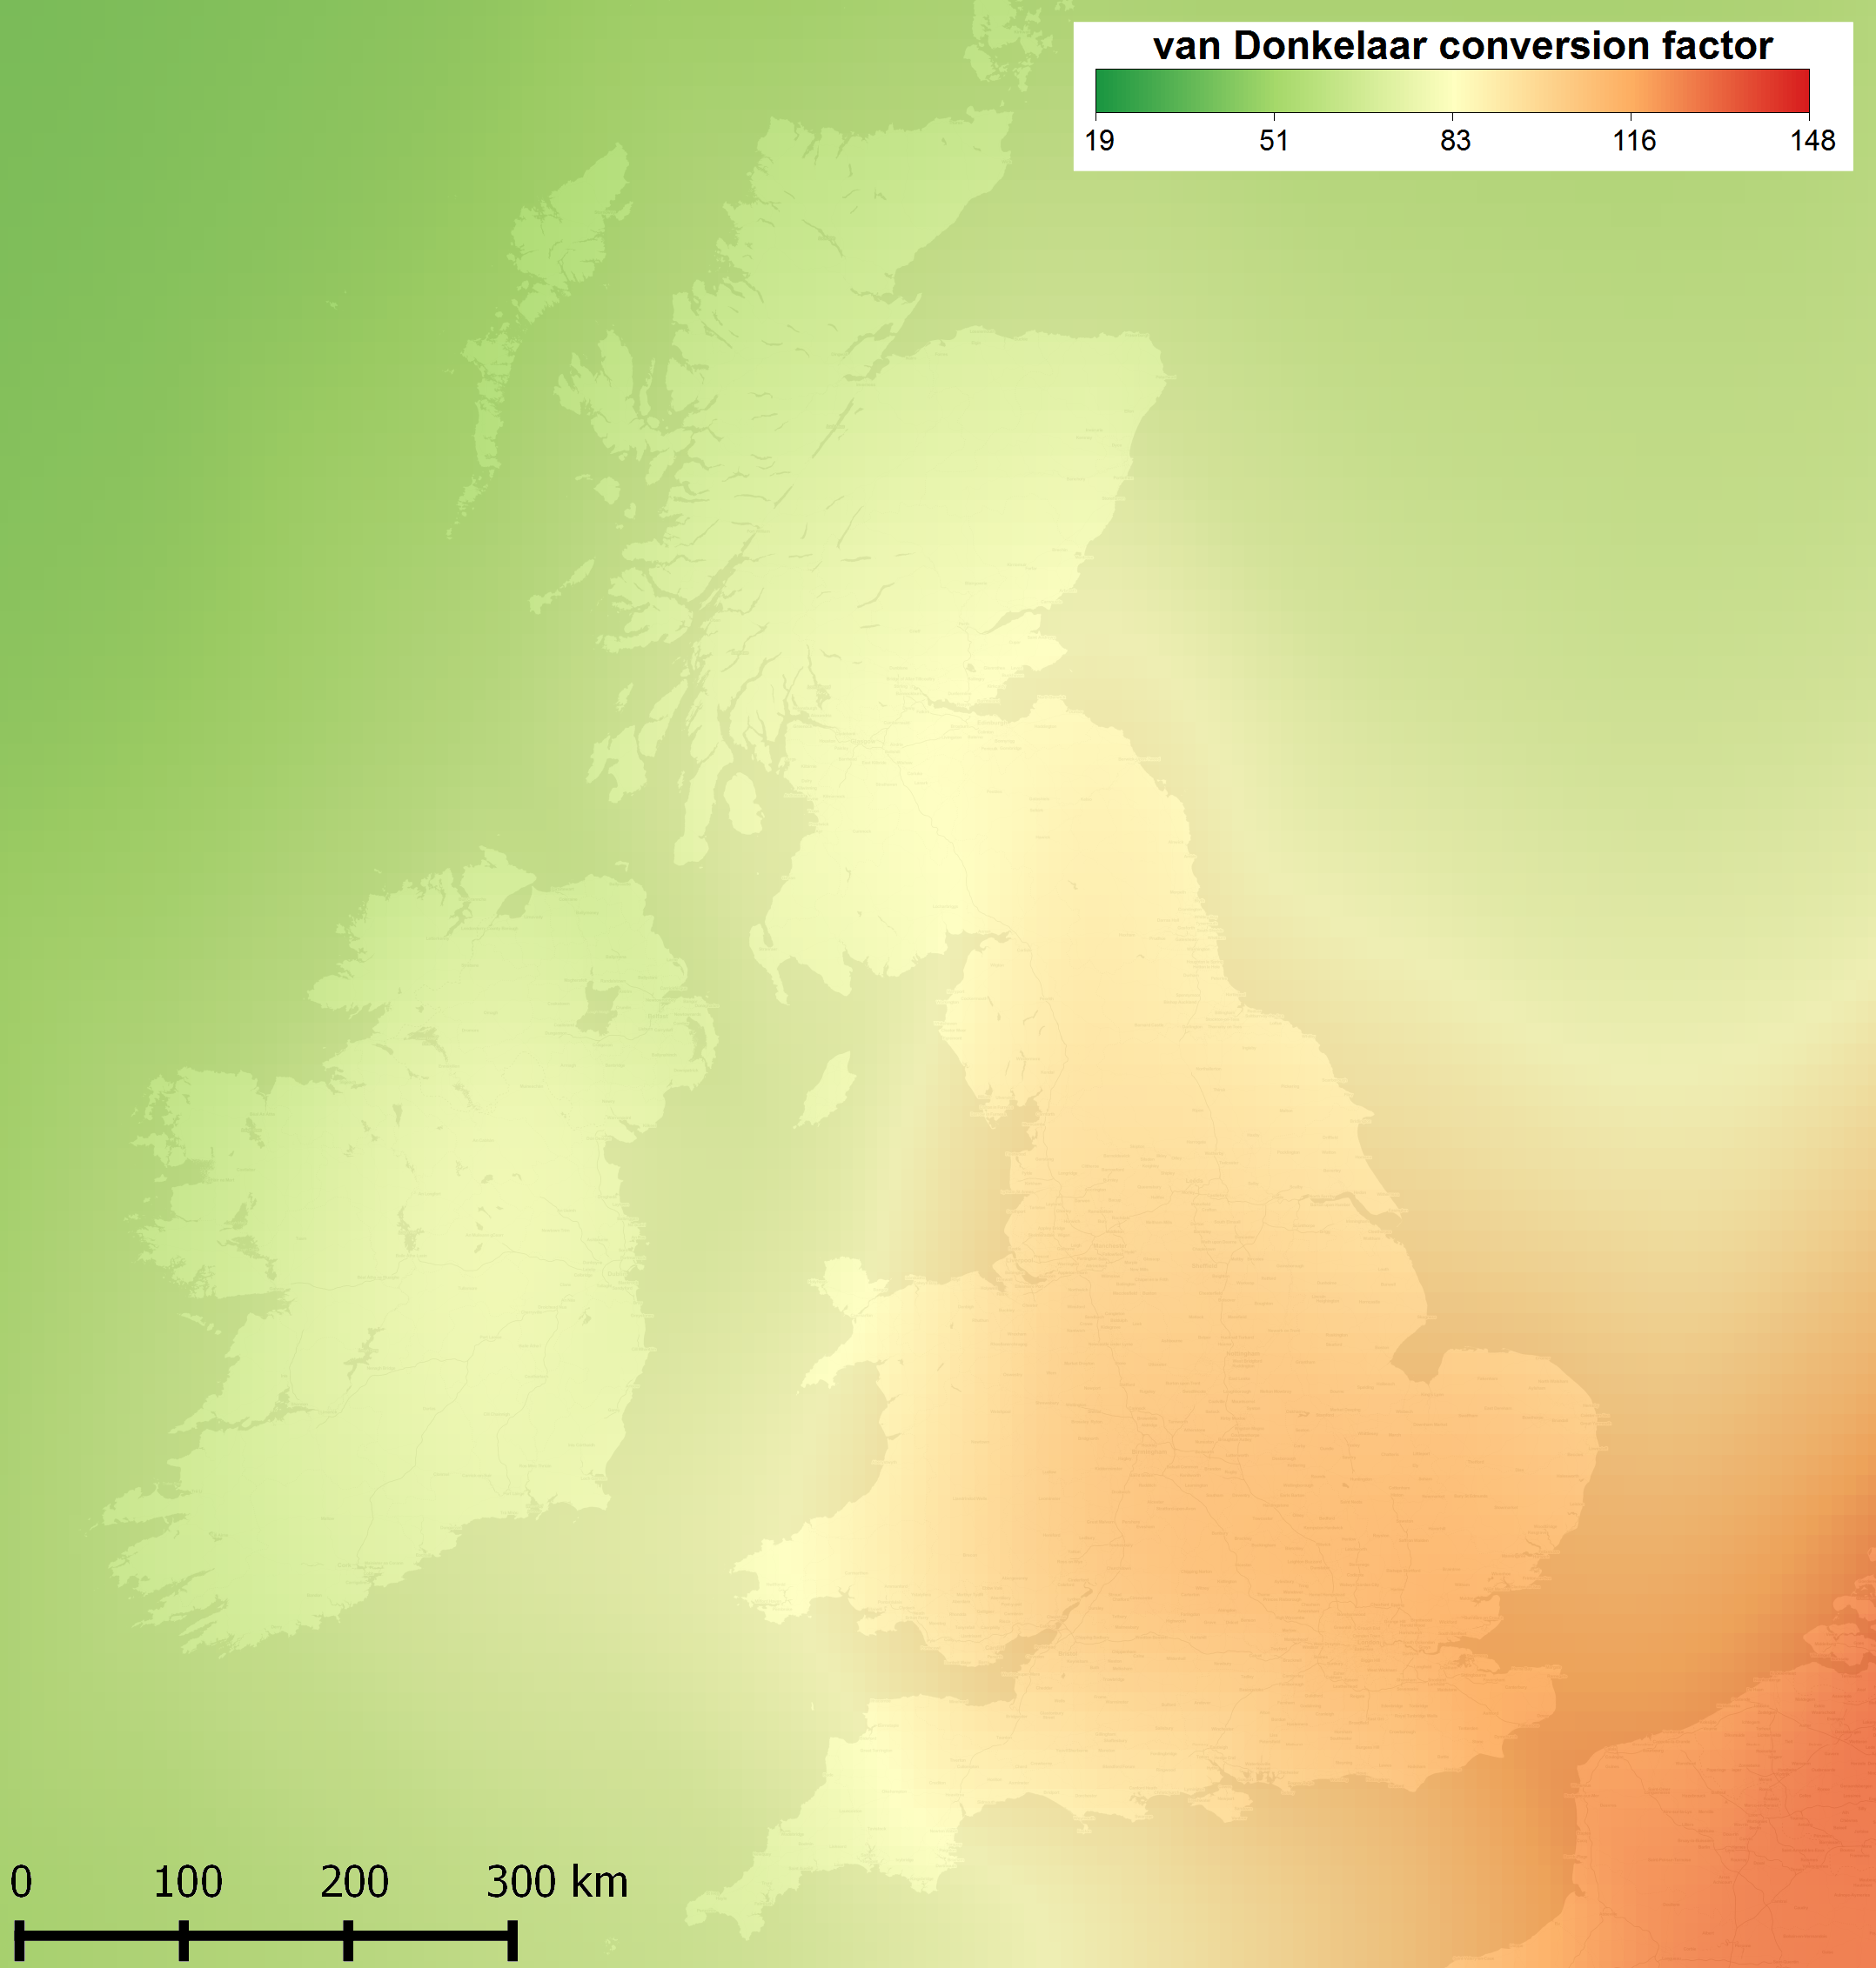
Estimate PM_{2.5} from AOT
Use conversion factors:
From global simulations
Monthly climatology
from van Donkelaar et al. (2010)

Slide 19
MODIS (10km)

Slide 20
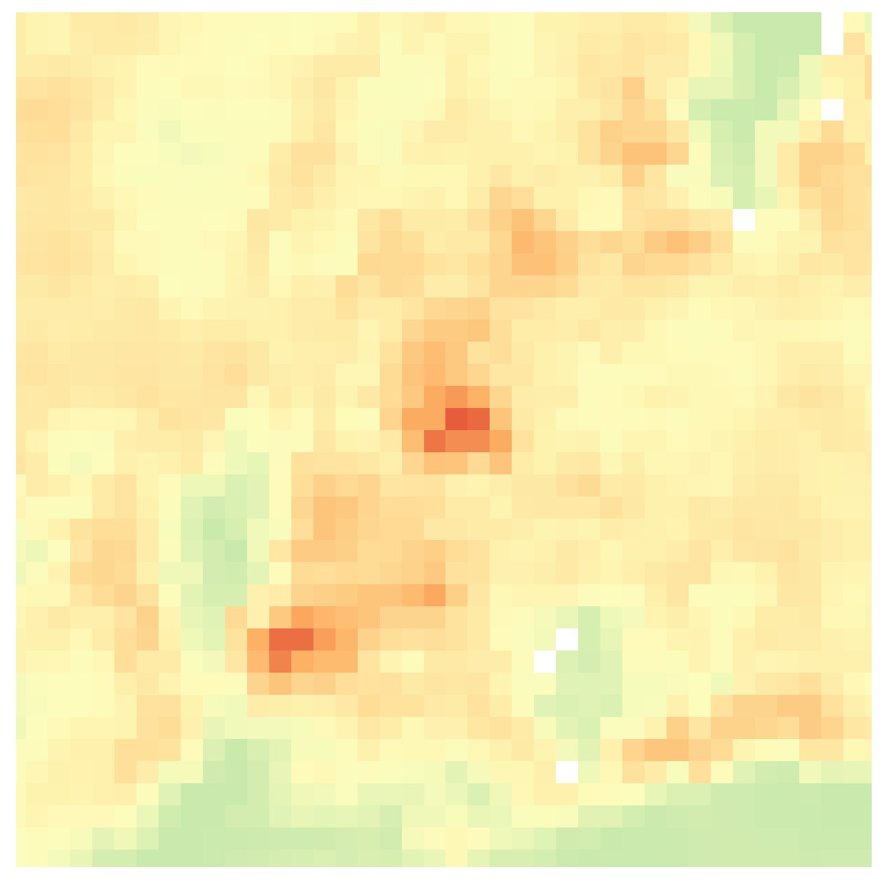
MAIAC (1km)

Slide 21
HOTBAR (30m)

Slide 22
Validation shows robust performance
PM_{2.5} (median error)
HOTBAR vs ground sites 6.0μg m⁻³
Ground instrument (for comparison) 2.5μg m⁻³
Global 10km analysis (van Donkelaar, 2010) 6.7μg m⁻³
AOT Validation
Error comparable to other methods, but at 100,000 times the resolution of MODIS 10km
MODIS 10km data: 60% within ± 0.13
OMI 15km data: RMSE = 0.15

Slide 23
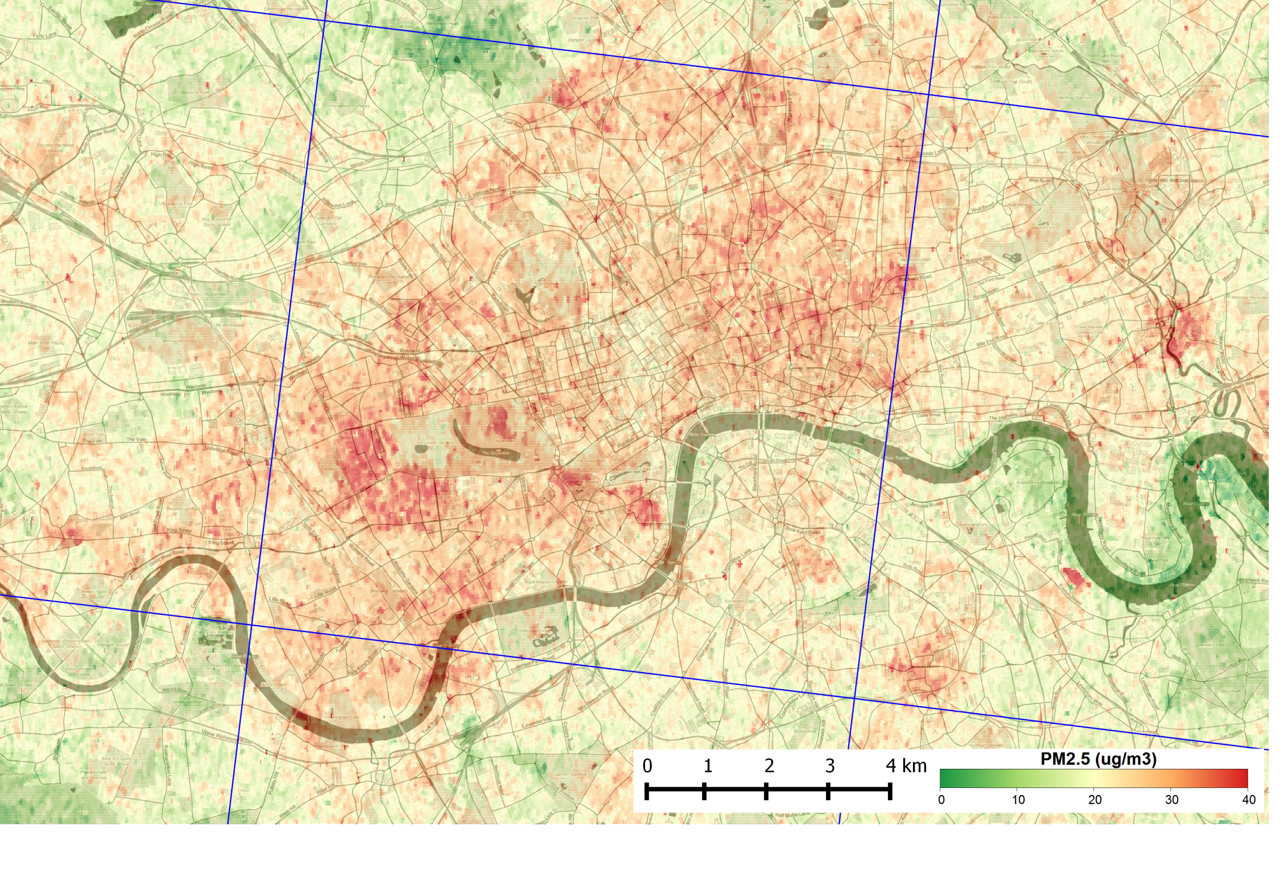

Slide 24
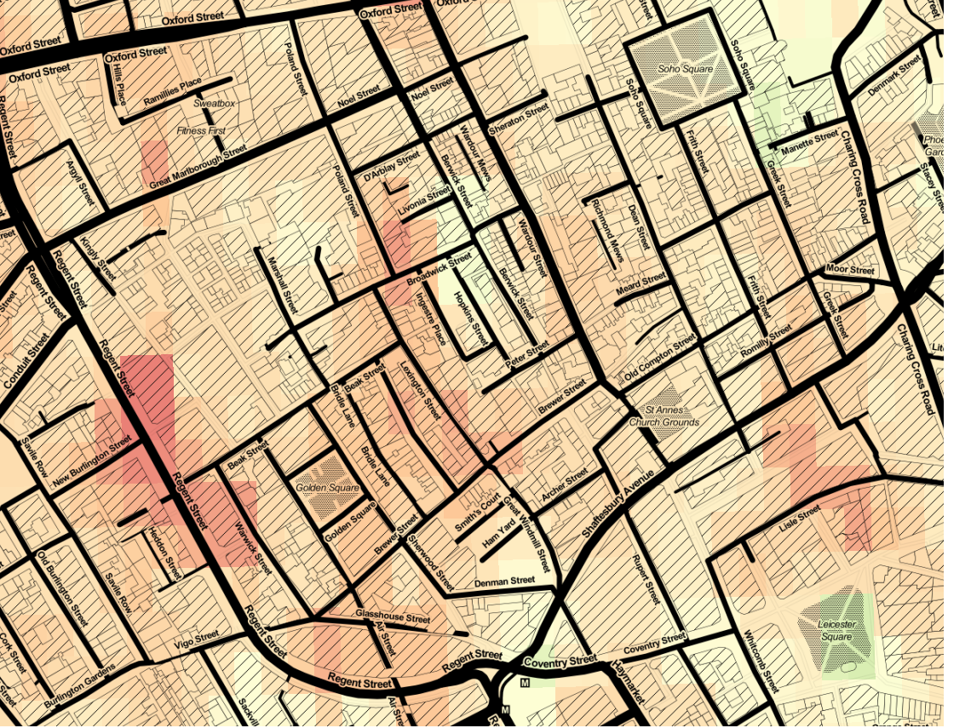

Slide 25
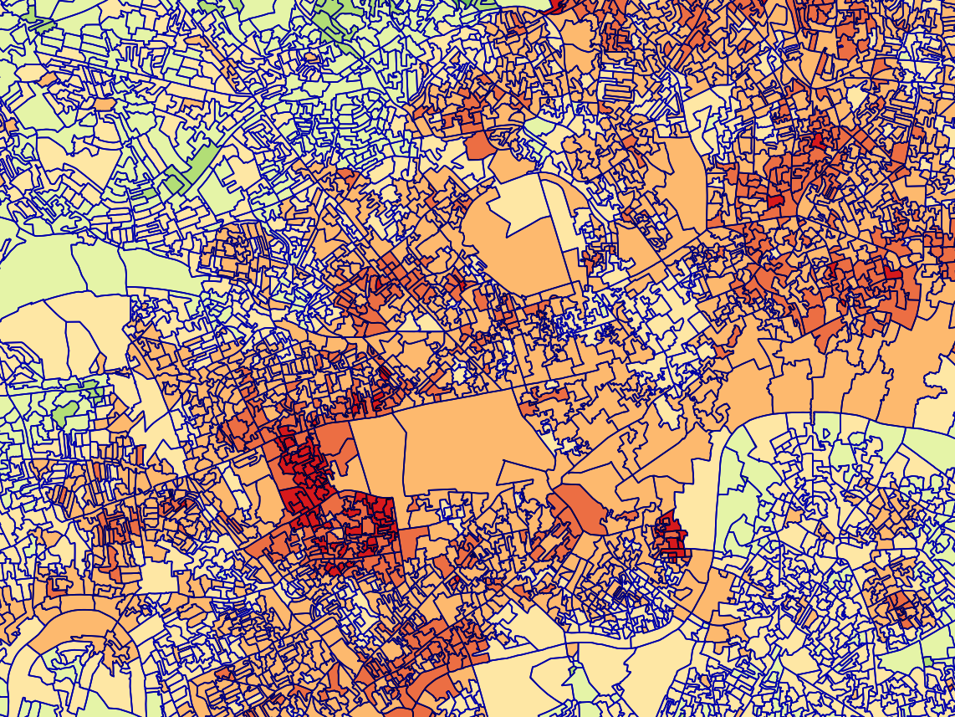
Census output areas
to link with health data

Slide 26
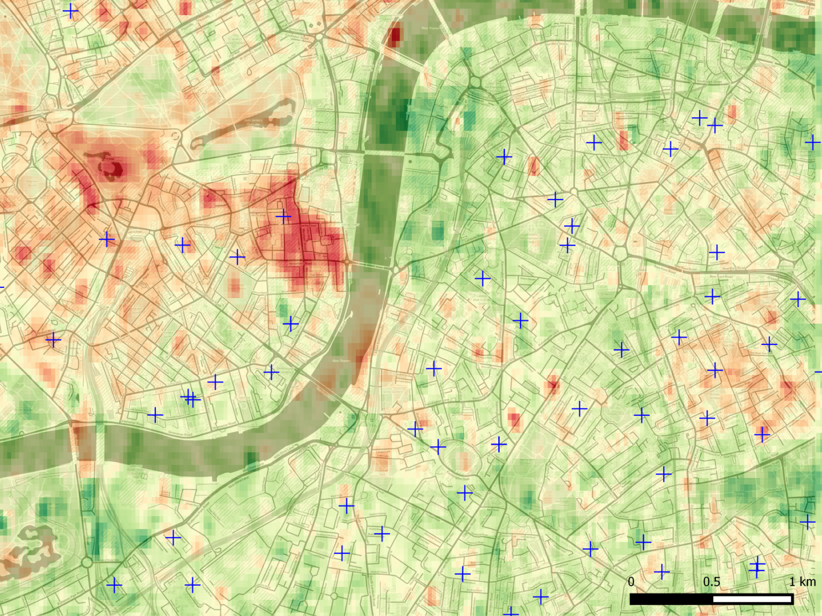
Schools
to estimate exposure around sites with vulnerable people

Slide 27
Ongoing work
Ongoing production of a global product, in association with
Includes extension to Landsat 8 & operationalisation
Applications
PM_{2.5} mapping for exposure estimation
Linking to health data
Combining ground data & other satellite data to get ‘the best of all worlds’

Slide 28
Any questions?
r.t.wilson@soton.ac.uk @sciremotesense

