Slide 1
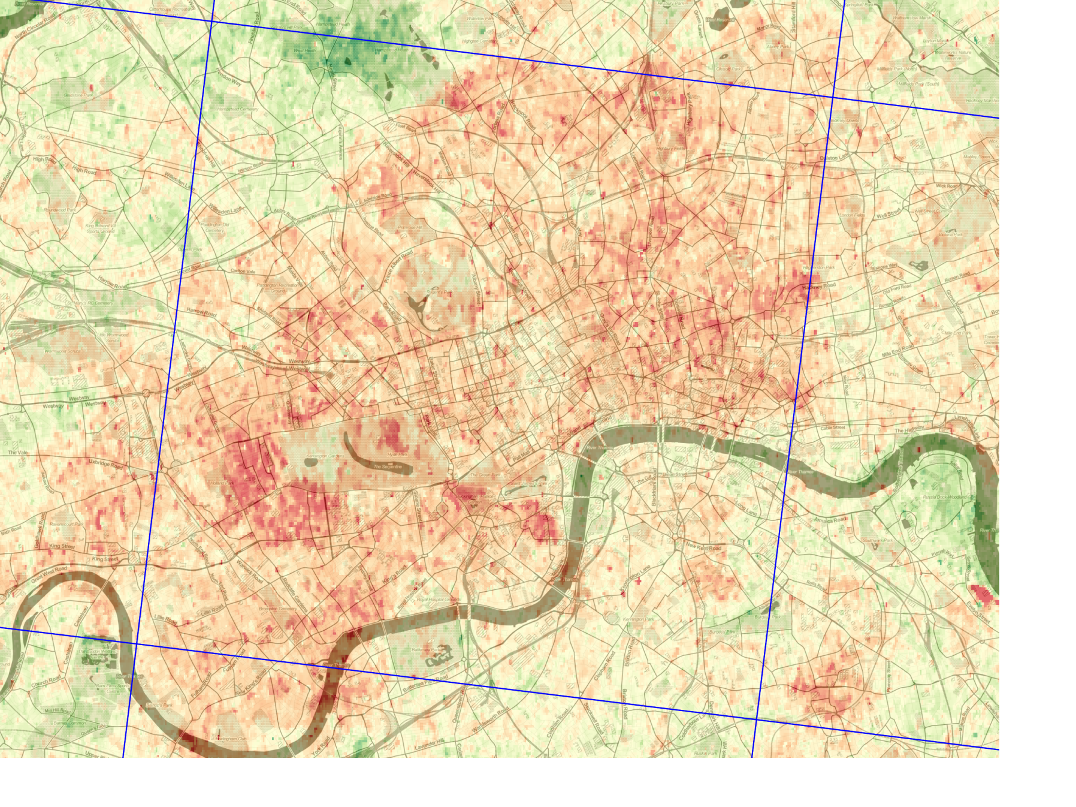



A novel method to retrieve AOT from high-resolution optical satellite images using an extended version of the Haze Optimized Transform
Robin Wilson, Edward Milton & Joanna Nield
r.t.wilson@soton.ac.uk @sciremotesense

Slide 2
MODIS
10km
MAIAC
1km

Slide 3
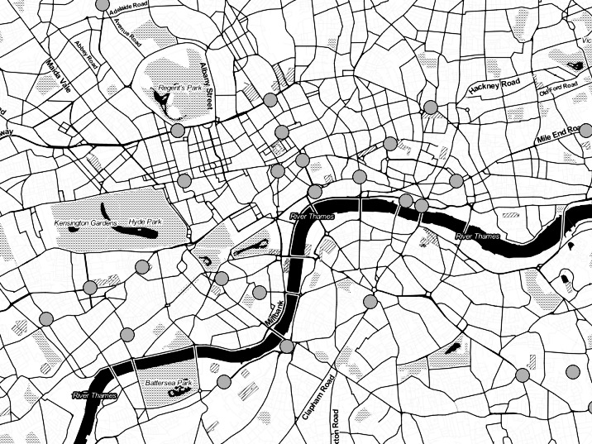
PM_{2.5}
“Health exposure needs tend to focus on spatial scales ranging from 1 to 100m ...neither surface monitoring or satellite measurements can deal with that spatial scale”
Hoff & Christopher (2009)
Atmospheric correction
“…an AOT range of 0.1-0.5 over southern England on a clear day…not captured by low-resolution satellite data”
Wilson et al. (2014)

Slide 4
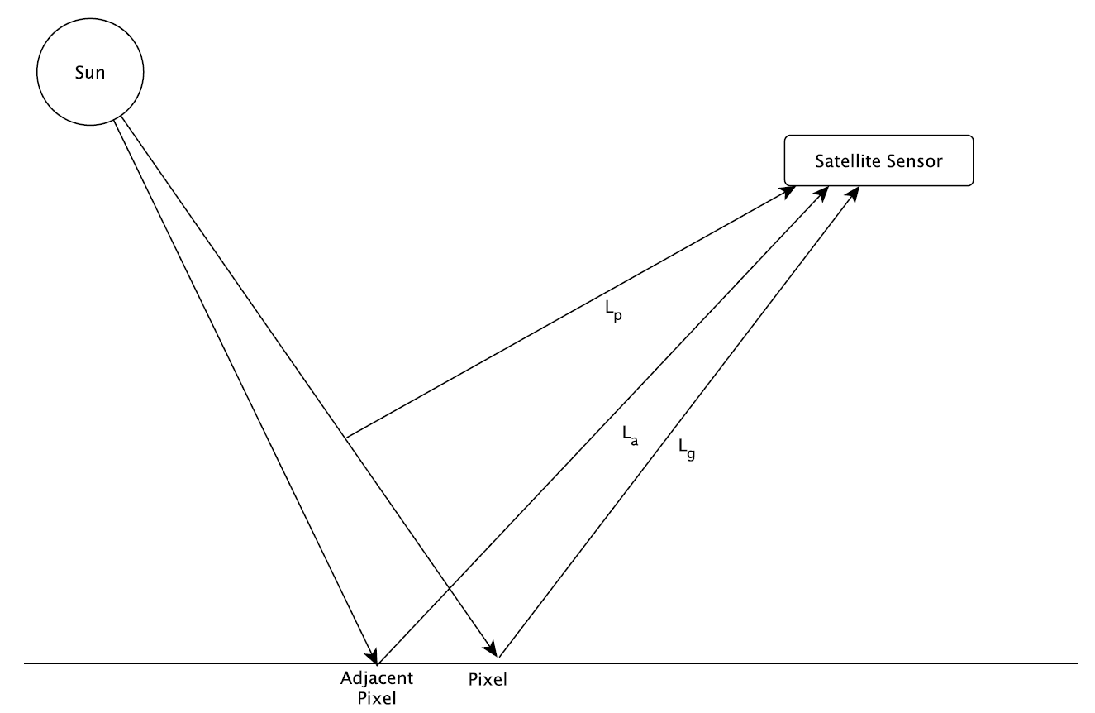
Radiative Transfer
But, we measure the sum!
Path Radiance
Aerosols cause scattering
Ground Radiance
Adjacent
Radiance

Slide 5
Radiative Transfer
But, we measure the sum!
Path Radiance
Aerosols cause scattering
Ground Radiance
How do we separate these?
Polarisation, Multi-temporal, Multi-angle…
Adjacent
Radiance

Slide 6
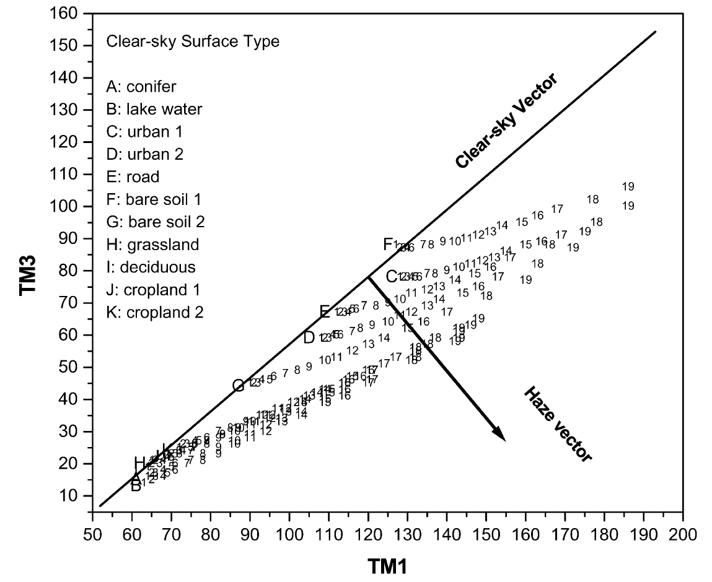
Haze Optimized Transform (HOT)
Distance ∝
Haze
Red
Haze =
Aerosols
Blue
Zhang et al. (2002)

Slide 7
HOTBAR
Haze Optimised Transform based Aerosol Retrieval
Input: Landsat image
Estimate the Clear Line
Correct for land-cover effects
Link HOT values to AOT
Output: AOT image

Slide 8
Estimating the Clear Line
The HOT set the Clear Line from a regression of a clear part of the image
BUT aerosols are everywhere!
We need Clear Pixels
  Created the LandsatAERONET dataset:
  Thousands of very accurately atmospherically-corrected pixels
  Range of land covers
  Easy to model any sort of atmospheric conditions

Slide 9
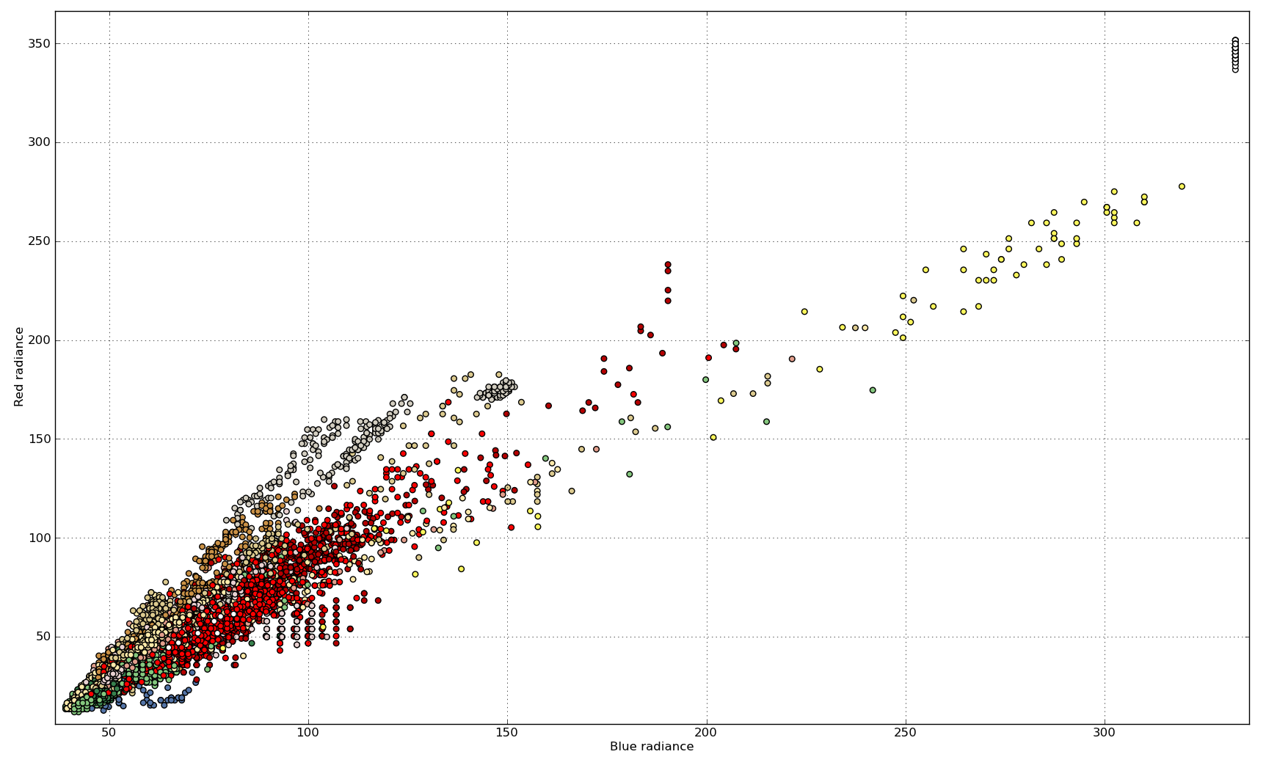

Slide 10
Monte Carlo Regression
Clear Line depends on land cover
So, get land cover proportions
(from GlobCover)
Estimate Clear Line from the LandsatAERONET dataset with a Monte Carlo Regression process

Slide 11
Correcting for Land Cover effects

Slide 12
Correcting for Land Cover effects
The HOT is not Land Cover invariant
We need to correct for this – how?
  Aerosols mix in the atmosphere
  → no sharp boundaries
  Land covers often have sharp boundaries
Look for sharp boundaries, correct the pixel values inside these ‘objects’
→ Object-based Image Analysis

Slide 13
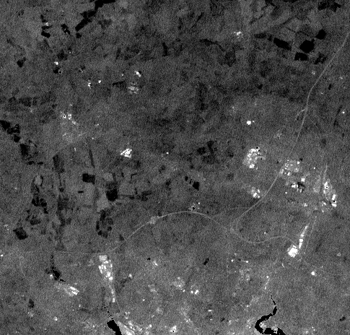
Original

Slide 14
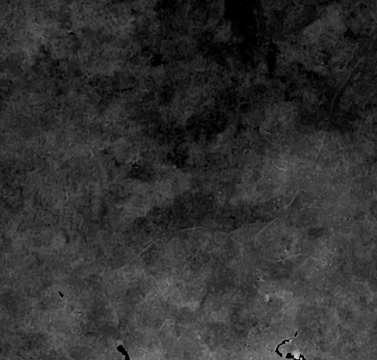
Corrected

Slide 15
Link HOT to Aerosol Optical Thickness
LandsatAERONET sample

Slide 16
Link HOT to Aerosol Optical Thickness
’Correct’ to Clear Line

Slide 17
Link HOT to Aerosol Optical Thickness
Simulate with AOT

Slide 18
Link HOT to Aerosol Optical Thickness
Calculate HOT and link with AOT

Slide 19
Py6S
Wilson, R. T. (2012). Py6S: A Python interface to the 6S Radiative Transfer Model, Computers and Geosciences 51, pp. 166–171.
www.py6s.rtwilson.com

Slide 20
Radiative Transfer
But, we measure the sum!
Path Radiance
Aerosols cause scattering
How do we separate these?
Polarisation, Multi-temporal, Multi-angle
Context
Spatial (land cover correction)
Spectral (LandsatAERONET dataset)
Ground Radiance
Adjacent
Radiance

Slide 21

MODIS (10km)

Slide 22
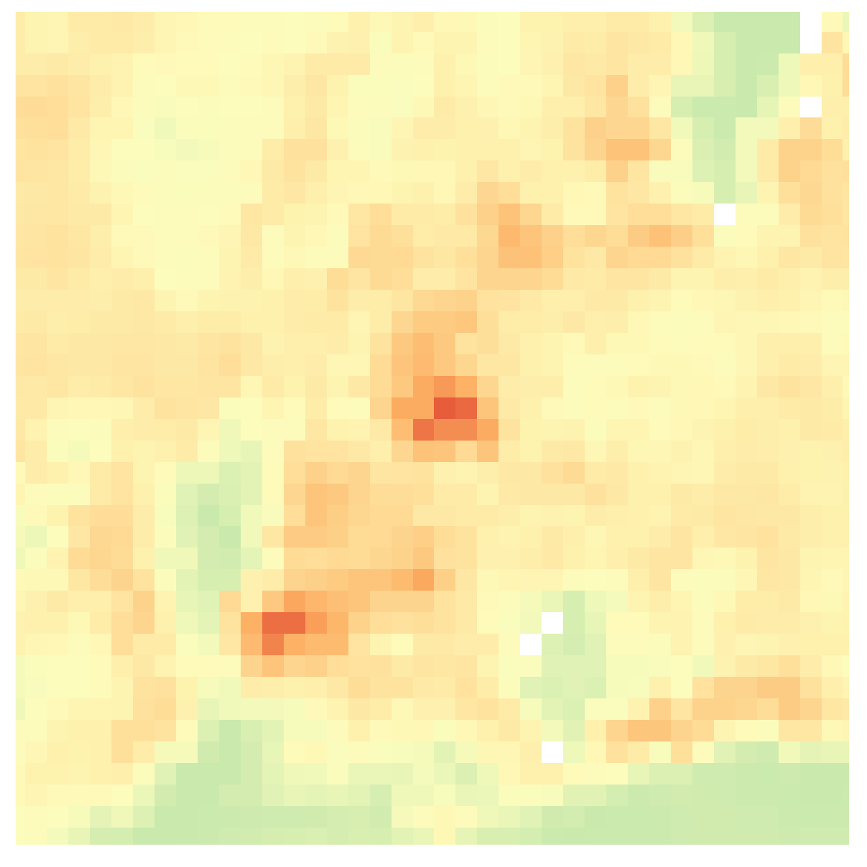
MAIAC (1km)

Slide 23
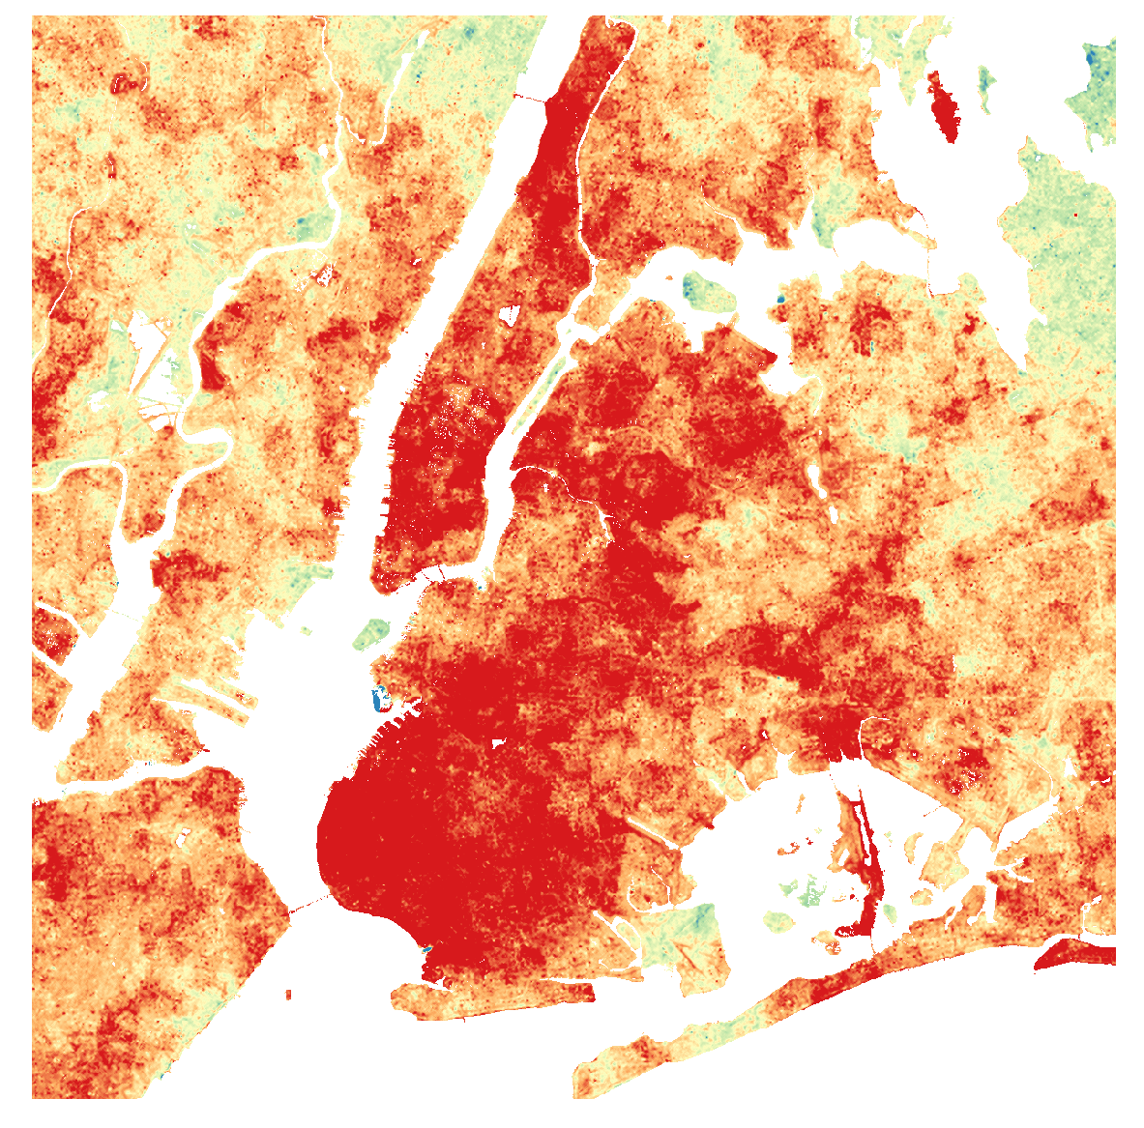
HOTBAR (30m)

Slide 24
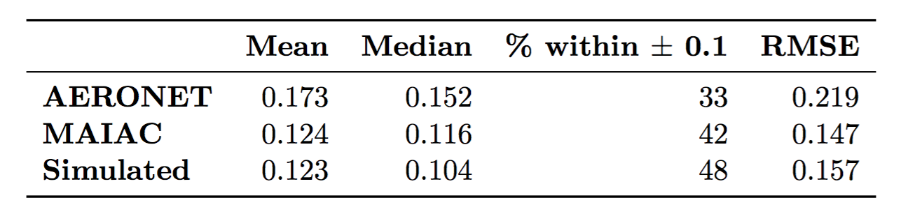
Validation shows robust performance
MODIS 10km data: 60% within ± 0.13
OMI 15km data: RMSE = 0.15
Error comparable to other methods, but at
100,000 times
the resolution of the MODIS 10km product

Slide 25
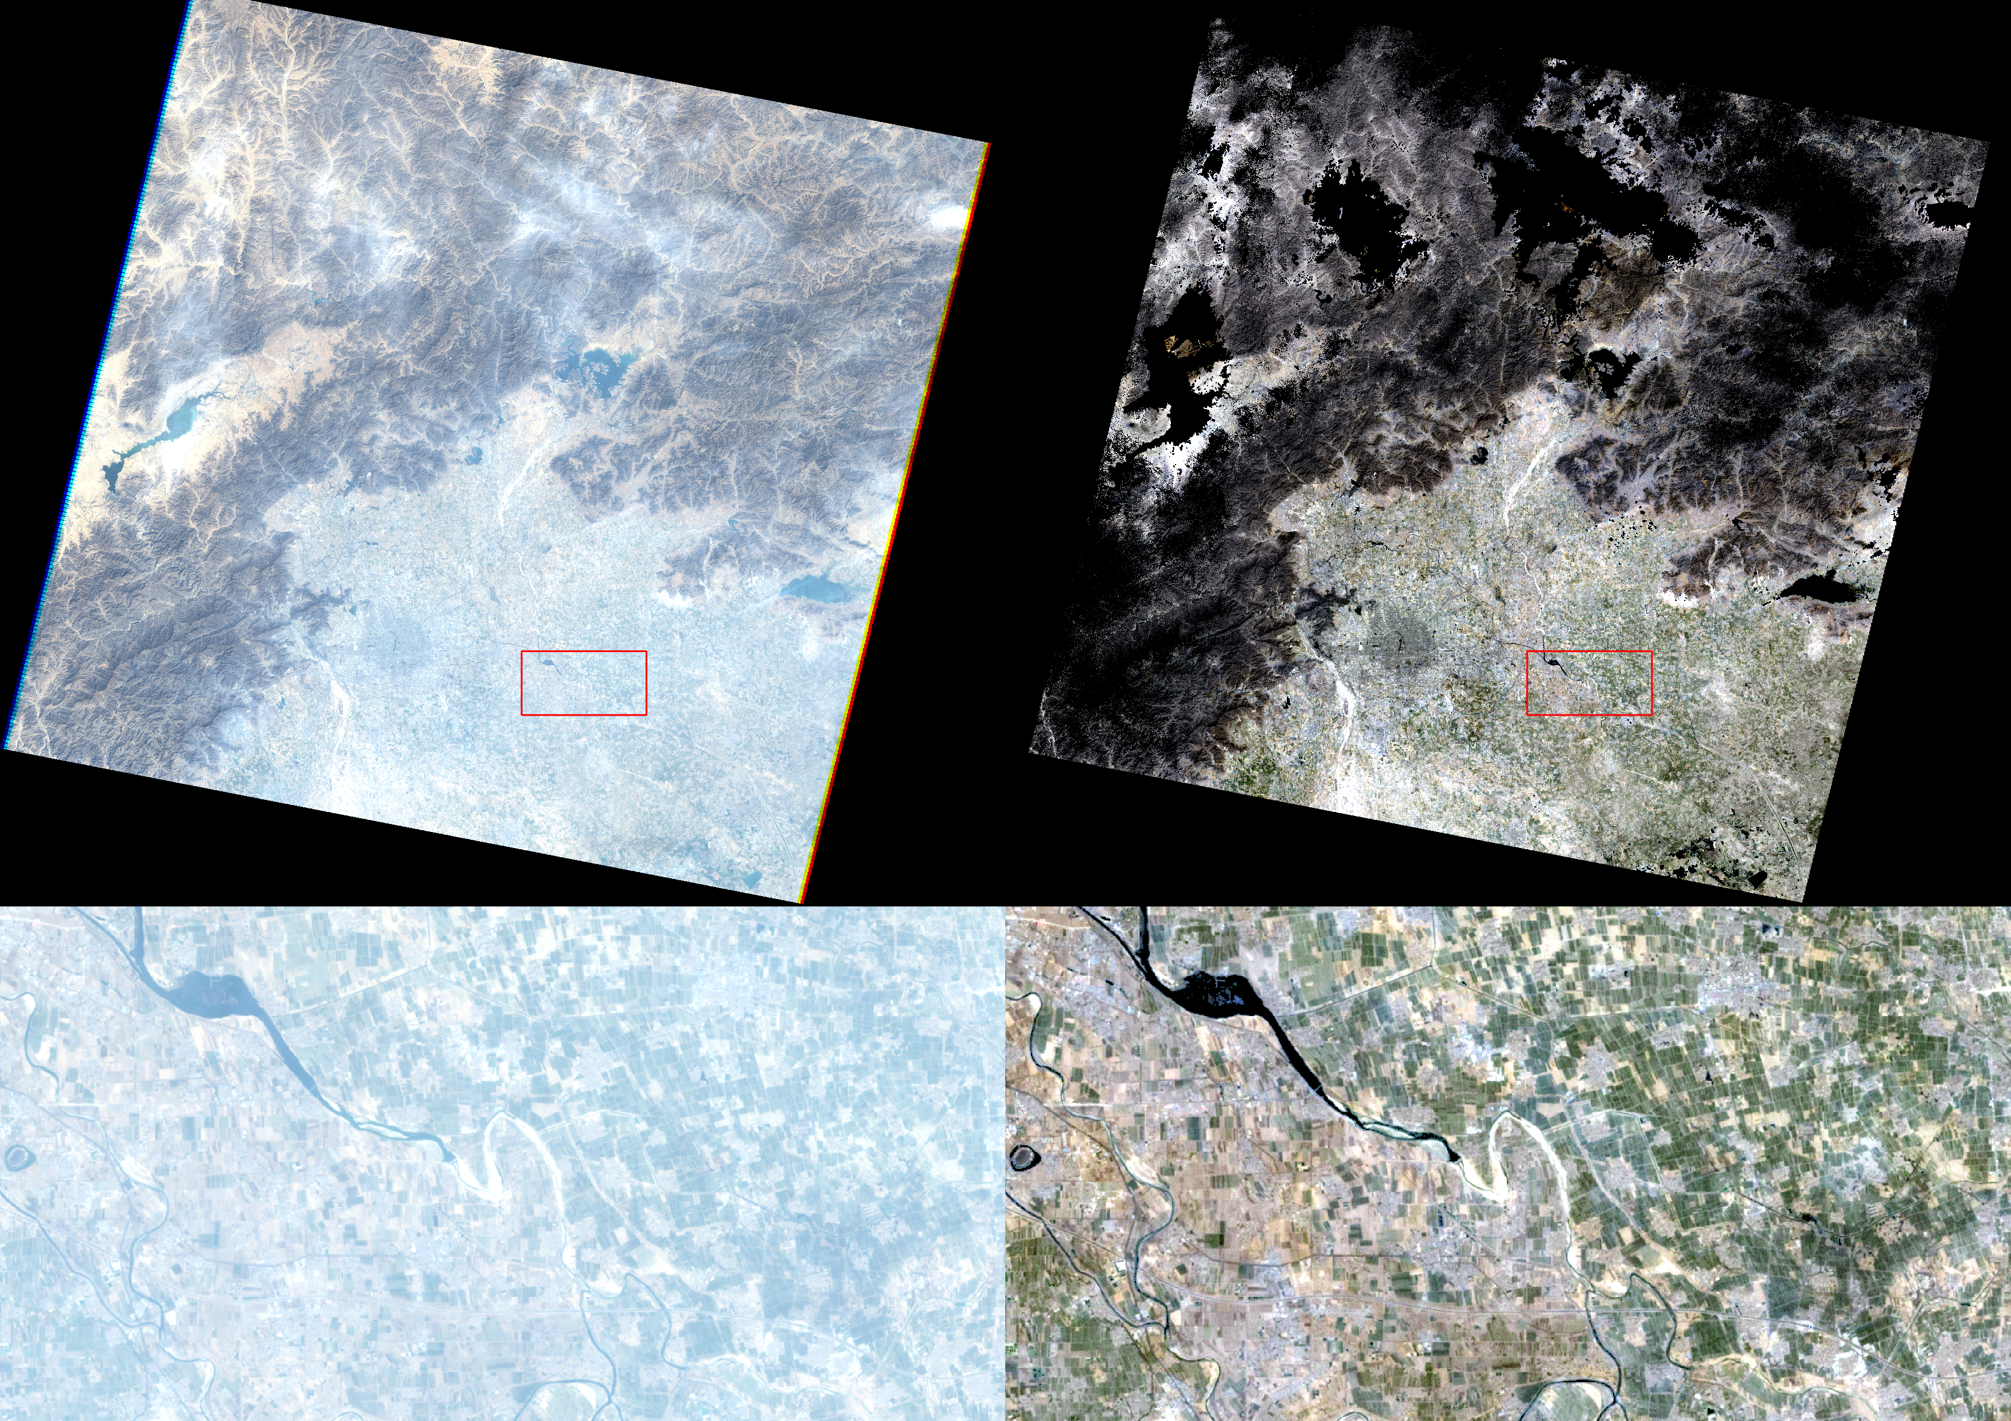
True per-pixel atmospheric correction

Slide 26
Landsat B1
Blue
Error compared with ground spectral measurements
Landsat B2
Green

Slide 27
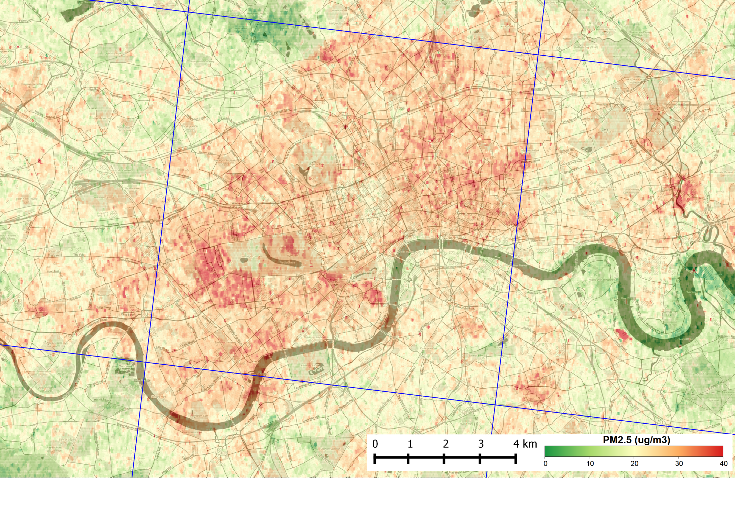
PM_{2.5} concentrations
Estimated from AOT using
van Donkelaar et al. (2010) conversion factors

Slide 28
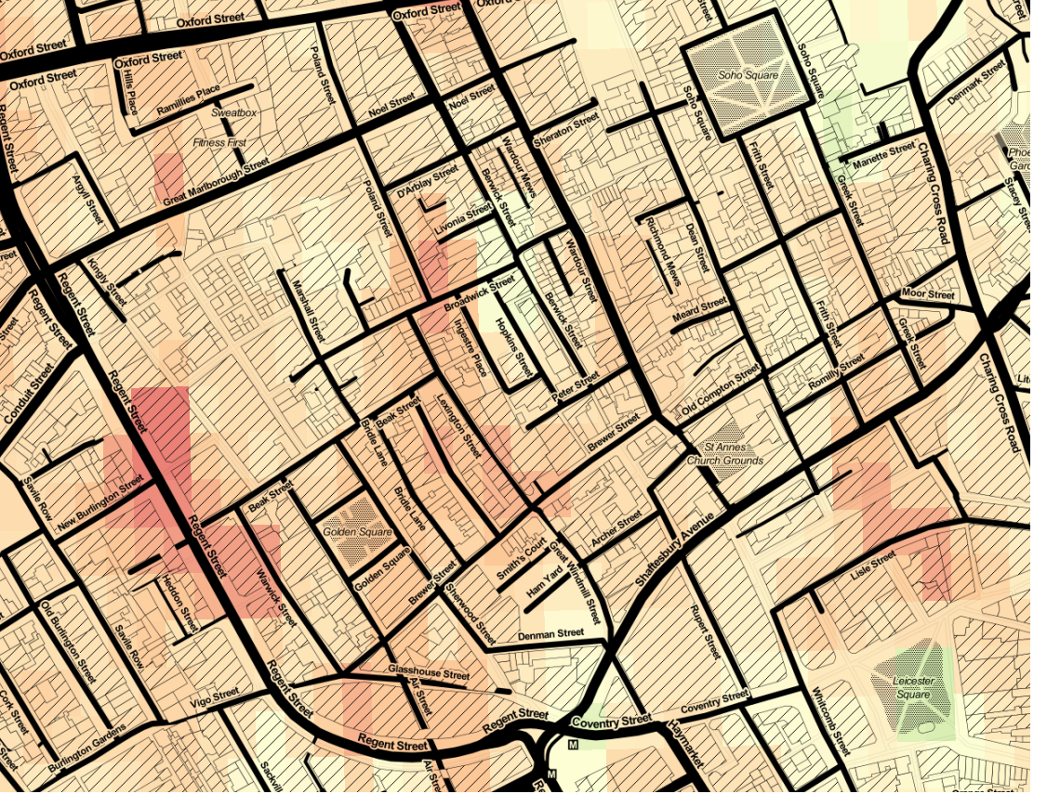

Slide 29
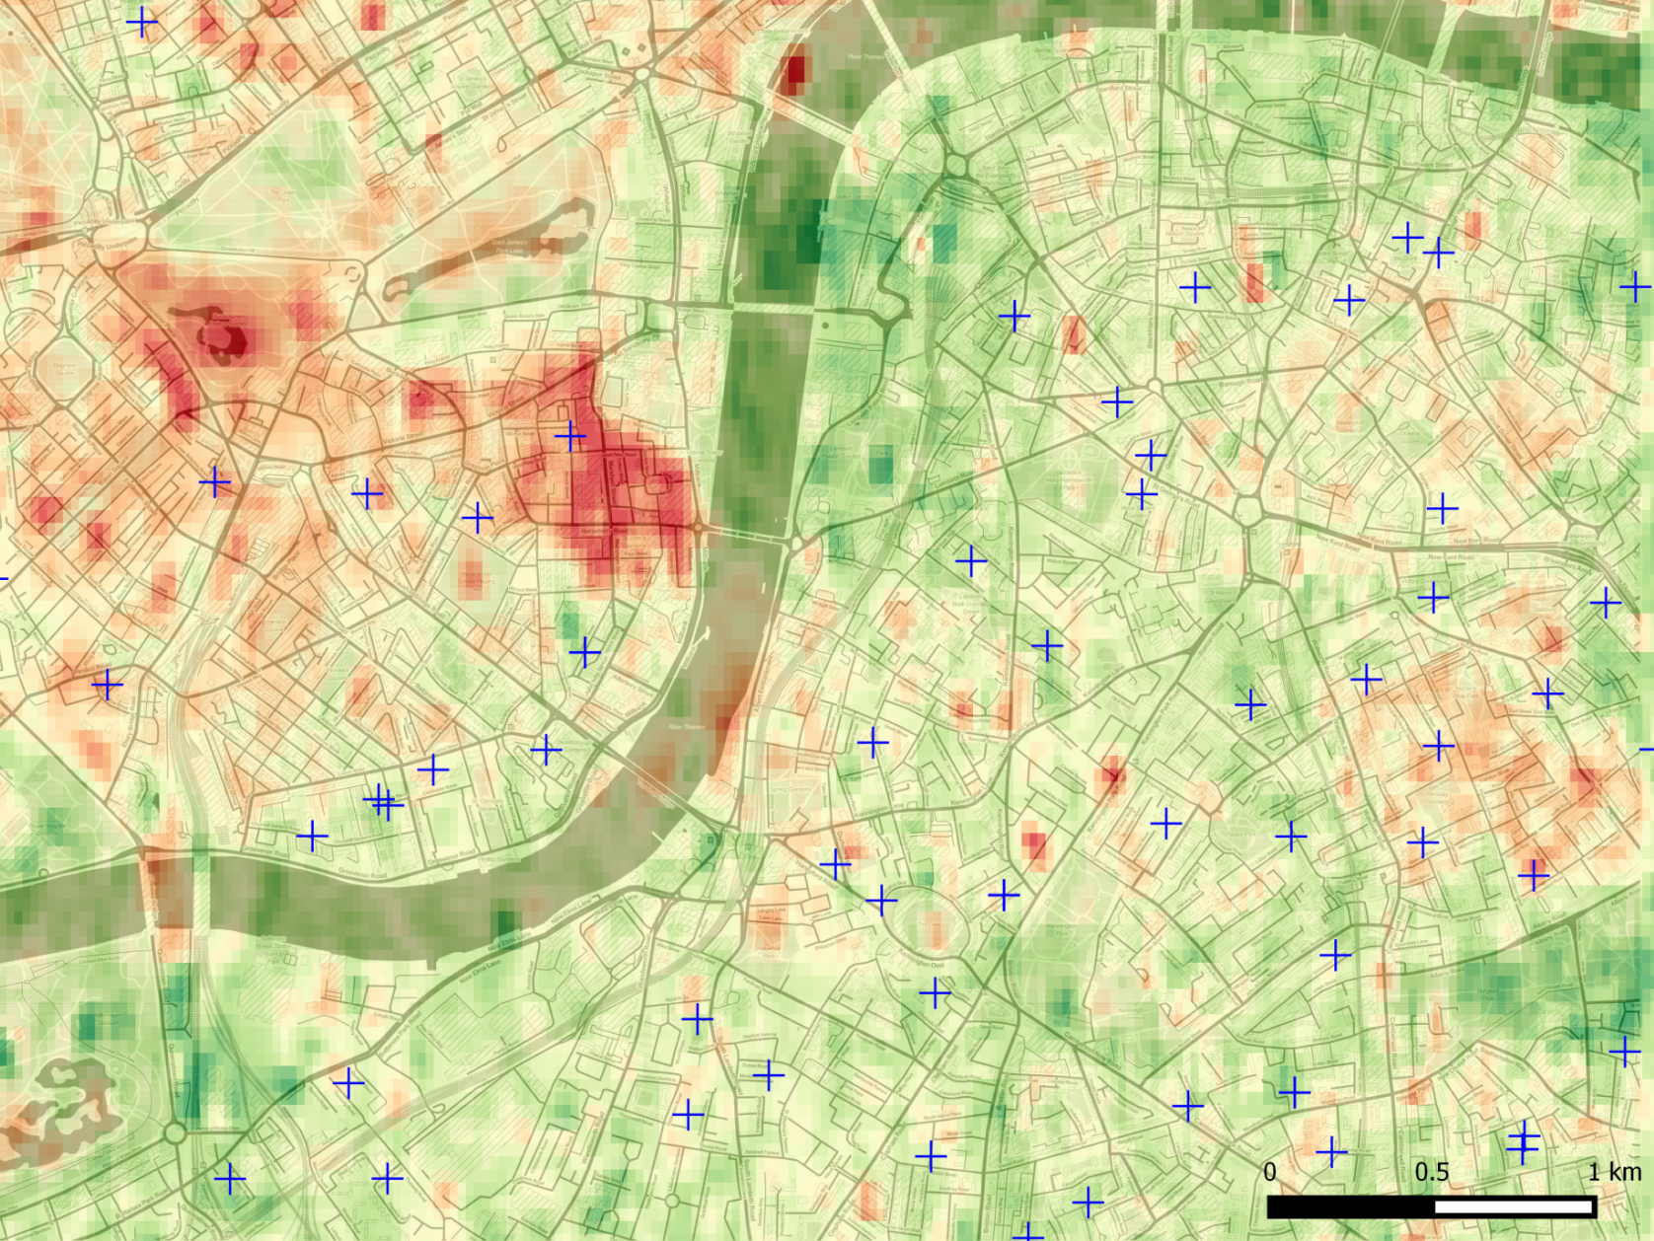
Schools
to estimate exposure around sites with vulnerable people

Slide 30
Ongoing work
Ongoing production of a global product, in association with
Includes extension to Landsat 8 & operationalisation
Applications
  PM_{2.5} mapping for exposure estimation
  True per-pixel atmospheric correction
  and more…

Slide 31
Any questions?
r.t.wilson@soton.ac.uk @sciremotesense

