Slide 1
Decentralised Systems and computer models, complexity theory, chaos and more
Dr Robin Wilson
Geography & Environment
University of Southampton

Slide 2
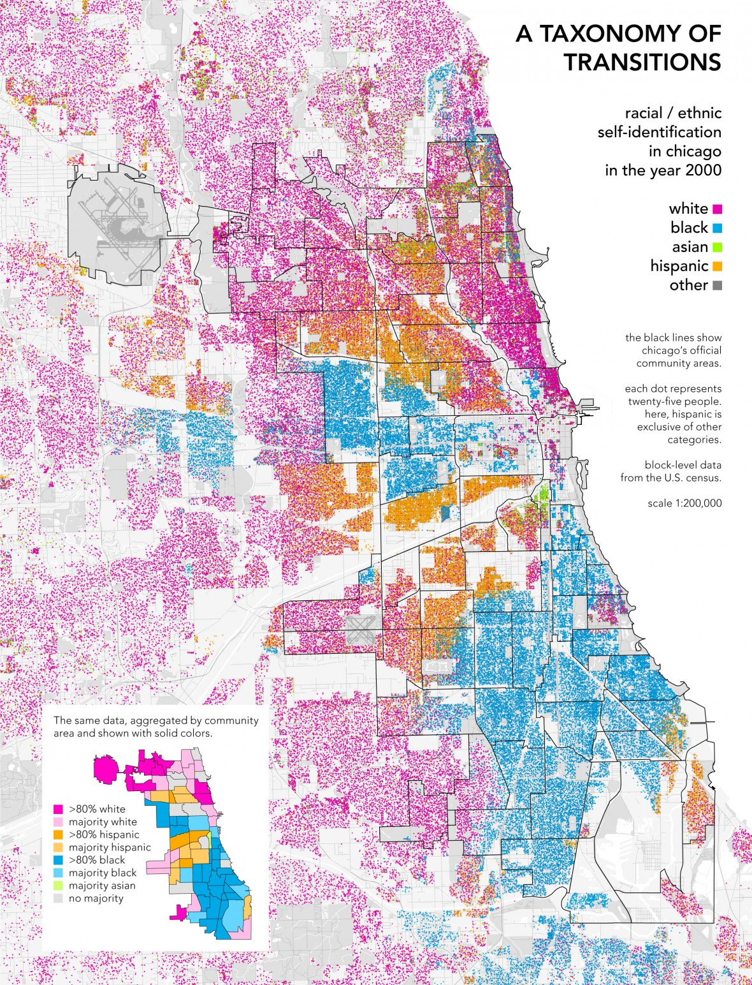

Slide 3
Demonstration

Slide 4
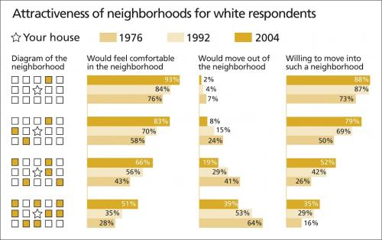

Slide 5
Computer Model
“All models are wrong; some are useful”

Slide 6
Agent-based model

Slide 7
Emergence
“Something from nothing…”
“The whole is greater than the sum of
the parts”

Slide 11
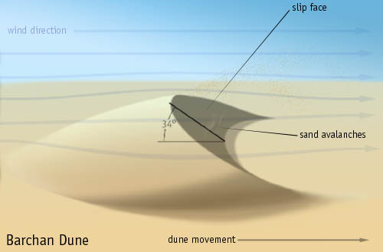

Slide 12
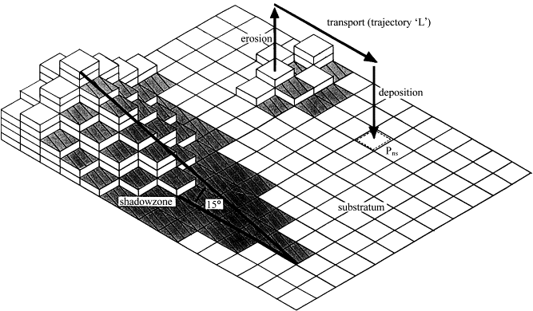

Slide 13
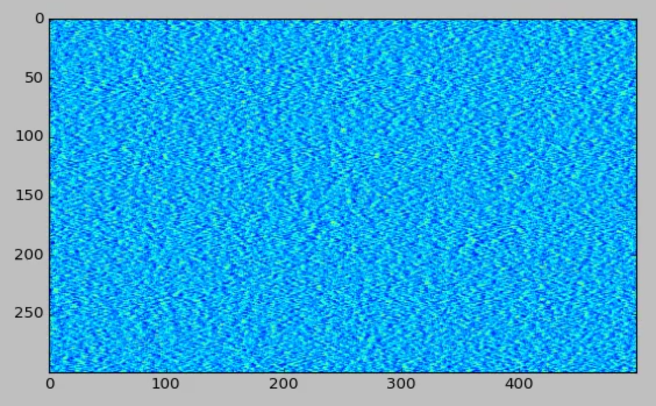
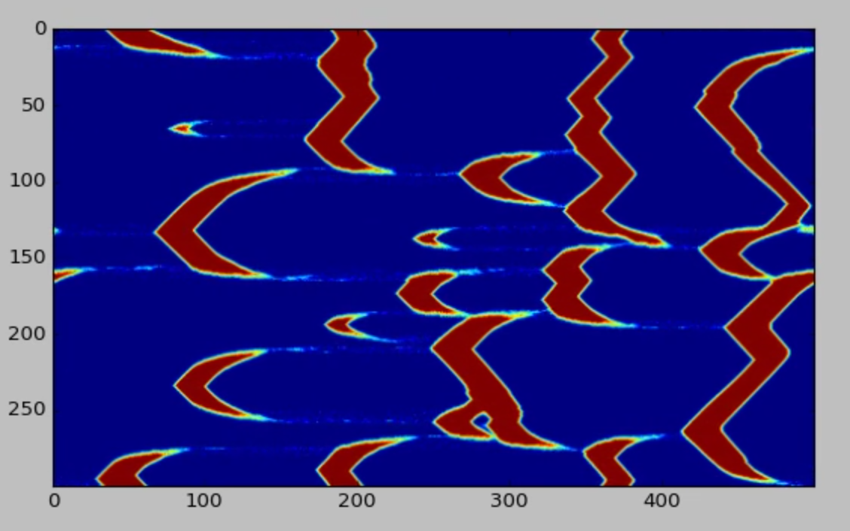
Self-organisation
“Architecture
without architects”

Slide 14
Levels of description

Slide 16
Demonstration

Slide 18
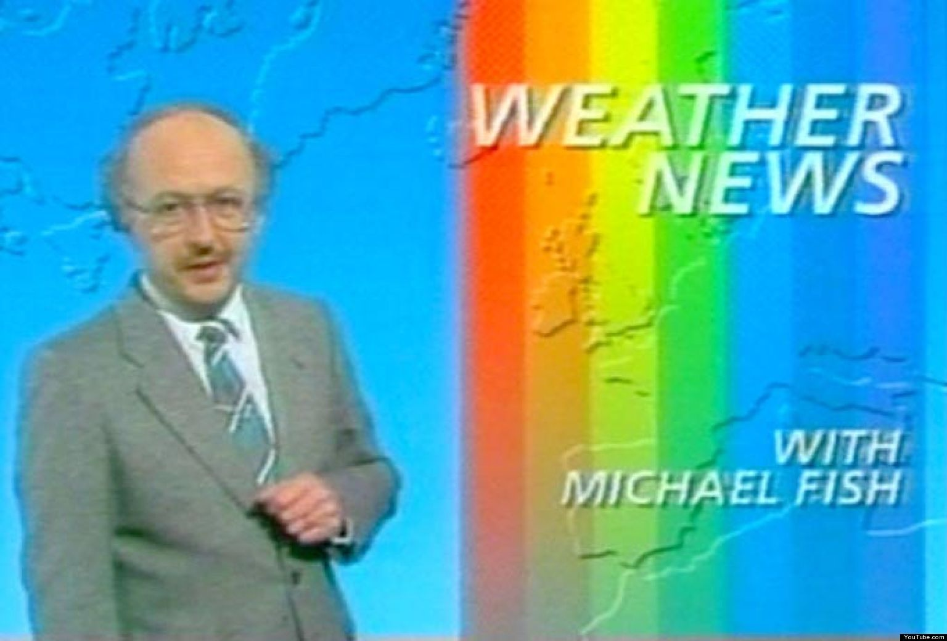

Slide 19
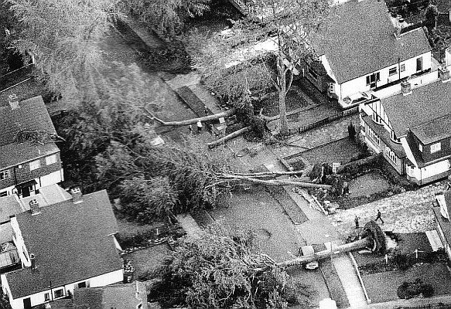
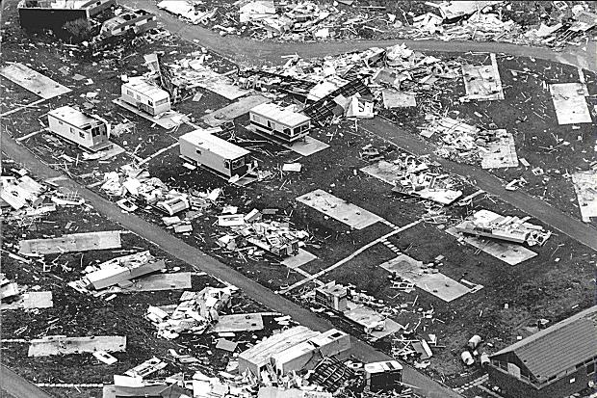
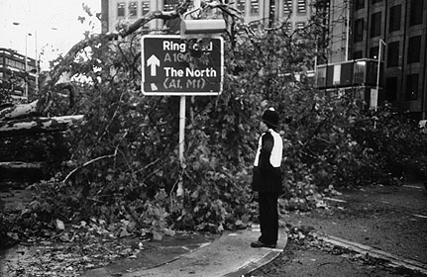

Slide 20
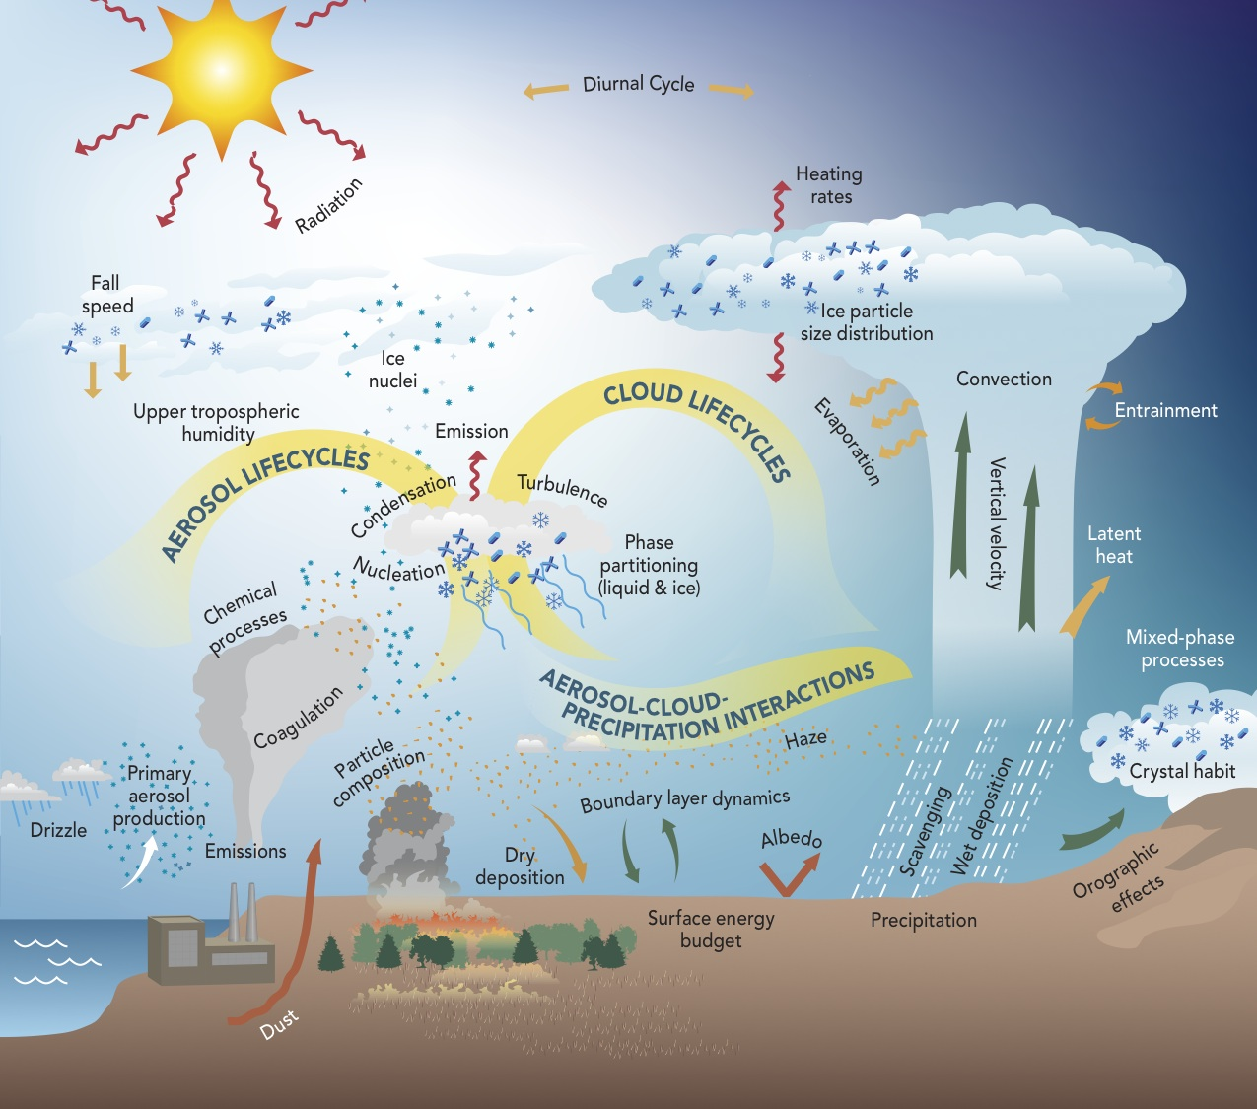

Slide 21
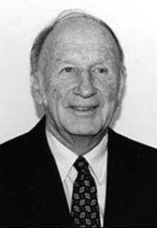
Notes:
Lorenz

Slide 22
0.060920
0.398534
0.478684
0.482870
0.170846
0.657570
0.204869

Slide 23
0.060920
0.398534
0.478684
0.482870
0.170846
0.657570
0.204869

Slide 32
Chaos
When the present determines the
future, but the approximate present
does not approximately determine
the future.

Slide 33
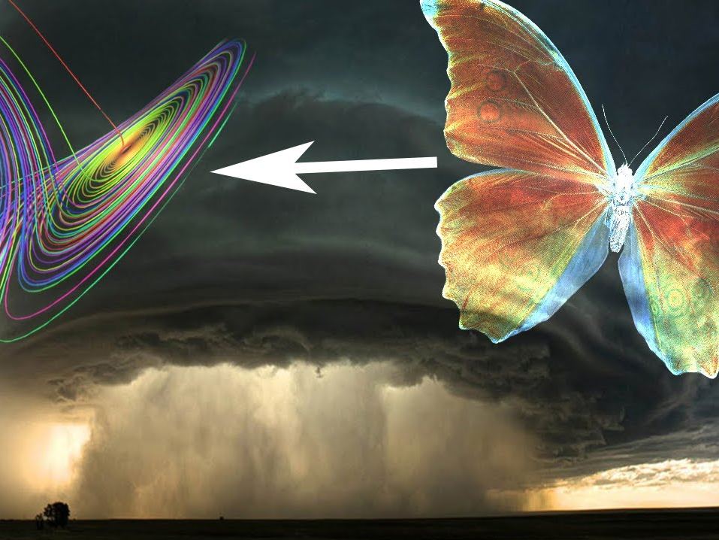
Chaos theory
Butterfly effect

Slide 35
Centralised vs Decentralised
from
“Who is in charge?”
to
“Is anyone in charge?”

Slide 38
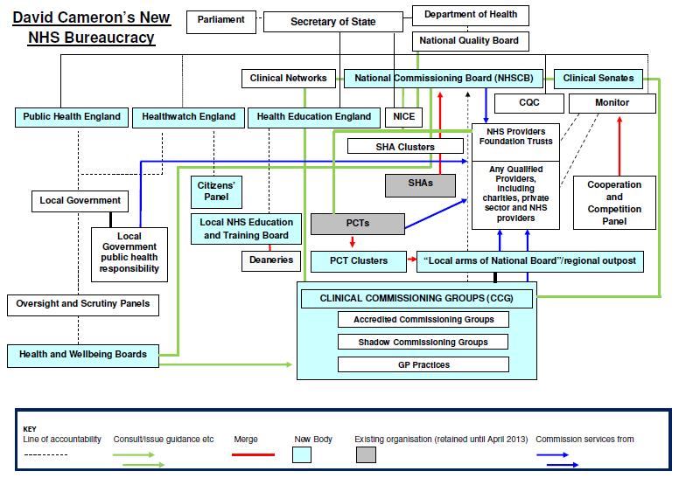

Slide 42
1. Stop when you get to a gap and hold on
2. When lots of ants are walking over you, stay still
3. When few ants are walking over you, carry on moving

Slide 45
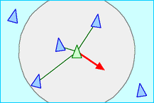
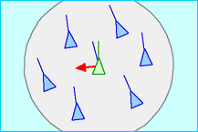
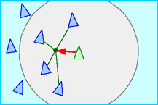
Boids
Separation:
Steer to avoid crowding local flockmates
Alignment
Steer towards the average heading of local flockmates
Cohesion
Steer to move toward the average position of local flockmates

Slide 46
Demonstration

Slide 47
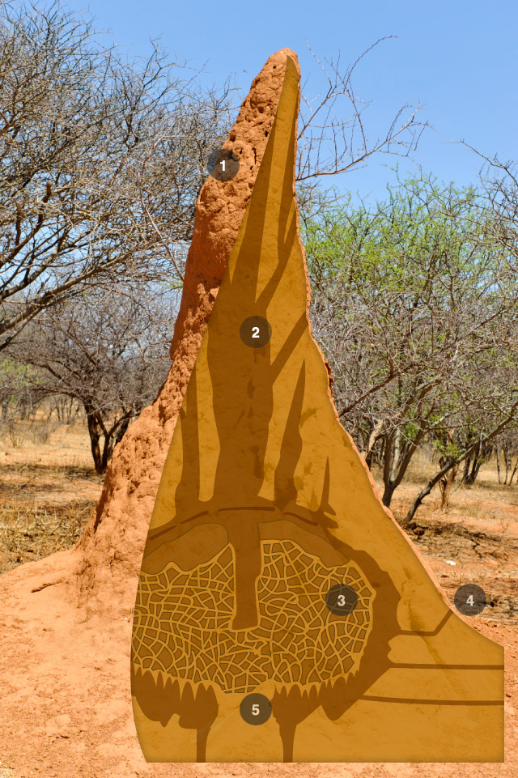

Slide 49
Self-organisation
Chaos theory
Emergent behaviour
Levels of description
Centralised vs Decentralised
Agent-based Modelling
Complex systems
Explanation?

