Slide 1
An introduction to geospatial data & processing
Dr Robin Wilson
www.rtwilson.com

Slide 2
What is geospatial data?

Slide 3
Schools in Oxfordshire
ID | Name | Type | Status | Phase | Gender | Pupils
123290 | Headington School | Other Independent School | Open | Secondary | Girls | 1046
122967 | Bartlemas Nursery School | LA Nursery School | Open | Nursery | Mixed | 63
122968 | Headington Quarry Foundation Stage School | LA Nursery School | Open | Nursery | Mixed | 81
122969 | Grandpont Nursery School | LA Nursery School | Open | Nursery | Mixed | 75
123129 | Dorchester St Birinus Church of England School | Voluntary Controlled School | Open | Primary | Mixed | 78
123130 | Great Milton Church of England Primary School | Voluntary Controlled School | Open | Primary | Mixed | 161
123131 | Marsh Baldon Church of England Controlled School | Voluntary Controlled School | Open | Primary | Mixed | 70
123132 | Culham Parochial Church of England School | Voluntary Controlled School | Open | Primary | Mixed | 51
123133 | Crowmarsh Gifford Church of England School | Voluntary Controlled School | Open | Primary | Mixed | 204
123134 | Harpsden Parochial School | Voluntary Controlled School | Closed | Primary | Mixed | 0
Data

Slide 4
Schools in Oxfordshire
ID | Name | Type | Status | Phase | Gender | Pupils | X | Y
123290 | Headington School | Other Independent School | Open | Secondary | Girls | 1046 | 453825 | 206828
122967 | Bartlemas Nursery School | LA Nursery School | Open | Nursery | Mixed | 63 | 453107 | 205197
122968 | Headington Quarry Foundation Stage School | LA Nursery School | Open | Nursery | Mixed | 81 | 455495 | 206950
122969 | Grandpont Nursery School | LA Nursery School | Open | Nursery | Mixed | 75 | 451204 | 205180
123129 | Dorchester St Birinus Church of England School | Voluntary Controlled School | Open | Primary | Mixed | 78 | 457895 | 194371
123130 | Great Milton Church of England Primary School | Voluntary Controlled School | Open | Primary | Mixed | 161 | 462976 | 202879
123131 | Marsh Baldon Church of England Controlled School | Voluntary Controlled School | Open | Primary | Mixed | 70 | 456387 | 199612
123132 | Culham Parochial Church of England School | Voluntary Controlled School | Open | Primary | Mixed | 51 | 450766 | 195061
123133 | Crowmarsh Gifford Church of England School | Voluntary Controlled School | Open | Primary | Mixed | 204 | 461707 | 189029
123134 | Harpsden Parochial School | Voluntary Controlled School | Closed | Primary | Mixed | 0 | 475602 | 180862
Geographic Data (‘Geodata’)

Slide 5
Schools in Oxfordshire
Everything happens somewhere
ID | Name | Type | Status | Phase | Gender | Pupils | X | Y
123290 | Headington School | Other Independent School | Open | Secondary | Girls | 1046 | 453825 | 206828
122967 | Bartlemas Nursery School | LA Nursery School | Open | Nursery | Mixed | 63 | 453107 | 205197
122968 | Headington Quarry Foundation Stage School | LA Nursery School | Open | Nursery | Mixed | 81 | 455495 | 206950
122969 | Grandpont Nursery School | LA Nursery School | Open | Nursery | Mixed | 75 | 451204 | 205180
123129 | Dorchester St Birinus Church of England School | Voluntary Controlled School | Open | Primary | Mixed | 78 | 457895 | 194371
123130 | Great Milton Church of England Primary School | Voluntary Controlled School | Open | Primary | Mixed | 161 | 462976 | 202879
123131 | Marsh Baldon Church of England Controlled School | Voluntary Controlled School | Open | Primary | Mixed | 70 | 456387 | 199612
123132 | Culham Parochial Church of England School | Voluntary Controlled School | Open | Primary | Mixed | 51 | 450766 | 195061
123133 | Crowmarsh Gifford Church of England School | Voluntary Controlled School | Open | Primary | Mixed | 204 | 461707 | 189029
123134 | Harpsden Parochial School | Voluntary Controlled School | Closed | Primary | Mixed | 0 | 475602 | 180862
Geographic Data (‘Geodata’)

Slide 6
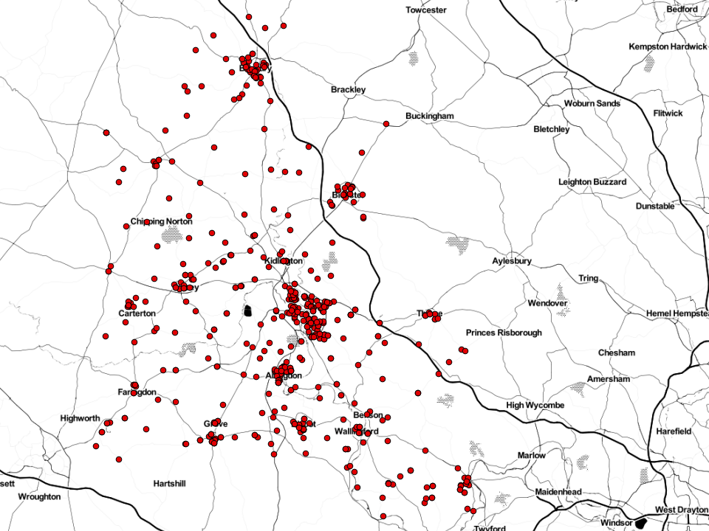
Points (one co-ordinate: X and Y)

Slide 7
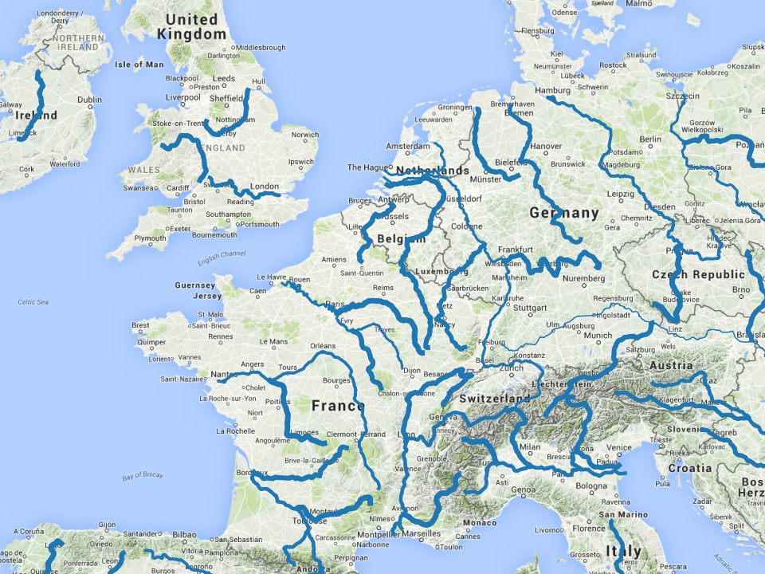
Lines (multiple co-ordinates)

Slide 8
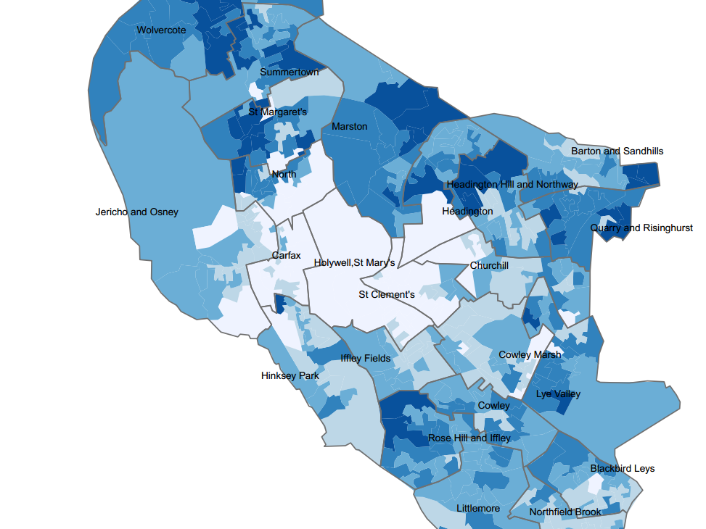
Polygons (multiple co-ordinates)

Slide 9
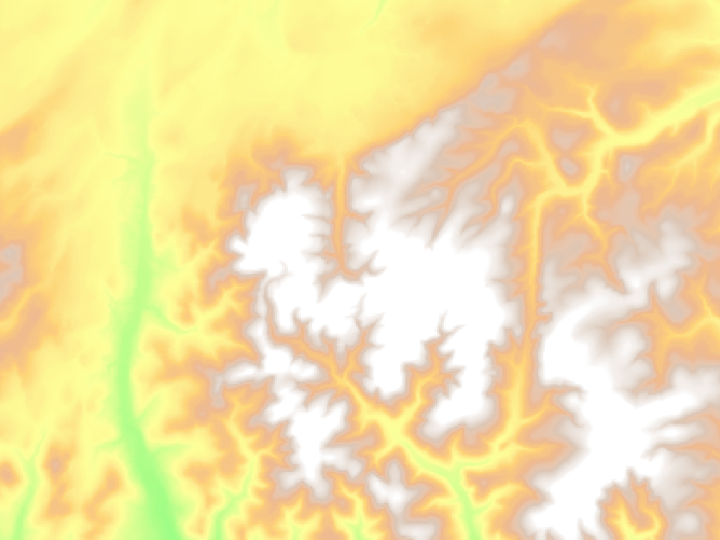
Raster (grid of values plus metadata)

Slide 10
10
11
13
17
20
23
…
Pixel size
Raster (grid of values plus metadata)

Slide 11
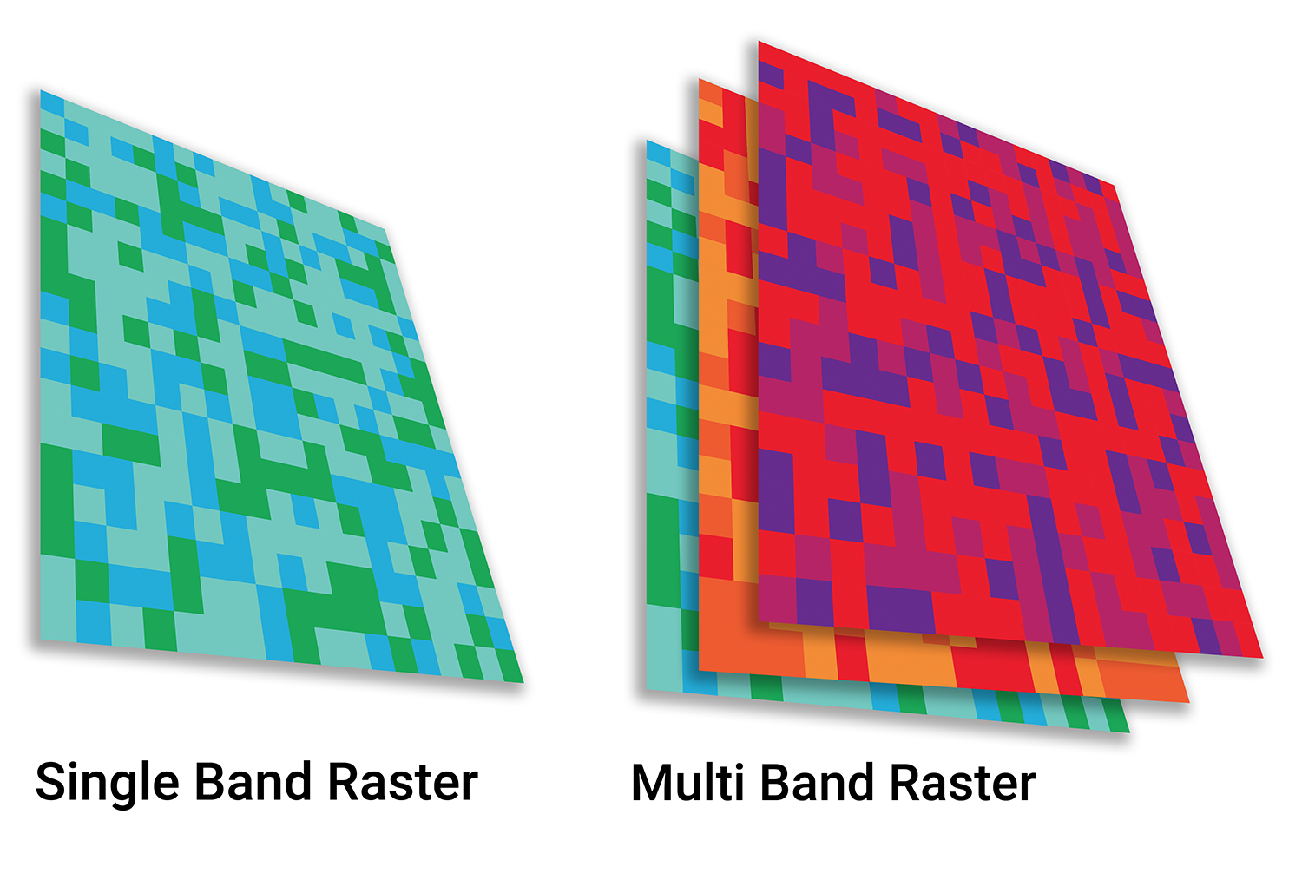
Raster (multiband)

Slide 12
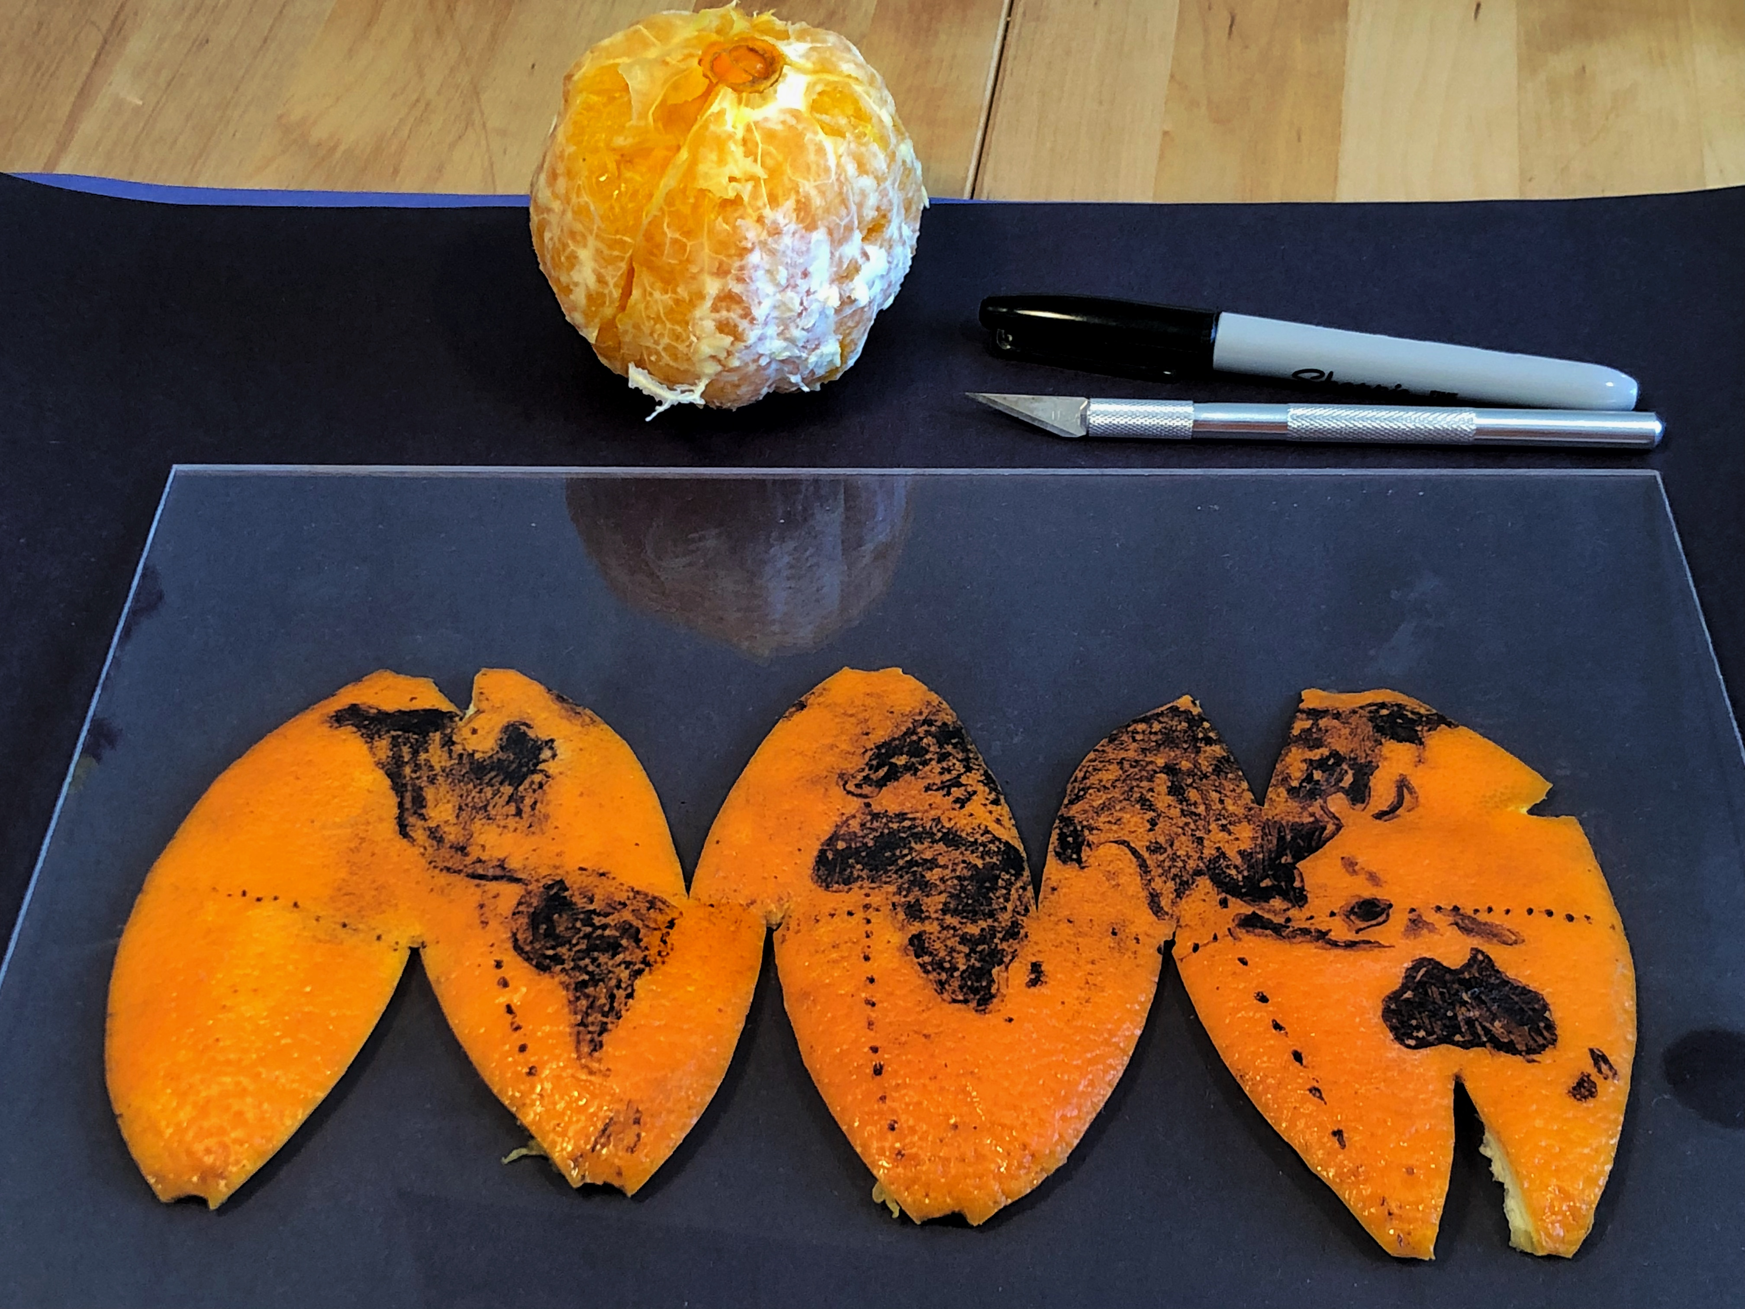
Beware of projections and co-ordinate systems
Latitude, Longitude for the whole world in degrees (but which comes first?)
X, Y in projected co-ordinate systems for specific areas usually in metres
epsg.io

Slide 13
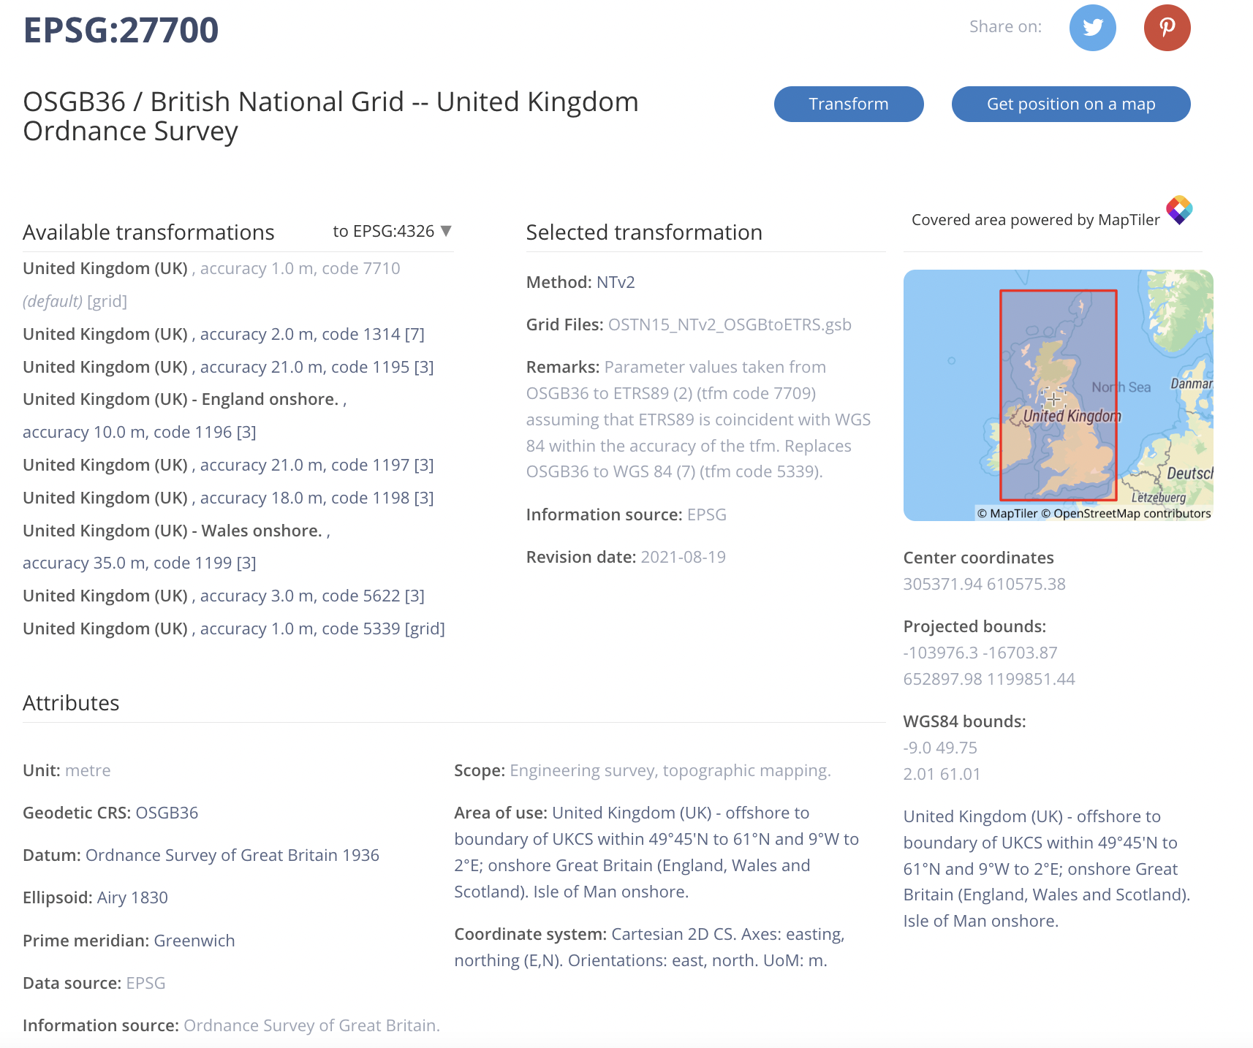

Slide 14
Where to get geospatial data?
National mapping agencies (eg. Ordnance Survey)
National statistical organisations (eg. Office for National Statistics)
OpenStreetMap
Satellite operators (eg. NASA, ESA, commercial operators)
My FreeGISData site – www.freegisdata.rtwilson.com
Customers, Clients…

Slide 15
Tools for processing geospatial data

Slide 16
Command-line tools
Translate formats
Reproject
Resample
Get information
Query
Formats
Raster | Vector
GeoTIFF / COG (.tif) | GeoJSON (.geojson)
ERDAS Imagine (.img) | GeoPackage (.gpkg)
JPEG2000 (.jp2) | GeoParquet (.parquet)
Grid (.grd or others) | Shapefile (.shp, .dbf, .shx etc)
 | CSV (.csv)
 | ESRI File GeoDatabase (.gdb)
 | Database connections (PostGIS, Spatialite)

Slide 17
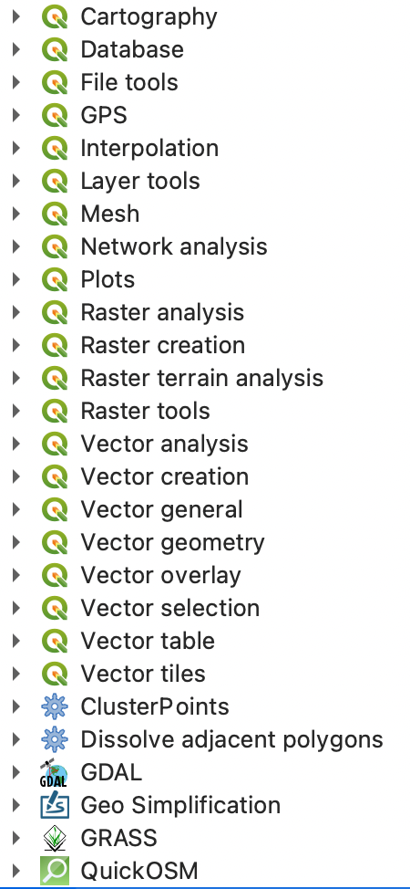
View – Edit – Process
PyQGIS & Graphical Modeler

Slide 18
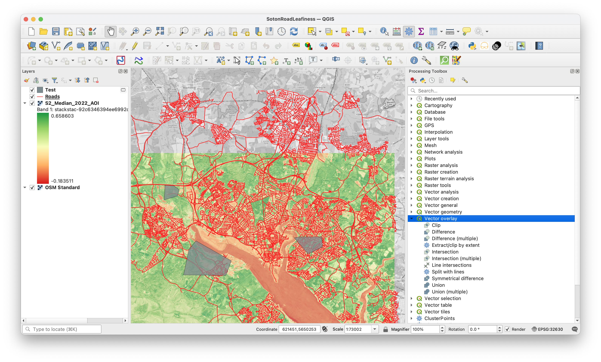

Slide 19
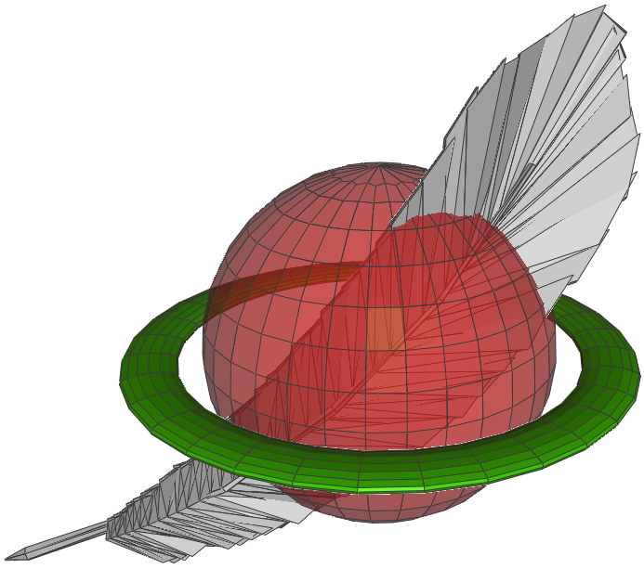
Spatialite
SELECT us_counties.geom , us_counties.id, COUNT(quakes.geom) AS total
FROM us_counties
JOIN quakes
ON ST_CONTAINS(us_counties.geom, quakes.geom)
GROUP BY us_counties.id;
Contains / Intersects / DWithin / …

Slide 20
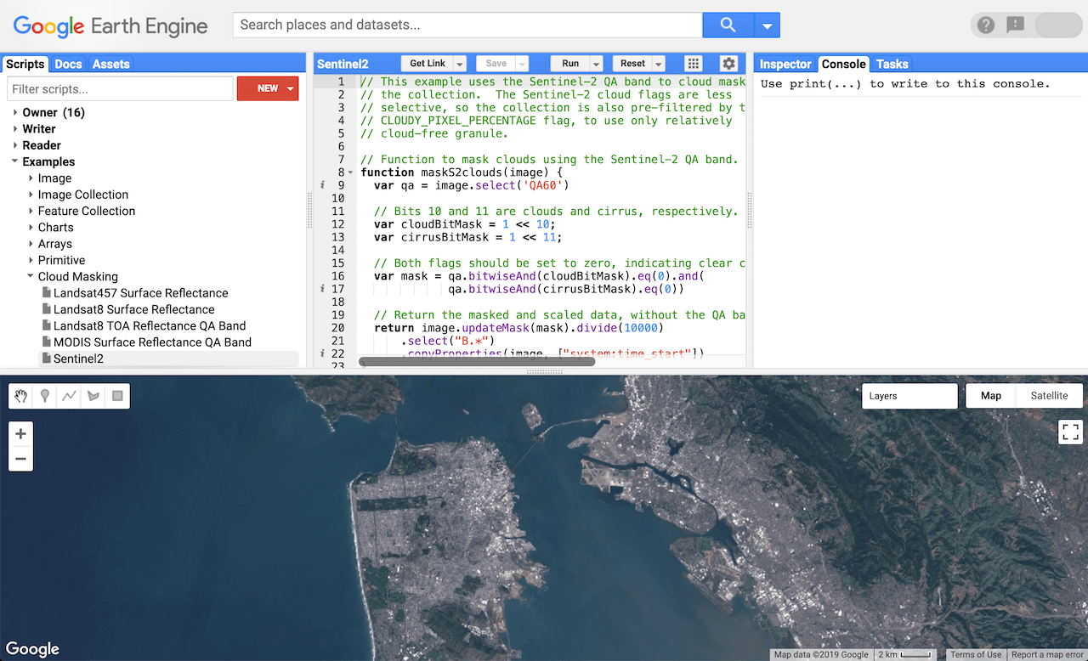
Cloud Native Geospatial

Slide 21
Python libraries
rasterstats
folium
fiona
rasterio
shapely
and lots more…

Slide 22
What is the relationship between house prices and distance to schools?

Slide 23
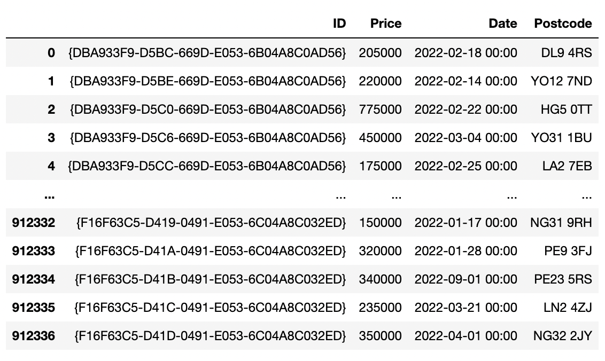
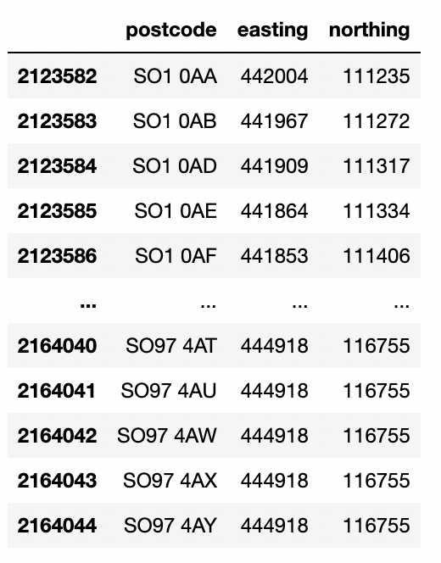
X & Y
House Prices
Postcodes

Slide 24
shapely
(Python vector geospatial objects)
geometries = [shapely.geometry.Point(x, y)
for x, y
in zip(
postcodes.easting, postcodes.northing)],
postcodes = gpd.GeoDataFrame(
data=postcodes,
geometry=geometries,
crs=27700)
Index | Col1 | Col2 | Geometry
0 | a | A | POINT(5, 9)
1 | b | B | POINT(2, -3)
2 | c | C | POINT(10, 7)
geopandas
(Pandas + Geo)

Slide 25
houseprices = pd.merge(
left=houseprices, right=postcodes, left_on='Postcode’, right_on='postcode’, how='inner’
)
houseprices.explore()

Slide 26
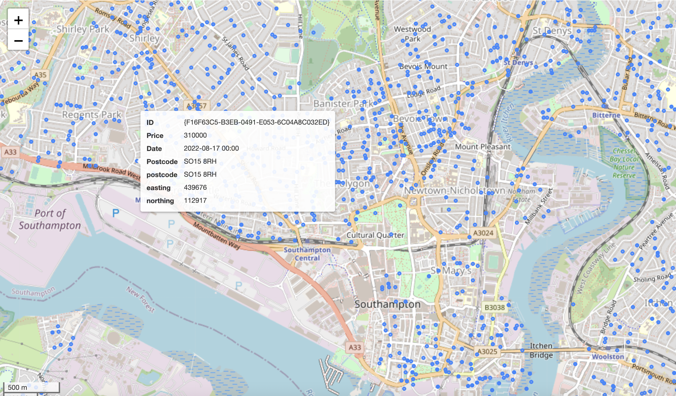
folium
(python webmaps)

Slide 27
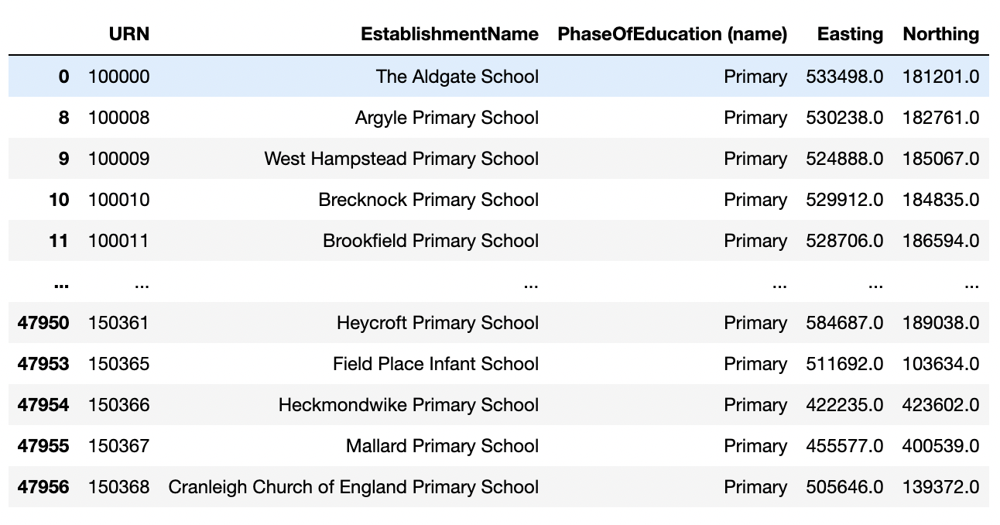
Schools
Do the same as before…

Slide 28
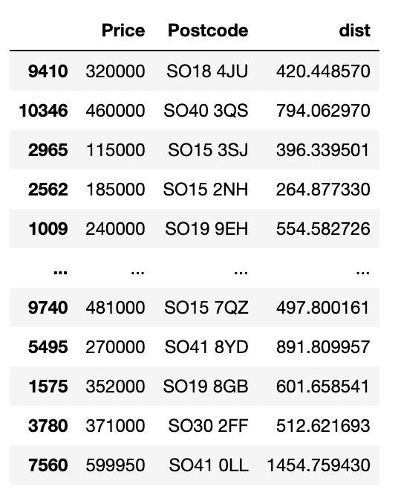
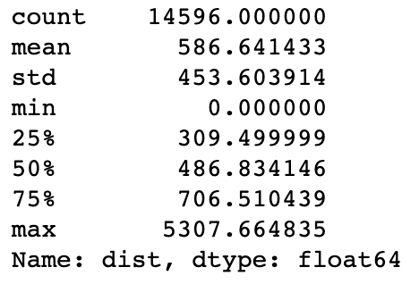
joined = gpd.sjoin_nearest(houseprices,
schools,
distance_col='dist')

Slide 29
How leafy are different neighbourhoods of Southampton?

Slide 30
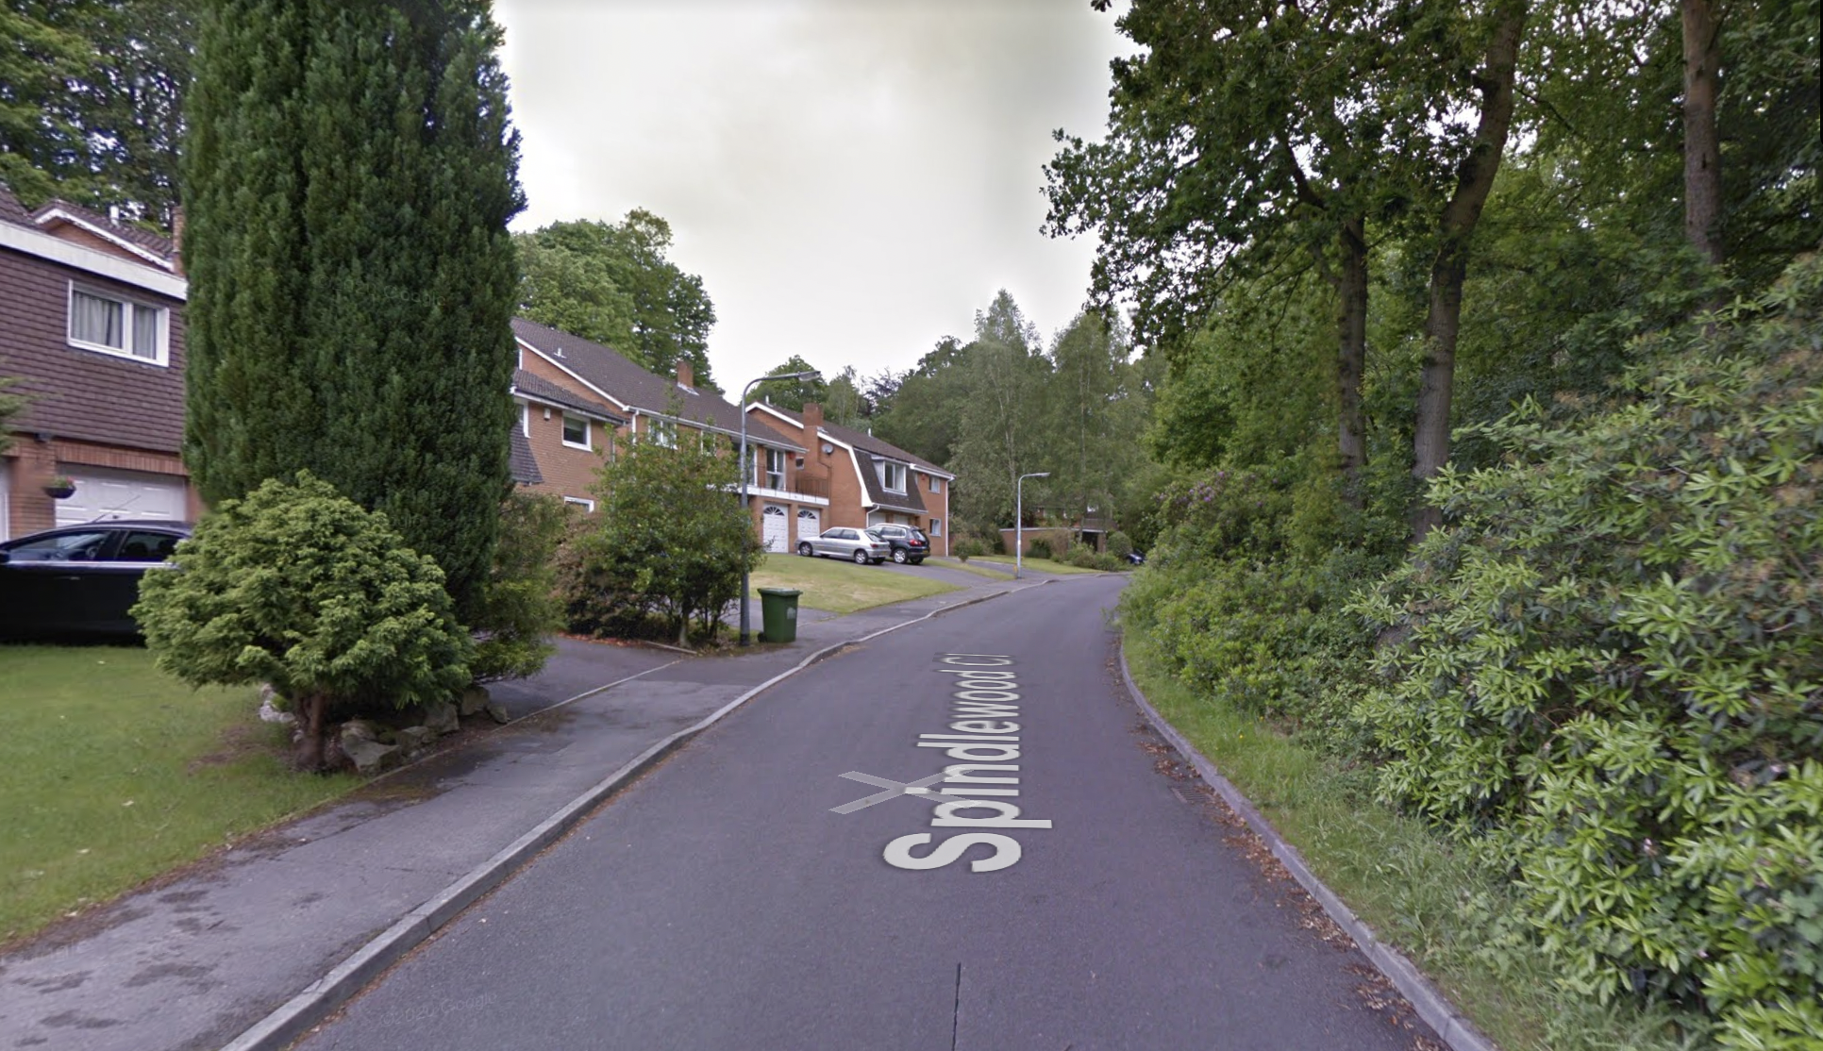
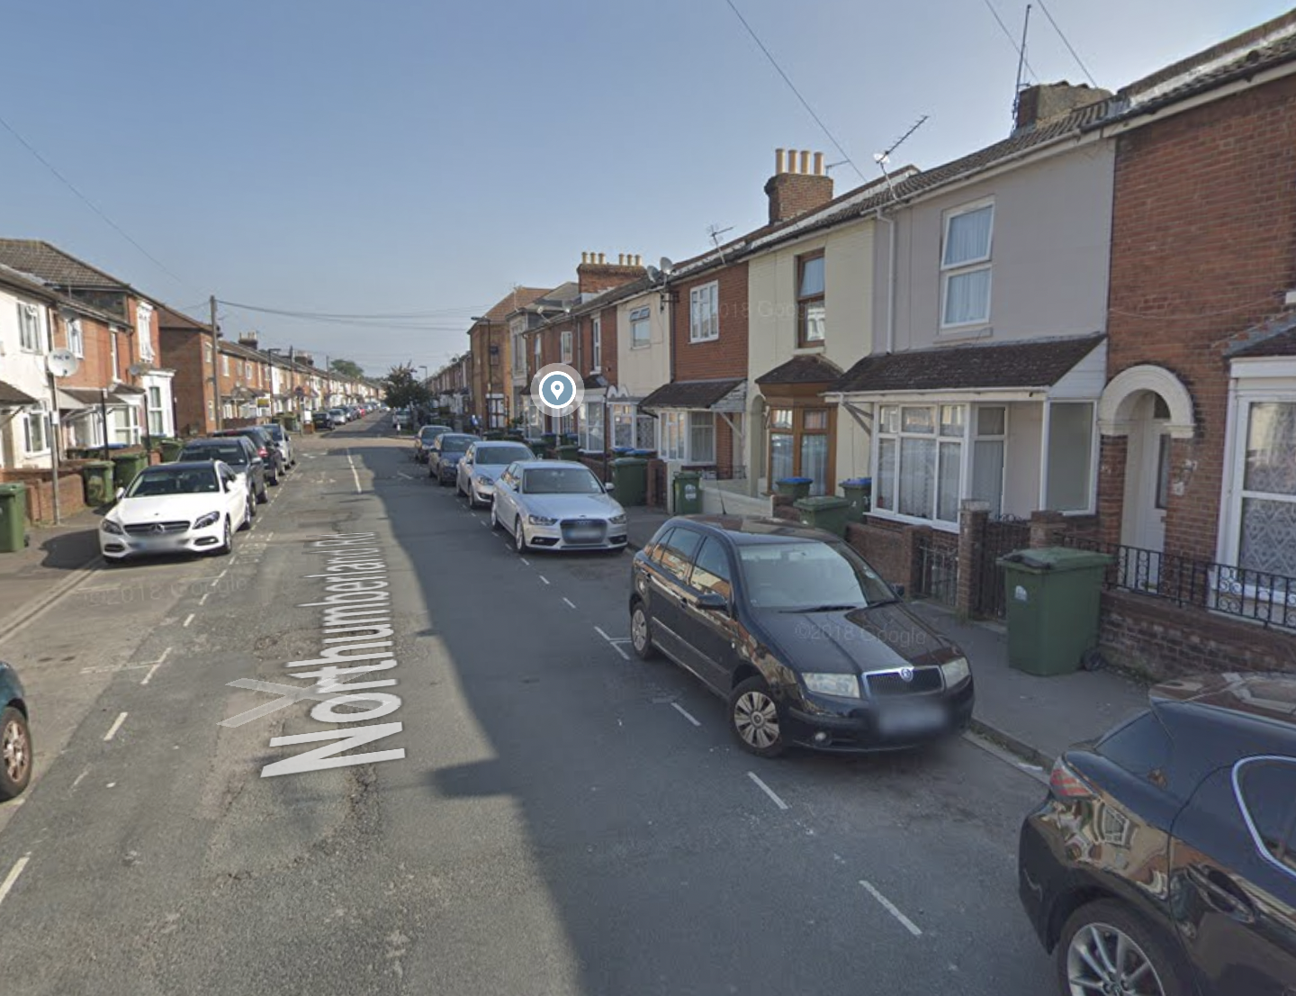

Slide 31
# Create the Dask cluster
cluster = GatewayCluster()
client = cluster.get_client()
cluster.adapt(minimum=4, maximum=24)
print(cluster.dashboard_link)

Slide 32
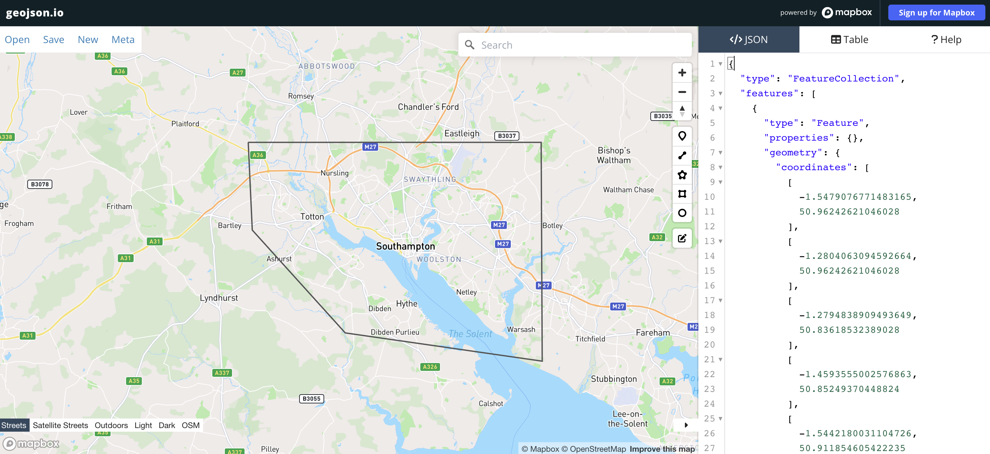
area_of_interest = <GEOJSON>
bbox = rasterio.features.bounds(area_of_interest)
rasterio
(python raster I/O)

Slide 33
stac = pystac_client.Client.open(
"https://planetarycomputer.microsoft.com/api/stac/v1",
modifier=planetary_computer.sign_inplace,
)
search = stac.search(
bbox=bbox,
datetime="2022-01-01/2023-01-01",
collections=["sentinel-2-l2a"],
query={"eo:cloud_cover": {"lt": 10}},
)
items = search.item_collection()
37 items
(individual satellite images from different times)
pystac
(python STAC interface)

Slide 34
Near Infra-red and Red bands
data = stackstac.stack(
items,
assets=["B08", "B04"],
chunksize=4096,
resolution=10,
)
xarray & stackstac (labelled multi-dim data & combining STAC items)

Slide 35
data = stackstac.stack(
items,
assets=["B08", "B04"],
chunksize=4096,
resolution=10,
bounds_latlon=bbox
)

Slide 36
median = data.median(dim="time").compute()
Small: 15s Large: 3 minutes
nir = median.sel(band='nir')
red = median.sel(band='red’)
ndvi = (nir - red)/(nir + red)
ndvi.rio.to_raster("S2_Median_2022_AOI.tif")

Slide 37
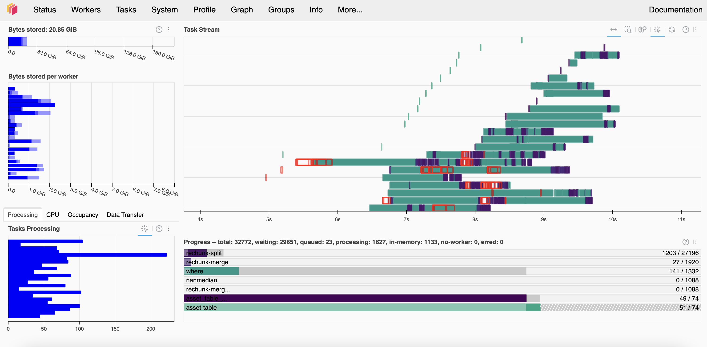

Slide 38
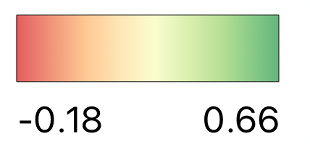

Slide 39
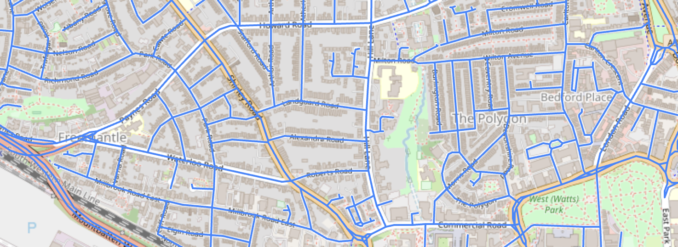
osmnx
(OSM network extraction)
roads = osmnx.graph_from_point(
(50.91404, -1.41640),
dist=10000,
network_type="drive")
osmnx.save_graph_geopackage(roads, "SotonRoads.gpkg")

Slide 40
roads.geometry = roads.geometry.buffer(10)
10m
10m

Slide 41
def rasterize_roads(roads_gdf, ndvi_filename, output_filename):
with rio.open(ndvi_filename) as f:
ndvi_metadata = f.meta
roads_reproj = roads_gdf.to_crs(ndvi_metadata["crs"])
meta = ndvi_metadata.copy()
meta["count"] = 1
del meta["nodata"]
with rio.open(output_filename, "w+", **meta) as out:
out_arr = out.read(1)
shapes = ((geom, 1) for geom in roads_reproj.geometry)
burned = features.rasterize(
shapes=shapes, fill=0, out=out_arr, transform=out.transform
)
print(f"Total burned pixels with value of 1: {burned.sum()}")
out.write_band(1, burned)

Slide 42
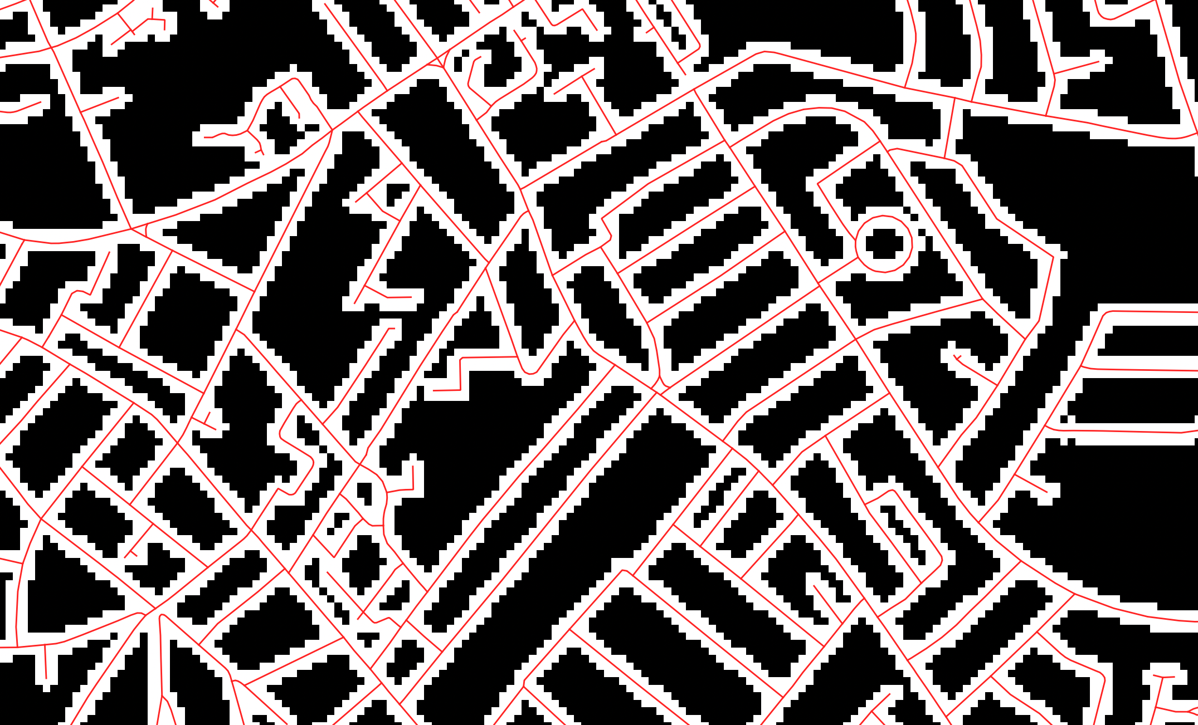

Slide 43
with rio.open("AOI_Roads.tif") as f:
roads_raster = f.read(1)
meta = f.meta
with rio.open("S2_Median_2022_AOI.tif") as f:
ndvi_raster = f.read(1)
masked = roads_raster * ndvi_raster
with rio.open("Masked_NDVI.tif", 'w', **meta) as f:
f.write(masked, 1)
rasterio
(python raster I/O)

Slide 44
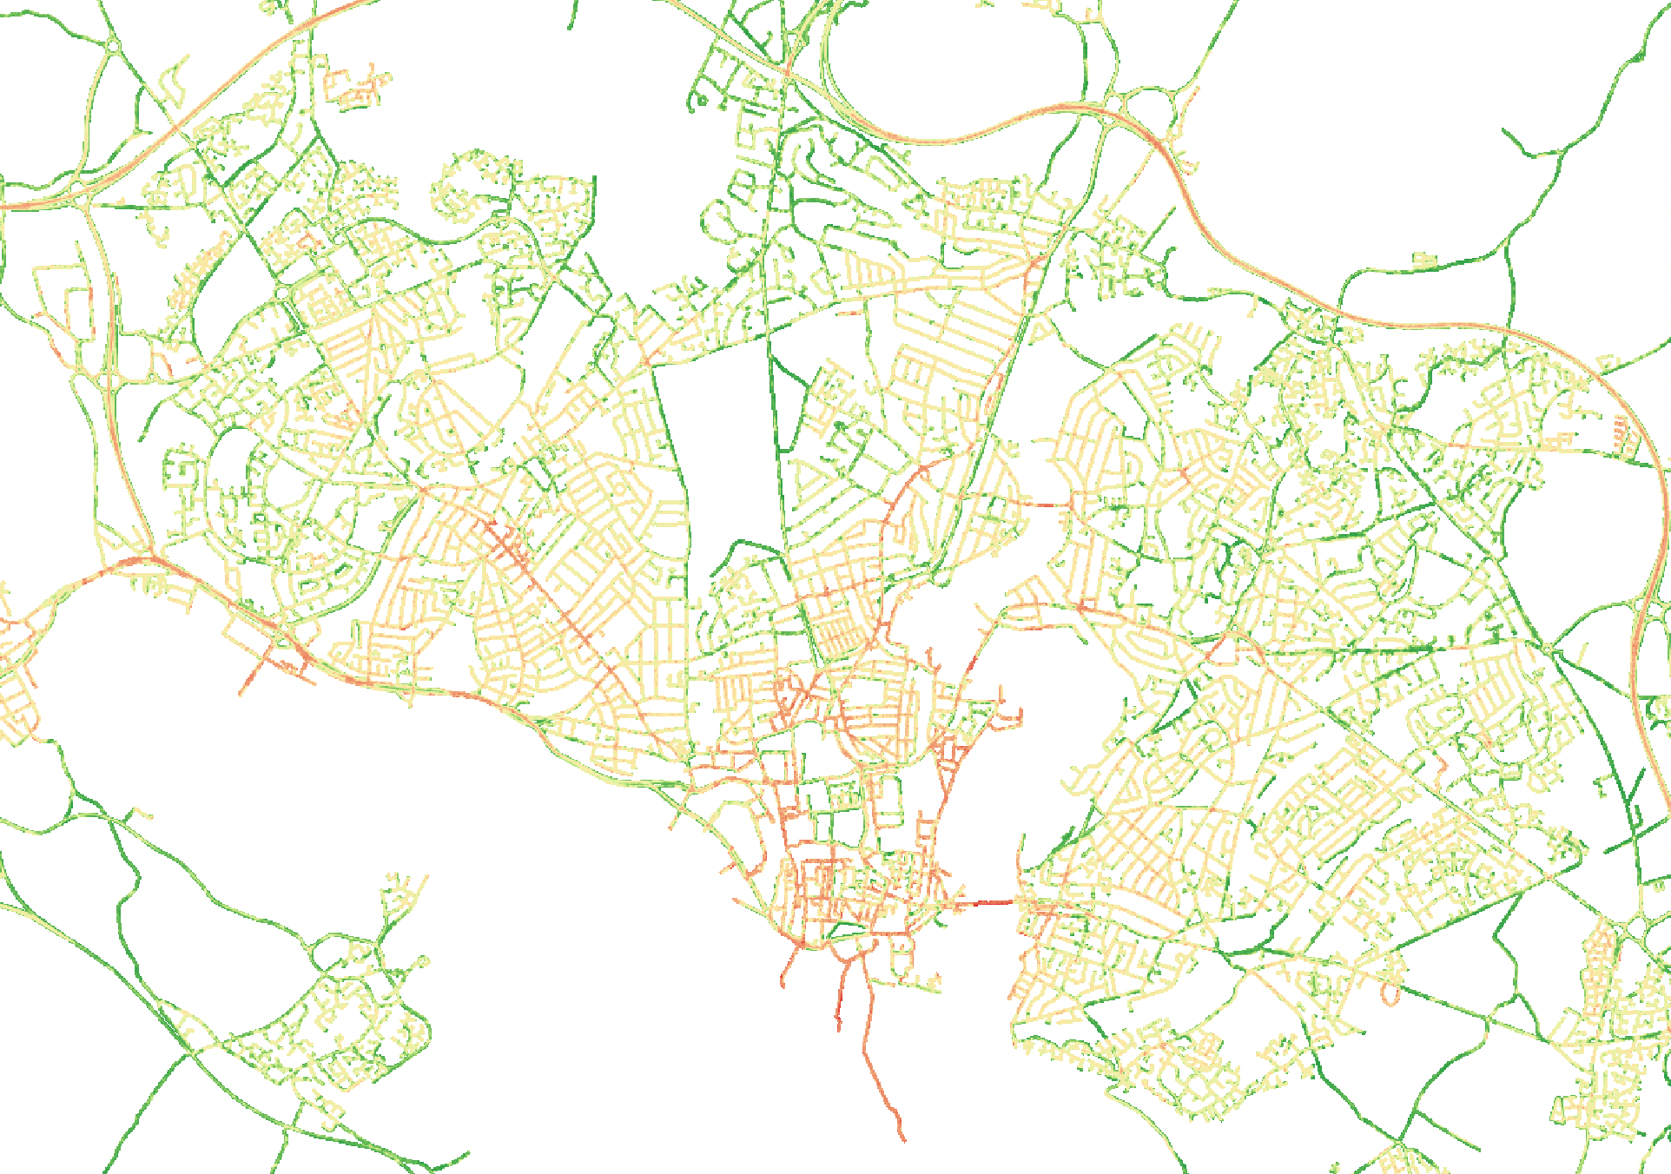

Slide 45
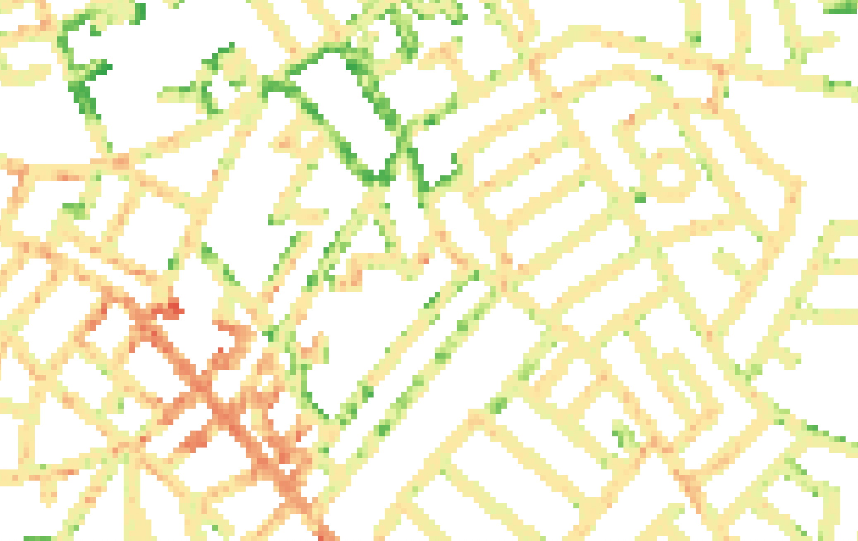

Slide 46
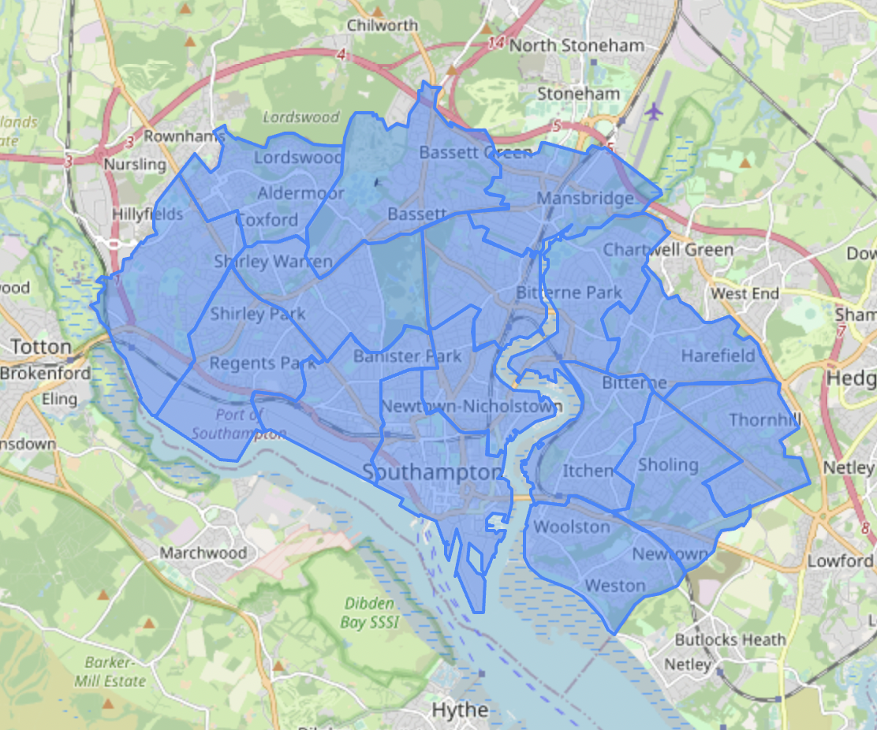
wards = gpd.read_file("SotonWards.shp")
wards = wards.to_crs(meta['crs'])
geopandas
(Pandas + Geo)

Slide 47
roadside_stats = zonal_stats(
vectors=wards.geometry,
raster='Masked_NDVI.tif’,
stats='mean’,
nodata=0,
prefix="roadside_"
)
wards = wards.join(pd.DataFrame(roadside_stats), how='left')
rasterstats
(python zonal statistics)

Slide 48
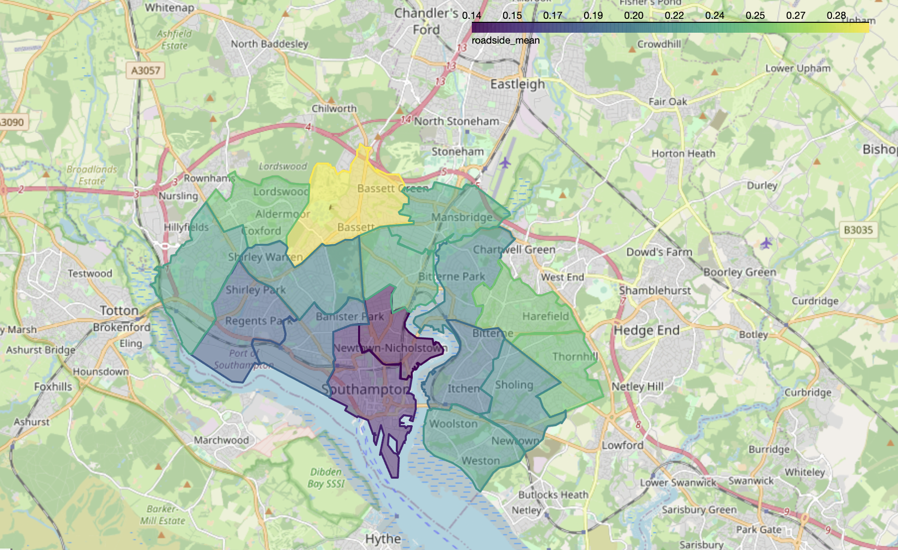
wards.explore(”roadside_mean")
folium
(python webmaps)

Slide 49
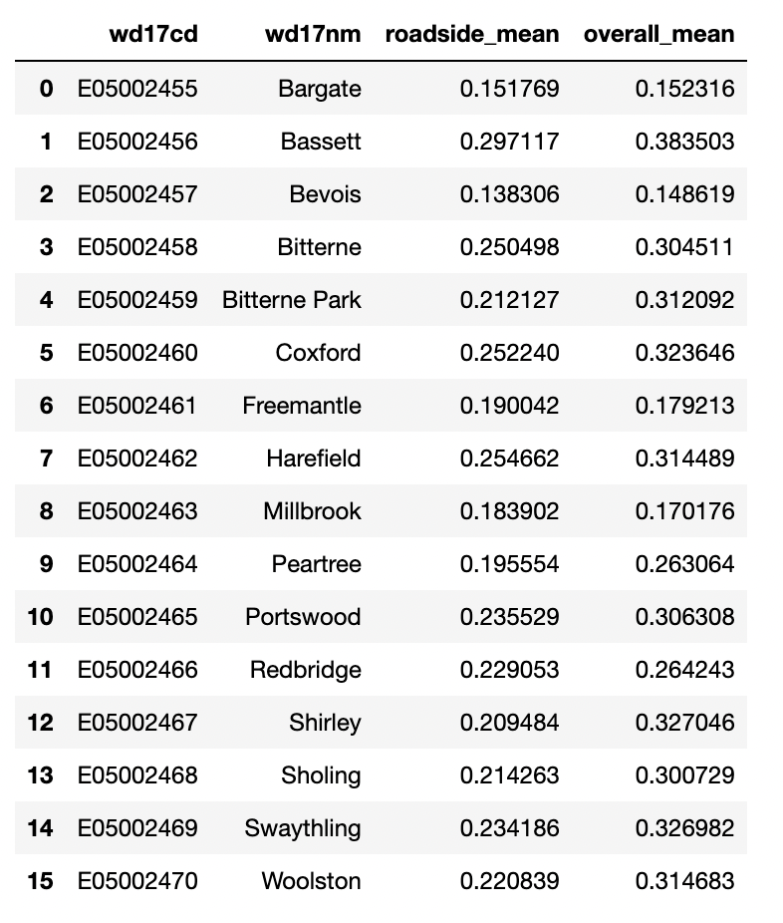
…?

Slide 50
Any questions?
I do freelance geospatial software
engineering and data science
www.rtwilson.com
robin@rtwilson.com

